Slide 1
TEP Kickoff Meeting October 15, 2019
Making EHR Data More Available for Research and Public Health (MedMorph)
Technical Expert Panel (TEP)
Co-Chairs:
Bill Lober
University of Washington
John Loonsk
Johns Hopkins University

Slide 2
MedMorph TEP Kick-off Agenda – 10/15/2019
TOPIC |  | LEAD(S) | TIME (ET)
1 | Roll Call, Welcome, and Introductions | Maria Michaels, TEP Co-Chairs: Bill Lober/ John Loonsk | 3:00 – 3:15
2 | Keynote Address | Chesley Richards | 3:15 – 3:30
3 | Project overview | Maria Michaels | 3:30 - 4:10
4 | TEP Objectives, Approach, and Logistics Mission Governance & documentation Membership composition Roles & expectations Meeting logistics Proposed Subgroups | Bill Lober/ John Loonsk | 4:10 - 4:25
5 | Summary/ Q&A, Action Items, Announcements Next Meeting | Bill Lober/ John Loonsk, MedMorph Project Team | 4:25 - 4:30

Slide 3
Keynote Address

Slide 4
Data, Decisions, Directions
MedMorph’s role in advancing better decision making
Chesley Richards, M.D., M.P.H. FACP
CDC Deputy Director for Public Health Science and Surveillance
Centers for Disease Control and Prevention
CDC is developing world-class data and analytics to transform today’s reality and meet new opportunities for lifesaving prevention and response.

Slide 5
As public health leaders, we must be prepared to handle the challenges of today and, at the same time, to make real the potential of the new innovation of tomorrow.
Robert R. Redfield, MD
Director, CDC, and Administrator, ATSDR
Notes:
CLICK to next slide

Slide 6
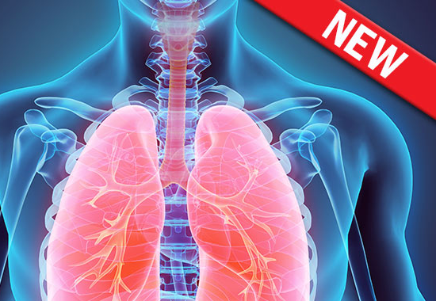
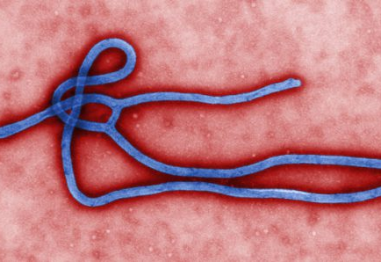
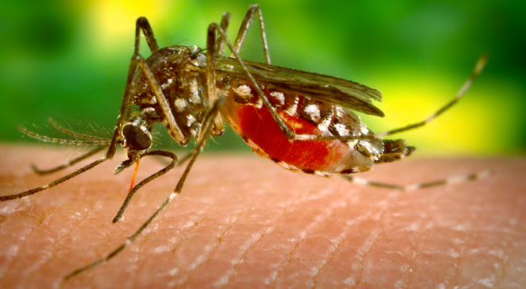
New Threats to Public Health Arise Every Day
Notes:
New threats to public health arise every day.
In public health, we often rely on care providers (typically in clinical settings), to be our eyes and ears. These care providers report certain conditions to us so we can help prevent diseases from spreading and becoming community-wide risks.
CLICK to next slide

Slide 7
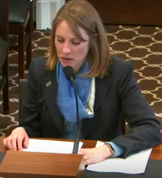
“The nation’s public health data systems are antiquated and in dire need of security upgrades - paper records, phone calls, spreadsheets and faxes requiring manual data entry are still are in widespread use and have significant consequences including delayed detection and response, lost time, missed opportunities and lost lives.”
“Data is moving slower than the disease…”
Testimony of Janet Hamilton, Director of Science and Policy at CSTE, speaks at Public Witness Day, April 9, 2019 Labor, Health and Human Services, Education, and Related Agencies (116th Congress)

Slide 8
And decisions are moving slower or without data or evidence

Slide 9
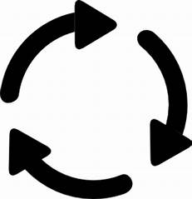
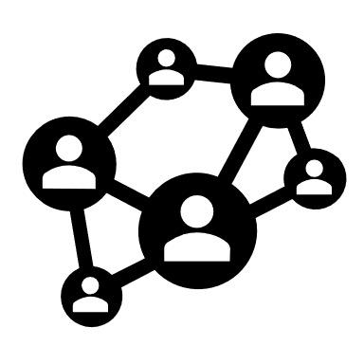
Foundational Questions
What is it?
Who has it?
When did they get it?
Where did they get it?
Where are they now?
What
causes it?
Where will it likely
spread next?
What can we do
to protect people?
What are the best options to prevent or protect?
Notes:
When threats are identified, we try to gather as much information as possible to better understand what has happened and what can be done in response.
Currently, public health officials spend most of their time fetching and wrangling the data to address basic questions, such as those listed on the left hand side of this slide.
Too often, due to fragmentation and latency in our reporting processes, the data we have are incomplete or outdated. This compromises our ability to answer the higher-level questions we all wrestle with, such as what caused the disease or injury, what communities are most at risk, what can be done, and what options are most cost effective.
This puts decision makers in a place where they have to make tough calls with only limited insights.
This is untenable.
Fortunately, it’s addressable.
CLICK to next slide

Slide 10
Public Health Data Modernization Initiative Vision
This initiative will develop and deploy world-class data and analytics to meet today’s and tomorrow’s health challenges.
Notes:
CDC is a unique agency with a unique mission: We work 24/7 to protect the safety, health, and security of America from threats here and around the world. To accomplish this mission, CDC must develop and deploy world-class data and analytics for more targeted, quicker outbreak responses. The data CDC generates and receives needs to be timely, accurate, and useable. 1. We must not be historical, or even real-time. We must be predictive. 2. We must change our agency culture and default behavior. 3. We must move CDC to a new world of public health data that will take us from limited potential to limitless possibilities.

Slide 11
Public Health Data Modernization Initiative Goals
Build and connect the digital public health data superhighway to facilitate a seamless, timely flow of relevant data
Implement the tools and skills to ensure effective, efficient, and timely knowledge creation from data analytics and visualization
Ensure that the knowledge created is applied to protect and improve health in real time
Notes:
CDC is a unique agency with a unique mission: We work 24/7 to protect the safety, health, and security of America from threats here and around the world. To accomplish this mission, CDC must develop and deploy world-class data and analytics for more targeted, quicker outbreak responses. The data CDC generates and receives needs to be timely, accurate, and useable. 1. We must not be historical, or even real-time. We must be predictive. 2. We must change our agency culture and default behavior. 3. We must move CDC to a new world of public health data that will take us from limited potential to limitless possibilities.

Slide 12
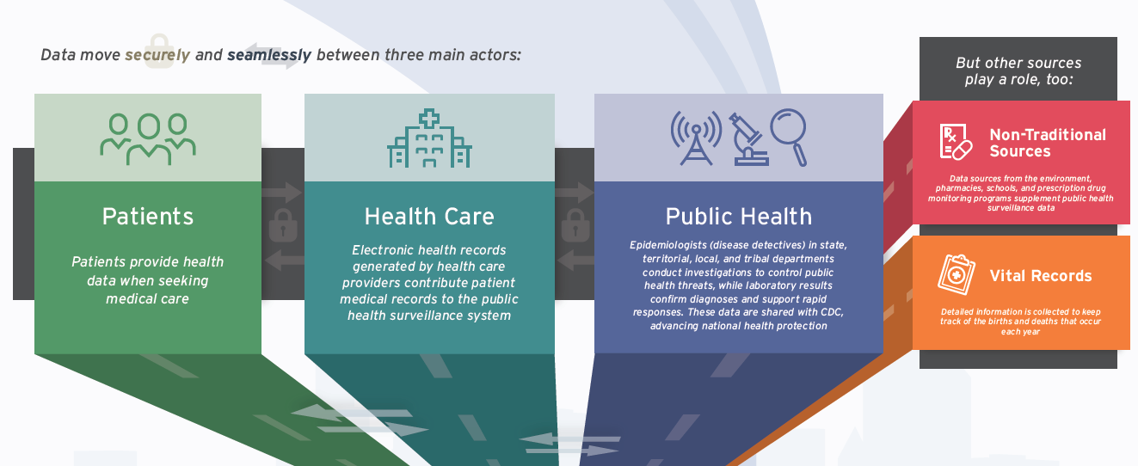
Public Health Information Superhighway
Hagan, Celia N., Holubowixh, Emily J., Criss, Tamara. “Driving Public Health in the Fast Lane.” The Urgent Need for a 21st Century Data Superhighway. Council of State and Territorial Epidemiologists. http://resources.cste.org/data-superhighway/mobile/index.html
5

Slide 13
HL7 FHIR-Based Interoperability
Exchange data electronically in standardized and generalizable ways to help reduce reporting burden
How can CDC’s partners capture data from EHRs and other sources, and report data to public health, without duplicate data entry and without disease-specific reporting mechanisms?
CDC efforts
Establish a FHIR Accelerator for Public Health within HL7 in collaboration with partners and stakeholders
Coordinate strategic direction involving FHIR among CDC centers and programs
Explore intersection and synergy with other programs such as electronic case reporting promoted by Digital Bridge
Notes:
CLICK to next slide

Slide 14
Digital Bridge

Slide 15
MedMorph GUIDING PRINCIPLES
Harmonize with national health IT policies
Align with data content standards (i.e., CCDS, U.S. Core Data for Interoperability [USCDI])
Align with interoperability standards (e.g., FHIR, API)
Build on a policy and data authorities’ architecture
Reuse instead of de novo development, wherever possible
Build data capacity in public health and research
Work towards a flexible solution and “as needed” workflows

Slide 16
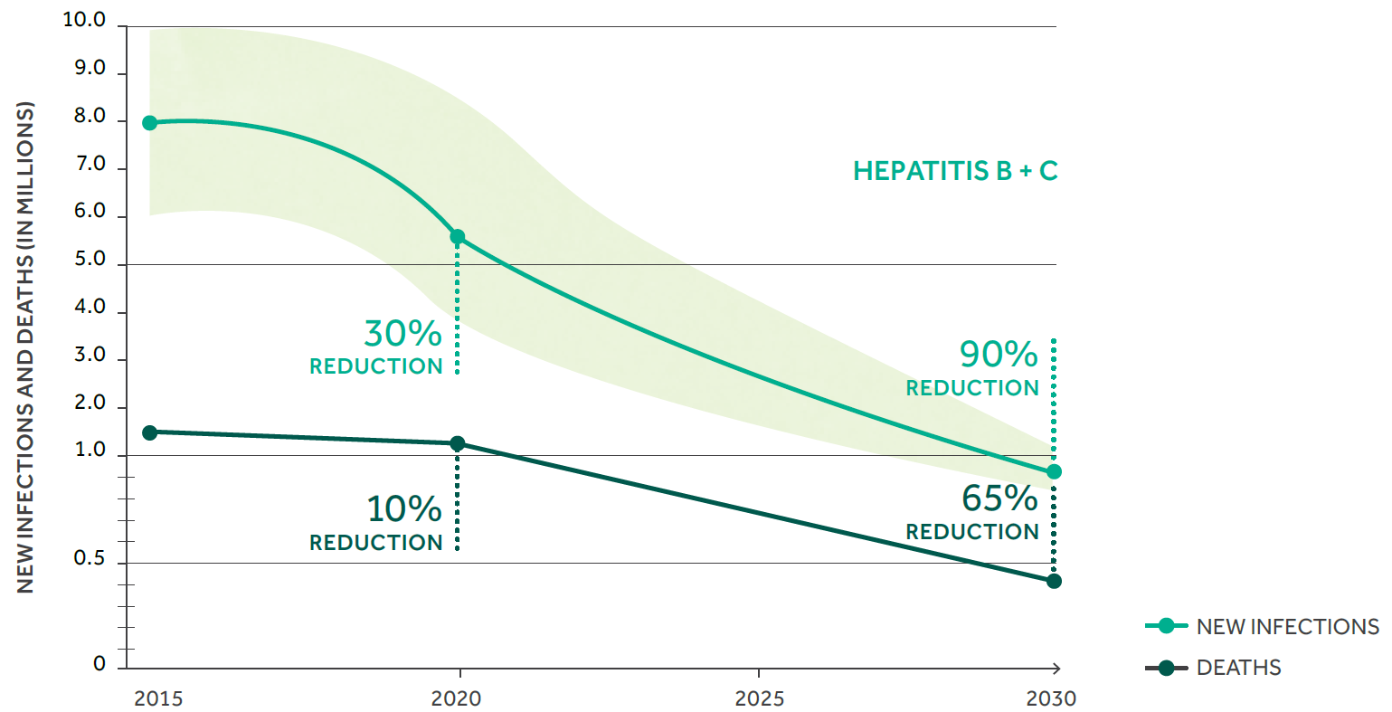
Global Viral Hepatitis Targets Include Incremental Reductions
Global Health Sector Strategy on Viral Hepatitis, 2016-2021: 2020 & 2030 Targets (WHO, 2016)
Notes:
Making EHR Data More Available for Research and Public Health – Hepatitis C Use Case
Key Take Home Points:
In a series of reports commissioned by CDC and developed by the National Academies of Science, Engineering, and Medicine (NASEM) between 2017 and 2018, the Academies concluded
that both hepatitis B and C could be eliminated as public health problems in the United States by 2030.
As shown here, elimination as a public health problem translates into a 90 percent reduction in incidence and a 65 percent reduction in mortality by 2030.

Slide 17
Current state of hepatitis C diagnosis, linkage to care, and treatment, United States, 2013
2.4 million living with hepatitis C¹
58.7% aware of infection²
21% linked to care³
<10% are treated³
¹Hofmeister MG et al.Hepatology.2019; ²NHANES 2013-2016 published estimate; ³Holmberg SD et al.N Engl J Med.2013
Notes:
Key Take Home Points:
At the same time, the National Academies also noted that achieving elimination in the United States will not be easy. It will require sustained investments in interventions that improve outcomes along the so-called cascade of care (represented here) and prevention.
Realizing those improvements, in turn, requires better data. So, the goal of this is to improve the availability and flow of information needed to assemble, track, and ultimately take public health action based on cascades of care and prevention at community, state, and federal levels.

Slide 18
Core Values and Commitments
Forget Perfect!
Show up and try things
Find inspiration from what already exists
What’s workable? What’s scalable? What’s sustainable?
Focus on Implementation
Setbacks are part of the process, we use them to propel us forward
Work in sprints, seek feedback, and improve
Foster transparency, collaboration, and trust
Share work in progress
You don’t have to figure it all out on your own

Slide 19
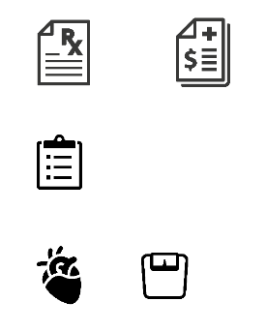
Laying the Conditions for Broad Interoperability
Notes:
This kind of broad interoperability is a key part of CDC’s data initiative. We must encourage and prioritize innovative ways to connect data using newer technologies we now have available, like biosurveillance in the cloud, application programming interfaces (APIs), Fast Healthcare Interoperability Resources (FHIR, pronounced “fire”), and SMART (Substitutable Medical Apps, Reusable Technology) on FHIR apps.
We are making progress, but we must keep going.
Our traditional systems were built for a simpler era: disease specific, isolated, and with limited inputs known a priori that came in at a slow and predictable cadence. These systems were designed to calculate counts/rates/ratios, typically at the national level, often only once or twice a year. Secondary and tertiary uses of the data were generally precluded by the use agreements under which the data were collected.
The technology was developed in isolation from those who depended on it. This approach gave us flashes of insights that were fit for purpose at the time, however, it now precludes our ability to use the best available data to guide decision-making and inform public health action in emergent situations.
We need change.. and we need partners looking at the data from many different areas of health and non-health to get ahead of the problems.
See this link for reference:
https://science.sciencemag.org/content/361/6408/eaau1184.full
CLICK to next slide

Slide 20
We cannot solve our problems with the same thinking we used when we created them.
Albert Einstein
Notes:
CLICK to next slide

Slide 21
Discussion

Slide 22
TEP Kickoff Meeting October 15, 2019
Making EHR Data More Available for Research and Public Health (MedMorph)
Maria Michaels, Lead, CSELS/OD
Wendy Blumenthal, Co-Lead/Cancer SME, NCCDPHP/DCPC
Arun Srinivasan, Technical Lead, NCCDPHP/OD
Brian Gugerty, Healthcare Surveys SME, NCHS/DHCS
Aaron Harris, Hepatitis SME, NCHHSTP/DVH
Abigail Viall, Hepatitis SME, NCHHSTP/OD
Laura Conn, eCR SME, CSELS/OD
Sameemuddin Syed, ORISE Fellow, CSELS/OD

Slide 23
The Data Lifecycle & Impacts to the Public’s Health
Guidelines
Recommendations
Guidance
Public Health Policies or
Mandates
Point of Care
Emergency Response
Public Health Departments
Community Services
Delivering actionable knowledge
ACTION
HEALTH
IMPACTS &
OUTCOMES
KNOWLEDGE
UPDATING
SCIENTIFIC
EVIDENCE
Fast Healthcare Interoperability Resources
(FHIR)
INFORMATION
DATA
EHRs
Registries
Public Health Info Systems
Community Info Systems
…many potential sources
Data Science Analytics
Data Linkages
Data Visualization
Analyzing data to advance evidence
Notes:
Structuring recommendations and using standards-based shareable CDS ultimately helps the data lifecycle. Computable guidelines (recommendations, guidance, etc.) help apply the evidence in practice more consistently since they are translated from the source of truth. Data resulting from the actions taken in practice would be more easily extracted to perform analyses that lead to information that can be incorporated into the knowledge that gets translated to practice… and the cycle begins anew.

Slide 24
Project Details

Slide 25
Project Overview
Funded by the Patient-Centered Outcomes Research Trust Fund (PCORTF) via the Department of Health and Human Services (HHS) Assistant Secretary for Planning and Evaluation (ASPE)
Total project timeline: 3 years
PROBLEM: Patient-centered outcomes researchers and public health professionals need better ways to get data from different electronic health record (EHR) systems without posing additional burden on health care providers
GOAL: Create a reliable, scalable, generalizable, configurable, interoperable method to get EHR data for multiple use cases
OBJECTIVE: Develop reference architecture and demonstrate a reference implementation (including implementation guides)

Slide 26
DRIVERS
Public health needs span surveillance, monitoring, quality measurement, research, population health management, and “secondary uses” of healthcare data
Collaboratively establishing a common framework helps increase the likelihood of success rather than trying multiple separate approaches
Closing the loop (e.g., through bidirectional data exchange) can deliver more public health value to healthcare
Leveraging existing efforts offers a foundation and lessons learned to build on
Notes:
Sufficient similarities across public health requirements to warrant coordination
Reduce burden to healthcare/providers
Harmonized public health requests to the FHIR community can be better served
Applying a common framework can address many public health initiatives, such as:
Electronic case reporting
Syndromic surveillance
Chronic disease surveillance
Registry reporting
Healthcare surveys
Etc.

Slide 27
Guiding Principles for Technical Approach
Leverage FHIR
Automate
Limit proliferation of IGs for public health
Promote configuration over proprietary implementation
Account for implementation variability
Notes:
Leverage FHIR
Automate (wherever possible)
Limit proliferation of IGs for public health
Promote configuration over proprietary implementation
Account for implementation variability (EHRs, HIEs, bulk FHIR)

Slide 28
Making EHR Data More Available for Research and Public Health
Technical Expert Panel:
End Users, Data Recipients, Stakeholders – Including representatives of additional use cases
Foundation of standards supported by health IT certification (CCDS/USCDI, APIs, FHIR)
Fully Modeled Use Cases
Hepatitis C, Cancer, Healthcare Surveys
Fully Modeled Use Cases
Hepatitis C, Cancer, Healthcare Surveys
Implementation Guides
For general use and for each use case
Technological Strategies
To develop scalable and extensible architecture
Technological Strategies
To develop scalable and extensible application
Agile Development: Iterative Design-Build-Test Cycles (test case: Hepatitis C)
CCDS: Core Clinical Data Set
USCDI: US Core Data for Interoperability
APIs: Application Programming Interfaces
FHIR: Fast Healthcare Interoperability Resources
PRODUCTS: Reference Architecture, Reference Implementation
(Open Source Software) & Balloted Implementation Guides, Roadmap for Scalability and Sustainability
National Test Collaborative
Including a variety of clinical organizations and their EHR platforms
Software
Clinical organization
EHR platform
Other testing partners (e.g., public health departments, registries, health IT developers, etc.)
Evaluation Planning
Measure and Evaluate

Slide 29
TEP Objectives, Approach, & Logistics

Slide 30
TEP Charter: Mission
Provide technical and subject matter expertise to
guide and inform the defining and refining of use cases, including evaluating the completed modeled use cases for broad usefulness, applicability, and implementability;
ensure the scalability and functionality of a reference architecture and reference implementation that will enable real-time data exchange between Electronic Healthcare Record (EHR) systems and public health/research systems;
for multiple conditions and uses.

Slide 31
TEP Charter: Governance & Documentation
Ground Rules:
Start/stop on time
Be engaged
Do not interrupt
Seek understanding
Try not to multi-task
Meeting Summaries:
Convener will draft and send to co-chairs for review and approval
Final version distributed to members
Recommendations:
All facts, ideas, and views are welcome for thoughtful discussion
Final Report:
Findings and recommendations from the TEP will help:
Define the use cases
Frame the initial set of data exchange requirements for a scalable and extensible reference architecture to facilitate data exchange

Slide 32
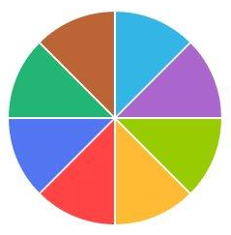
TEP Charter: Membership Composition
Use case subject matter experts
Public and population health experts
Clinical end users
Standards experts
Terminology experts
Research experts
Electronic health record developers
Clinical decision support developers
Clinical quality reporting experts
Professional Associations
Evaluators
Federal partners

Slide 33
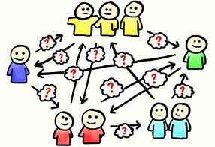
TEP Charter: Roles & Expectations - Convener
Convener (Core Project Team, Project Technical Team):
Facilitate TEP meetings;
Keep TEP informed of overall CDC project progress;
Provide documentation to support direction of products/implementation and alignment to TEP guidance;
Provide technical expertise;
Provide briefing materials and reports; including meeting minutes
Manage logistics for meetings

Slide 34
TEP Charter: Roles & Expectations – Co-Chairs
Co-Chairs:
Direct the overall meeting;
Manage the TEP decision-making process;
Determine final recommendations from the TEP;
In collaboration with the Convener, determine and approve key agenda items for each meeting
Approve any replacement of TEP members
Meet with CDC to coordinate activities of the TEP
Designate chairs of any subgroup which may be needed

Slide 35
TEP Charter: Roles & Expectations – Members
Members:
Actively participate and contribute to the work of the TEP as individuals;
Work collaboratively with other TEP members;
Attend all meetings possible and prepare appropriately;
Complete review of all materials, and if necessary, any assignments prior to each meeting
Inform the CDC team and Co-Chairs if unable to attend any meeting, providing comments and recommendations prior to the meeting

Slide 36
TEP Charter: Logistics
Frequency: Monthly (full TEP), may have ad hoc if necessary
Duration: 1 hour (full TEP)
Location: virtual / web conference
Meeting Agenda: 48 hours prior to each meeting
Meeting Summaries: 3 days following each meeting
TEP Materials: Posted to a TEP website (TBD for now)
TEP will be convened October 2019 to December 2021

Slide 37
Proposed TEP Subgroups
Business Process and Clinical Workflows
Includes: working across use cases, data access/authorities/policies
Reference Architecture
Data Standards
Evaluation
Are these the right subgroups to achieve this project?

Slide 38
KEY TAKEAWAY
Need to achieve interoperability, scalability, extensibility, generalizability, portability
Using a common approach
Across multiple use cases
Across multiple EHRs
To any endpoint
Without additional burden to healthcare providers

Slide 39
Reminder
If you haven’t already done so, please complete the Google form (sent by email as a link and included in kick-off meeting invite).
If you are not able to access the invite through this link, please email Sameemuddin Syed for an alternate format: puv5@cdc.gov

Slide 40
For questions or more information please contact:
Maria Michaels – maria.michaels@cdc.gov

Slide 41
Additional Slides

Slide 42
Guiding Principles for Technical Approach
Leverage HL7 FHIR ecosystem to reduce burden on healthcare to meet Public Health and Research data needs
Automate as much EHR interface development as possible
Maximize the utilization of data that should already exist in EHRs (using US Core Data for Interoperability, USCDI)
Limiting the proliferation of Implementation Guides (IGs) to essential
Minimize proprietary system/software implementation and advocate configurations approach
Be inclusive to work in the current landscape and business models of trusted third parties & intermediaries
Advance framework to work across a broad set of evolving operational models e.g., EHR FHIR interfaces, Bulk FHIR, Trust Frameworks etc.
Recognize what needs to be in a EHR FHIR vs what is currently available
Recognizing clinical and public health role on population health care continuum

Slide 43
DRAFT
Clinical Data Extraction using a
Common Public Health Reporting Pattern
Services
e.g. CQL Runtime Services, Validation, Messaging, De-ID, hashing, Anonymization, linking, NLP etc..
APPS
Vocab & terminology Services
Supplemental Data Collection Services
Triggers
Subscription (data), CDS Hook (event)
Rule
CQL
Specification
e.g., Implementation
Guide
Bulk
FHIR
=
+
+
Plan
Definition
IG
CQL
Policy & Trust Authorities
e.g., TEFCA, state statutes/regulations
APPS

Slide 44
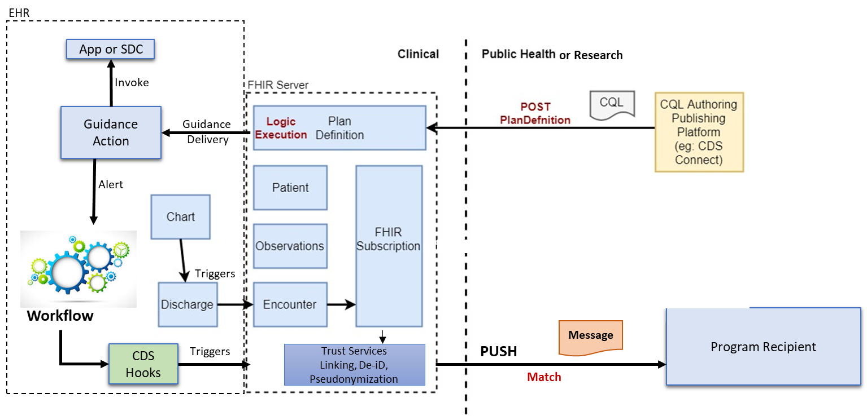
ConOPS with FHIR Messaging Model – Ideal State
DRAFT
Initiate Clinical Action based on Public Health Data

Slide 45
Draft Common Reporting Framework Elements*
Functional Elements | Sub-Elements | Leading Approach | Status | Alternatives | Moving Forward
Triggering |  | FHIR Subscription Simple value set match | FHIR Subscription being re-engineered Efforts to include PH needs | CDS Hooks Manual initiation in EHR apps | Ensure that new FHIR Subscription includes PH needs
 | Reporting rules / queries | CQL against EHR FHIR and Bulk FHIR repositories | Increasing acceptance of CQL engine with EHR (not “in API”) | Proprietary apps | Advocate for EHR CQL engine and API inclusion
Report Creation | Local interrogation and population | CQL rules? Backend apps and XSLT? Local FHIR queries | Report creation is EHR driven – not yet part of “core” FHIR API CQL engine to create reports? | Backend apps EHR development | Advocate for common approach to report construction
 | Trust services | Pseudonymization Deidentification Hashing for deduplication | Developing as distributable supporting services / “backend apps” to demonstrate | EHR or data warehouse development | Advocate for adding trust services to core FHIR scope
 | Report validation | FHIR validation engine FHIR implementation guides | Included in FHIR servers to validate queries | Separate validation tools | Advocate for “push” validation
Sending |  | RESTful submit FHIR Messaging | Leading approach to FHIR exchange through intermediaries PH Connectathon work on FHIR messaging, DaVinci alerting? | Alert and remote query | Advocate for FHIR Messaging Mature FHIR Message resource
Reporting Specification Distribution (setup) |  | FHIR implementation guides (data specification) PlanDefinition (“when, where, how”) - Trigger codes - CQL rules | In eCR IG as Electronic Reporting and Surveillance Distribution (eRSD) specification Also have eRSD distribution service | Spreadsheets, etc. | Advancement of PlanDefinition support in FHIR servers (needed for guidelines too)
* A Common Framework for EHR Reporting, Surveillance, Population Health, etc. in FHIR, Loonsk, J; Srinivasan A; Conn L; HL7 WGM Sep 2019

Slide 46
TEP Charter: Responsibilities – Detailed
Identify and build on previous efforts (e.g., electronic case reporting )
Identify data elements (subsets of USCDI) needed to target the use cases
Identify workflow and triggers
Identify key patient-centered outcomes research questions and endpoint system requirements
Identify roles and security requirements for handling patient-centered identified data
Discuss pros & cons for various technical approaches
Determine requirements across use cases that can be met with a reference architecture that can be flexible enough to address the needs of multiple use cases

