Slide 1
March 16, 2021
Making EHR Data More Available for Research and Public Health (MedMorph)
Technical Expert Panel (TEP)
Co-Chairs:
Bill Lober
University of Washington
John Loonsk
Johns Hopkins University

Slide 2
MedMorph TEP Meeting Agenda – 03/16/2021
TOPIC |  | LEAD(S) | TIME (ET)
1 | Logistics & Welcome | Maria Michaels TEP Co-Chairs: Bill Lober, John Loonsk | 3:00-3:05
 | IHE and MedMorph | Amit Trivedi – HIMSS Adam Bazer – HIMSS Katiya Shell – EMI Advisors | 3:05-3:30
2 | IHE Connectathon Update | Dragon Bashyam | 3:30-3:35
3 | MedMorph RA Ballot Reconciliation Update | Becky Angeles | 3:35-3:40
4 | Upcoming HL7 Activities Connectathon Workgroup Meeting Content IGs | Becky Angeles | 3:40-3:50
5 | USCDI Updates as Related to MedMorph | Becky Angeles | 3:50-3:55
6 | Wrap Up Next Meeting April 20th, 2021 | Maria Michaels TEP Co-Chairs: Bill Lober, John Loonsk | 3:55-4:00

Slide 3
IHE and MedMorph
Amit Trivedi, MS
Director, Informatics and HIT Standards, HIMSS
Primary Investigator
Adam Bazer, MPD
Senior Technical Manager, Informatics and HIT Standards
Program Manager
Katiya Shell, MPH
Health Business Consultant, EMI
Project Manager

Slide 4
Integrating the Healthcare Enterprise
Accelerating Data Exchange At Home & Around the Globe
Overview Brief for the Making EHR Data More Available For Research and Public Health (MedMorph) Techincal Expert Panel Monthly Series
3/16/2021

Slide 5
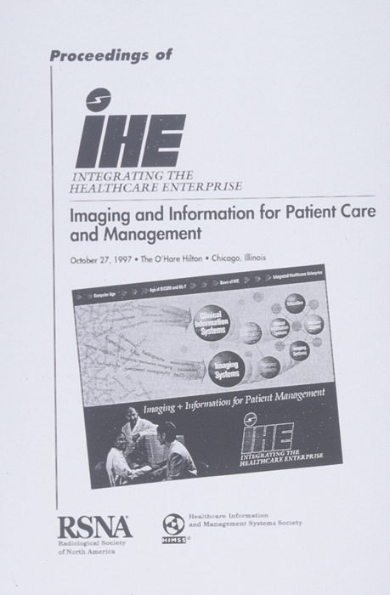
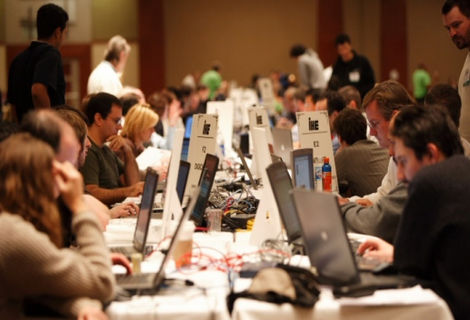
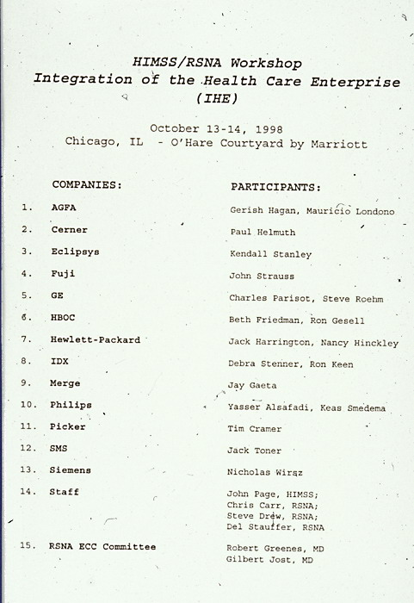
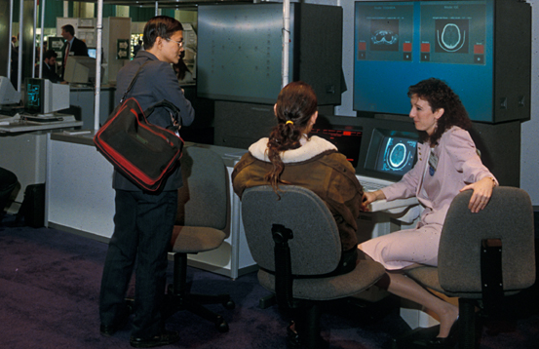
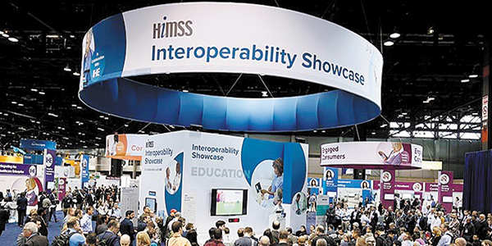
What is Integrating the Healthcare Enterprise (IHE)
Over twenty years of Collaboration, Community and Continuous Improvement
Launched by HIMSS and RSNA in 1998 to increase standards adoption and help decrease the costs for providers of implementations and integration of multiple vendor systems.

Slide 6
IHE International IHE USA
Designs & Develops IHE Integration Profiles & Technical Framework
Integrates Globally-developed Testing Tools into Interoperability Testing Platform
Establishes & Maintains Relationships with Global Standards Development Organizations
Customizes Integration Profiles to meet US-specific interoperability deployment needs
Guides US healthcare stakeholders how to leverage testing tools to meet their unique needs
Accelerates standards adoption to meet US policy goals
Founded in 1998 Founded in 2010

Slide 7
IHE’s Glide Path to Interoperability Deployment
Development
IHE International
Deployment
IHE USA
CALL FOR PROPOSALS
Months 1-3
DRAFTING & PUBLICATION
Months 4-14
TESTING & CONFORMANCE
Months 15-18
DEMONSTRATION
Ongoing
Call for Proposals
Integration Profile Selection by Domain Committees
Technical Framework Development
Published for Public Comment
Trial Implementation Posted
Connectathon Testing Event
Connectathon Product Registry published
Demonstrate at HIMSS Global Conference Interoperability Showcase
Deploy globally, Implement locally
through deployment committee activities

Slide 8
Moving From Patient to Person-Centered Healthcare
Fee-for-Service, Patient-Centered Model
Value-based, Person-Centered Model
Patient
Person
How IHE USA Drives the Value Transformation
IHE USA deploys a suite of FHIR-based Integration Profiles to help move the US healthcare industry from a fee-for-service to value-based care model, supporting the infrastructure needs outlined by ONC’s FHIR at Scale Taskforce to enable these use cases.

Slide 9
How IHE Profiles Drives FHIR-Based Data Exchange
Supporting adoption through action
Discover how IHE integration profiles support leveraging legacy systems and emerging API-based technologies to support improved interoperability and US-based compliance with the 21st Century’s Cure Act.

Slide 10
Data Exchange Profiles
Cross-Enterprise Document Sharing (XDS)
IHE Integration Profile
IT Infrastructure Domain
Standards Profile Based On:
Utilizes:
ebRegistry
Simple Object Access Protocol (SOAP)
Security Assertion Markup Language (SAML)
Other IHE Integration Profiles referenced:
Patient Identity Management
Patient Identifier Cross Referencing (PIX)
Patient Demographics Query (PDQ)
Based on HL7 v2 or v3
Additional Information:
Supports Centralized or Distributed Repository
User / Organization Federation
Certificate Authority trust domain
SAML assertions

Slide 11
FHIR-Enabled Data Exchange Profiles
Mobile Access to Health Documents (MHD)
IHE Integration Profile
IT Infrastructure Domain
Standards Profile Based On:
Utilizes:
100% FHIR Infrastructure
Additional Information:
Provides FHIR-based methods of publishing and accessing Document Sharing
Enables publication of Documents by Apps
Enables Discovery of available documents by Apps
Enables Retrieval of the Document content
Option for XDS on FHIR
Option for minimal metadata
Option for push vs pull
Superset alignment with US Core – DocumentReference

Slide 12
Federalization Discovery & Retrieve Sharing Models: Data Flow
Cross-Enterprise Document Sharing
(XDS)
Cross-Community Access (XCA) & Cross-Community
Patient Discovery (XCPD)
Federated Communities
Document Source
Cross-Enterprise Document Sharing
(XDS)
XDS
Community B
Document Consumer
Mobile access to Health Documents (MHD) API:
Publish
Discover/Query/
Retrieve
Mobile Access to Health Documents
(MHD)
Mobile access to Health Documents (MHD) API:
Query/Retrieve
Cross-Enterprise
Document Sharing (XDS)
Community A
XDS
Community C
Document Source
Mobile Access to Health Documents
(MHD)
XDS
Community D
Document Consumer

Slide 13
FHIR-Enabled Data Exchange Profiles
Mobile Health Document Sharing (MHDS)
IHE Integration Profile
IT Infrastructure Domain
Standards Profile Based On:
Utilizes:
100% FHIR Infrastructure
Other IHE Integration Profiles referenced:
Document Registry
Mobile Access to Health Documents (MHD) transactions
Persistence and lifecycle management
Additional IHE Profiles referenced:
Patient Identity Management
Authorization - OAuth
Consent Management
Trust Framework – Certificate Authority
Vocabulary Management
Audit Record Repository
Provider Directory

Slide 14
FHIR-Enabled Data Exchange Profiles
Mobile Health Document Sharing (MHDS)
IHE Integration Profile
IT Infrastructure Domain
Standards Profile Based On:
FHIR-Based Support Profiles:
Patient Demographics Query for Mobile (PDQm)
For Patient Look-up
Proxy to PDQ, PIX, XCPD
Patient Identity Cross-Reference for Mobile (PIXm)
For Patient Look-up
Proxy to PDQ, PIX, XCPD
Internet User Authorization (IUA)
An Oauth profile complimentary to SMART-on-FHIR
Proxy to XUA (SAML)
Audit Trail and Node Authentication (ATNA)
secure http specification, and FHIR AuditEvent specification
Similar functionality in both worlds
Audit Logging by either FHIR AuditEvent or DICOM/SYSLOG AuditMessage
Mobile Care Services Directory (mCSD)
Directory of Provider, Organization, and Health Services
Proxy to HPD, CSD, PWP, or a uddi based management

Slide 15
What Integration Profile(s) Should You Use?
How to Choose the Right Set of IHE Profiles to Achieve Your Desired Effects
Already have XDS?
Already have XCA?
Need Async backbone?
Need End-to-End Security?
XDS Document Source/Consumer?
Yes
Yes
Yes
Yes
Yes
No
Current
Infrastructure
Yes
Single Community?
No
XDS + MHD
XCA + MHD
MHDS

Slide 16
Principles of a Document
Persistence
Continues to exist in an unaltered state, for a time period defined by local and regulatory requirements
Stewardship
Maintained over its lifetime by a custodian, either an organization or a person entrusted with its care
Potential for Authentication
An assemblage of clinical information that is intended to be legally authenticated
Context
Establishes the default context for its clinical contents
Wholeness
Parts of the document may be created or edited separately, or may also be authenticated or legally authenticated, but the entire document is still treated as a whole unit
Human readability
Human readable for easier comprehension

Slide 17
Document Metadata Enables Discovery
author
availabilityStatus
classCode
Comments
creationTime
entryUUID
eventCodeList
FormatCode
healtcareFacilityTypeCode
languageCode
mimeType
patientID
practiceSettingCode
serviceStartTime
serviceStopTime
Title
typeCode
entryUUID
FormatCode
homeCommunityId
mimeType
PushMetadata
repositoryUniqueID
size
uniqueID
URI
author
classCode
confidentialityCode
creationTime
enntryUUID
hash
legalAuthenticator
patientID
practicdeSettingCode
serviceStartTime
serviceStopTime
size
Descriptive
Privacy & Security
Exchange
availableStatus
creationTime
legalAuthenticator
patientID
sourcePatientID
sourcePatientInfo
author
creationTime
healthcareFacilityTypeCode
legalAuthenticator
practicdeSettingCode
sourcePatientID
sourcePatientIInfo
Lifecycle
Patient Identity
Provenance

Slide 18
Multiple Documents Formats of the Same Document Related By Document Associations
Document Consumer
Electronic Medical Record
(EMR)
Consolidated Clinical Document Architecture
(C-CDA 2.1)
Provider
Patient
Application
HITSP Interoperability
Specification C32
Portable Document Format
(PDF)
Fast Healthcare Interoperability Resource
(FHIR)
Continuity of Care Document
(CCD)

Slide 19
FHIR Conformance Resources
A Publication Request Using Mobile Access to Health Documents (MHD)
Capability Statement(s)
Structured Definitions(s)
Available @
IHE.Github.com
CodeSystem
ValueSet
Examples

Slide 20
Consuming Documents Is Hard
MHD Profile
Eliminates the need to understand SOAP and eBXML while enabling API use of JSON or simple XML
But Document Content and Format isn’t Changed
They are various formats (PDF, DICOM, CDA, CCR)
CDA XML is not simple XMP
Better
Consume fine-grain FHIR Resources
Observation, Allergy Intolerance, Immunization, Medication, etc.
Yet
Use of data will eventually need to know the integrity and authenticity of the data
Clinicians decisions based on fine-grain FHIR Resources will need to reference the source and thus clinical context of data – cross-enterprise adds emphasis of need for Provenance

Slide 21
FHIR-Enabled Data Exchange Profiles
Query for Existing Data for Mobile (QEDm)
IHE Integration Profile
IT Infrastructure Domain
Standards Profile Based On:
Underlying HL7 Standards Used:
Observation,
AllergyIntolerance,
Condition,
DiagnosticReport,
Medication,
MedicationStatement,
MedicationRequest,
Immunization,
Procedure,
Encounter,
Provenance,
OperationOutcome,
Bundle

Slide 22
Finding & Extracting Data with FHIR-Enabled Profiles
mXDE
Query for Existing Data for Mobile (QEDm)
Supports queries for clinical data elements by making the information widely available to other systems within and across enterprises
Defines a transaction used to query a list of specific data elements, persisted as FHIR resources.
Mobile Cross-Enterprise Document Data Element Extraction (mXDE)
Provides the means to access data elements extracted from shared structured documents
Enables the deployment of health data exchange infrastructures where fine-grained access to health data coexists and complements the sharing of coarse-grained documents and fine-grained data elements
Notes:
Mobile Cross-Enterprise Document Data Element Extraction (mXDE)
Underlying HL7 Standards Used:
Observation,
AllergyIntolerance,
Condition,
DiagnosticReport,
Medication,
MedicationStatement,
MedicationRequest,
Immunization,
Procedure,
Encounter,
Provenance,
OperationOutcome,
Bundle
Query for Existing Data for Mobile (QEDm)
Underlying HL7 Standards Used:
Observation,
AllergyIntolerance,
Condition,
DiagnosticReport,
Medication,
MedicationStatement,
MedicationRequest,
Immunization,
Procedure,
Encounter,
Provenance,
OperationOutcome,
Bundle

Slide 23
Turning Documents Into Resources
FHIR Resources
EHR
Shared Documents
XDS/XCA/MHDS
Observation
Obs 1
Obs 2
Ops 3
Med Summary
Medication
Med 1
Med 2
Med 3
LAB/RAD
Health App
Episode
2/7/1989
Allergy
Al 1
Al 2
Al 3
Discharge Summary
1/2/2002
EMR
Immunization
Imm 1
Imm 2
Imm 3
Other Documents
Provenance
Prov 1
Prov 2
Prov 3

Slide 24
Using Provenance
Determine how often the issue is referenced
One document vs. all of them
Determine who has published the issue
Pull the metadata
DocumentReference
Pull the Document
Model for Provenance
One Provenance for each Document
Where a data Resource came from many documents, it will have many Provenance.target pointing at it
Provenance.target → 1..* Resources (the resources that came from this document)
Provenance.recorded → when the decomposition happened (might inform cache)
Provenance.policy == “urn:ihe:pcc:qedm:2017:document-provenance-policy”
Provenance.agent → the software “assembler” that decomposed this document into these Resources
Provenance.entity → the DocumentReference representing this document

Slide 25
Enabling Technology for FHIR Accessibility of Document Sharing
Document Metadata Query
Publication of Documents
Decomposed Documents into
Resources
Provenance enables getting to
the source Document

Slide 26
Dive Deeper into Integrating the Healthcare Enterprise (IHE)
Further Areas for Future Discussions
IHE Use Case-Focused Collaborations/Projectathons
Assessment Curation and Data Collection
International Patient Summary
The SANER Project
Care Coordination Guidelines
Care Plans
IHE Content Profiles
Describe the content of a payload found in an IHE transaction
Transaction neutral and without dependencies upon the transaction that they appear in
Stakeholder Engagement
Emergency Medical Services

Slide 27
How Can IHE Strengthen & Support the MedMorph Project- Potential Next Steps
Help the MedMorph project think through transactions points and critical outcomes for each use case
Assist with the development of test procedures and identification of testing tools
Visibility at the HIMSS 21 interoperability show case
Support formal testing of the MedMorph project artifacts

Slide 28
Questions?
Thanks!

Slide 29
Appendix

Slide 30
ONC/IHE USA Cooperative Agreement Team
Joyce Sensmeier, RN-BC, MS, CPHIMS, FHIMSS, FAAN
Senior Advisor, Informatics, HIMSS
Executive Sponsor
Amit Trivedi, MS
Director, Informatics and HIT Standards, HIMSS
Primary Investigator
Adam Bazer, MPD
Senior Technical Manager, Informatics and HIT Standards
Program Manager
Katiya Shell, MPH
Health Business Consultant, EMI
Project Manager
Abigail Barth
Health IT Analyst, EMI
Analyst
Evelyn Gallego, MBA, MPH, CPHIMS
Founder & CEO, EMI Advisors
Program SME
John Moehrke
Health Informatics Standards Architect, By Light Professional IT Service
Technical SME
Andrea Fourquet
Health Informatics Consultant eHealth sign
Technical SME
Michael Kirwan
Product Director-Telehealth, RPM, Blue Connect Global
Technical SME

Slide 31
Profiles In Action
A Sample of Healthcare Stakeholders Who Integrate IHE Profiles into their Systems
Academic
Kyungpook National University
UC Davis Health Institute for Population Health
Yonsei University Mirae Campus
Data Analytics, Exchange & Management
Bridgehead Software
CARADIGM
CareEvolution
Change Healthcare
Cloud Solution International
Dapasoft Inc
Dedalus USA
Enovacom
Forcare BV
Genesis Systems, Inc.
HealthCelerate
Hyland
Iatric Systems
Indra Soluciones TI
Infor (US), Inc.
InterOperability Bidco, Inc.
IRM Inc.
ITH icoserve / Siemens
Karos Health
Lumeris (EGHC)
NextGate
Optum
Qvera
RAIN Live Oak Technology
Rhapsody
Seqster
Simplex Bilgi Teknolojileri A.S.
Talis Clinical, LLC
Virence Health
Electronic Health Records
Allscripts
Cerner Corporation
ezCaretech
eClinicalWorks
Epic
MEDHOST
NextGen Healthcare
ICT, Infrastructure & IS Services
Ascom (US) Inc.
InterSystems Corporation
JBS International, Inc.
Kno2
Logibec
März DES GmbH
MedAllies
PatientSafe Solutions
Ricoh USA
Spok
Summit Healthcare Services, Inc.
TALON
Tiani "Spirit" Gmbh - Cisco Systems Inc.
VitalChek
Voalte
Vocera Communications
Imaging
Candelis, Inc.
Canon Healthcare Solutions
IBM Watson Health Imaging
Lexmark Healthcare
lifeIMAGE
Hinacom Software and Technology, LTD
INFINITT Healthcare Co.,Ltd.
Medical Systems Co. Ltd
Moksha Digital Software Pvt. Ltd
Paxerahealth
Philips Medical Systems
Sectra
Shanghai United Imaging Healthcare Co, Ltd
Siemens Healthcare GmbH
Vital, a Canon Medical Group Company
Hardware
Bernoulli Enterprise, Inc.
Dell
Mindray
STANLEY Healthcare
Life Sciences
Abbott
Baxter Healthcare
Bayer Healthcare
B.Braun Medical
Fukuda Denshi
Getinge
NantHealth
PRA Health Sciences
Sunquest Information Systems
Surescripts
Varian
Medical Devices
Medtronic
BD
Capsule Technologies
COVIDIEN
Draeger Medical Systems, Inc
EndoSoft, LLC
GE Healthcare
Guard RFID Solutions
Hill-Rom Company, Inc.
ICU Medical
Ivenix
Masimo
Omnicell
Smiths Medical
WelchAllyn
ZOLL
Public Health
Centers for Disease Control and Prevention
Delaware Department of Health and Social Services
New Hampshire Dept of State
New Hampshire Dept. of Health and Human Services
NIST
Cancer Reporting and Epidemiologic Surveillance Program
Utah Department of Health
Veterans Health Administration
AllianceChicago
Association of Public Health Labs
College of American Pathologists
Türkiye Cumhuriyeti Sağlık Bakanlığı (Turkish Ministry of Health)
Michigan Department of Health and Human Services
Improvement California
Tara Dragert
Vice President, Product Innovation
Surescripts
“Surescripts using IHE standards was really a no brainer for us.
When we decided we wanted to stand up a national network for interoperability with the National Record Locator Service, you just look at the level of adoption with IHE standards at present and it just made the most sense.
There's already a very large portion of vendors that have some level of investment with IHE standards that we wanted to use so it was the best path to getting adoption and utilization as quickly as possible like the nation needs us to do.”

Slide 32
Document Sharing Models
Content Creator
Content Consumer
Direct Push
Documents & Metadata
Patient
Application
Diagnostic
Image
Clinical
Note
Provider
Medication
List
Centralized
Discovery
and Retrieve
Content Consumer
Document
Request
Document
Registration
Document Custodian
Application
Provider
Patient
Application
Provider
Organization
Centralized Locator
Peer
Entity
Peer
Entity
Federated
Discovery
and Retrieve
Peer
Entity
Data
Peer
Entity
Peer
Entity
Peer
Entity

Slide 33
Direct Push Sharing Model: Data Flow
Mobile access to Health Documents (MHD)
Document Source
Document Consumer
RESTful push*
Cross-Enterprise Document Reliable Interchange
(XDR)
Document Source
Document Reliable Messaging System
Document Consumer
Cross-Enterprise Document Media Interchange
(XDM)
Document Source
Document Consumer
Write
Read
*an application program interface (API) that uses HTTP requests to access and use data.

Slide 34
Centralized Discovery & Retrieve Sharing Models: Data Flow
Mobile Health Document
Sharing (MHDS)
Document Source
Query/
Retrieve
Document Consumer
Publish
MHDS Infrastructure (FHIR)
Mobile access to Health Documents (MHD) API:
Publish
Mobile access to Health Documents (MHD) API:
Query/Retrieve
Cross-Enterprise Document Sharing
(XDS)
Document Source
Query/
Retrieve
Document Consumer
Publish
XDS Infrastructure

Slide 35
IHE Connectathon Update
Dragon (Nagesh) Bashyam

Slide 36
IHE Connectathon
A08 Death Notification
EPIC IHE Instance
EPIC FHIR Sandbox
Authorization Failure
Authorization Success and FHIR APIs Query successful
UW ADT Processor
BSA
CAP SDC App
mTuitive
Sample Notify Message
With Epic FHIR Sandbox working
TTP
Message Received
Validation Failure based on content
EDRS
CA Cancer Registry
Message Received , some timeouts

Slide 37
Lessons Learned
Content Type issues (application/json, application/fhir+json)
SSL Handshake issue due to non-compliant certificate on the EHRs FHIR Endpoint
$process-message not implemented by most servers
Processing of the Bundles of type message is also not consistent
ADT Feeds used for notification may not have the exact FHIR Identifiers required by BSA to establish context, so they have to be translated for context.
Maybe use multiple PIDs with FHIR Ids ?
SMART on FHIR Backend Services Implementation
Authorization successful in one instance and fails with another instance
EDRS
Validation of data may not be known to the clients submitting the data
Registry
Performance of APIs needs to be improved to avoid a timeout, maybe a testing issue only

Slide 38
HL7 MedMorph FHIR IG Ballot Reconciliation - Update
Becky Angeles

Slide 39
MedMorph Ballot Update
Total in Ballot Pool - 158
61 - Abstain
60 - Affirmative
6- Negative
31 – No Vote
80.38% Quorum
Pass
Comment Breakdown (116 total comments)
91 comments are Affirmative
25 comments are Negative
10 Technical Corrections spelling and broken links (don’t need to be block voted)
4 Questions
6 Comments (accolades and recommendations )
96 Change Requests
Total Ballot Comments: 116
Block Vote 1: 23 (includes 1 non-ballot comment) - passed Feb 25th
Block Vote 2: 34 (includes 4 non-ballot comments) - passed March 4th
Block Vote 3: 29 (includes 2 non-ballot comments) - passed March 11th
Block Vote 4: 2 - pending vote on March 25th
eCR Harmonization: 16 (includes 1 non-ballot comment)
Ready to Discuss on RA WG: 3
Research: 6
Marked as Duplicates: 7
Not yet grouped: 3 (however, there are 2 that have been added outside the ballot window)

Slide 40
Upcoming HL7 Activities
Becky Angeles

Slide 41
Tentative MedMorph 2021 Timeline
Jan
Feb
March
April
May
June
July
Aug
Sept
Oct
Nov
Dec
2022
Develop MedMorph Use Case Content IGs
Finalize Content IG
IHE Connectathon
Submit Content IG Proposals
Submit Use Case Content IG NIBs
Submit Use Case Content IGs for Ballot
Sept FHIR Connectathon
RA Ballot Disposition
HL7 WGM
HIMSS Interoperability Showcase
FHIR Connectathon
HL7 WGM
Legend
HL7 Processes
Update RA IG and Republish
MedMorph Project Activities
Real World Pilot Testing of the MedMorph RA IG

Slide 42
Tentative MedMorph 2021 Deliverables and Dates
Deliverable / Activity | Due Date
May 2021 FHIR Connectathon Proposal | Tue., March 23, 2021
FHIR IG Proposals for Content IGs | Sun., June 20, 2021
FHIR Connectathon | Mon., May 17 – Wed., May 19, 2021
HL7 Working Group Meeting | Mon., May 24 – Fri., May 28, 2021
Notification of Intent to Ballot (NIB) FHIR IG Proposal | Sun., July 4, 2021
FHIR IGs for Content IGs Substantively Complete | Sun., July 4, 2021
Sep 2021 FHIR Connectathon Proposal | Thu., July 15, 2021
RA IG Ballot Reconciliation Deadline | Sun., July 25, 2021
FHIR Ballot Content Freeze | Tue., July 27, 2021
Ballot Pool Enrollment | Mon., July 12 – Thu., August 12, 2021
Ballot Voting Period | Fri., August 13 – Mon., September 13, 2021
FHIR Connectathon | Mon., September 13 – Wed., September 15, 2021
HL7 Working Group Meeting | Mon., September 20 – Fri., September 24, 2021

Slide 43
HL7 May Connectathon and WG Meeting
HL7 FHIR Connectathon May 17-19
https://confluence.hl7.org/display/FHIR/2021+-+05+Connectathon+27
Early bird registration – April 23rd: Member $175.00, Non- Member $275.00
HL7 Working Group Meeting May 24-28
Registration: http://www.hl7.org/events/working_group_meeting/2021/05/
Early Bird –May 8th – Member $200.00, Non-Member $350.00

Slide 44
Content Implementation Guides
MedMorph plans to ballot 3 FHIR Content Implementation Guides (IGs) during the Sept 2021 HL7 Ballot Cycle
Cancer Reporting Content IG
Health Care Survey Reporting Content IG
Research Content IG
NOTE: Hepatitis C Reporting will reuse the eCR FHIR IG as its content IG (no ballot required)
Work with the RA and UC WGs to determine what sections should be included in the Content IGs
Work with Cancer, Health Care Survey, and Research SMEs to determine the specific content for each IG

Slide 45
USCDI Updates as Related to MedMorph
Becky Angeles

Slide 46
MedMorph’s Submission to USCDI ONDEC
MedMorph analyzed data elements from the multiple MedMorph use cases. Identified elements that were used by 2 or more use cases that were not existing in USCDI
Submitted 76 data elements to be considered added to USCDI
2 MedMorph elements were assigned USCDI Draft v2
19 MedMorph elements were assigned Level 2
3 MedMorph elements were assigned Level 1
10 MedMorph elements were assigned Comment Level
40 MedMorph elements were considered duplicates of existing USCDI v1 elements or other submissions
2 MedMorph elements are unknown
A BIG thanks to all who contributed time, effort, brain power – especially:
Wendy Blumenthal, Cindy Bush, Steve Eichner, Brian Gugerty, Genny Luensman, Craig Newman, Jenna Norton, Sameemuddin Syed

Slide 47
Draft USCDI v2 New/Reclassified Classes and Elements
https://www.healthit.gov/isa/sites/isa/files/2021-01/Draft-USCDI-Version-2-January-2021-Final.pdf
Notes:
In the event that too many level 2 data elements were eligible for promotion into the USCDI’s next version, the HITAC recommended that ONC consider establishing a prioritization process in order to reduce the risk of overwhelming providers and health IT developers with new requirements. The HITAC noted that a prioritization process should consider data classes/elements’ relevance to high priority goals, applicability to broad stakeholder groups, clearly defined use cases and workflows, and clear value propositions for adoption. Consistent with these recommendations and the fact that more than 100 submitted data elements were classified at level 2, ONC further prioritized the level 2 data elements for consideration as part of what would be put forward for public comment in Draft USCDI version 2 (USCDI v2). A key factor as part of our prioritization this year recognized that the ongoing COVID-19 pandemic has placed a strain on the resources of health IT developers and the health care community. For the Draft USCDI v2, we determined that proposed data elements for inclusion would need to meet two general priorities: 1) impose minimal new development burden, and 2) complement existing data elements in USCDI in order to support the broadest possibilities of use. To prioritize data elements for Draft USCDI v2, we assessed whether a level 2 data element could fill a significant gap within USCDI v1 and was already supported by current versions of the C-CDA and FHIR US Core implementation guide. We recognize that these criteria may change each year based on trends within the submissions received, high priority target areas, and other factors. We aim to provide relevant details on a given year’s priorities in order to provide greater transparency into the process and ensure continued alignment of USCDI submissions to high priority target areas for health IT and health care. As a result, we identified a set of data classes and elements for the Draft USCDI v2, which is set forth on the following pages. Level 2 data elements that were not included in the Draft USCDI v2 can be reviewed on the USCDI Level 2 webpage.

Slide 48
MedMorph Elements and USCDI V2
Class | Element
Clinical Notes | Cause of Death Information Date Pronounced Dead
Current Pregnancy | Last Menstrual Period Estimated Date of Delivery Mother’s Prepregnancy Weight
Immunizations | Immunization Code Immunization Status Immunization Administered Date Reason Immunization Note Performed
Laboratory Test | Laboratory Test/Panel Code Laboratory Test Performed Date
Laboratory Values/Results | Laboratory Result Status Laboratory Result Value
Medications | Date Medication Prescribed Medication Prescribed Code Medication Prescribed Dose Medication Prescribed Dose Units Medication Prescribed Reason Reference Date Medication Administered Medication Administered Code Medication Administered Reason Reference Medication Administered Performer Medication Administration Dose Medication Administration Dose Units
Class | Element
Newborn's Delivery Information | Gestational Age Place of Birth APGAR Score Pregnancy Outcome Birth Weight
Mother's Delivery Information | Number of Prenatal Visits Date of First Prenatal Care Visit Mother’s Delivery Weight Number of Fetal Deaths this Delivery Number of Live Births this Delivery Plurality
Patient Demographics | Patient Medical Record Number Patient Medicare Number Patient Social Security Number Patient Gender Identity Patient Marital Status Patient Address Use Period Patient Vital Status Patient Pregnancy Status Observation Patient Birth Place
Patient Work | Job Usual Work
Class | Element
Problems | Condition Onset Date Condition Abatement Date Condition/Diagnosis Code Date of Diagnosis Condition/Diagnosis Recorded Date
Procedures | Procedure Code Procedure Date Procedure Status

Slide 49
MedMorph Elements and USCDI V2
Class | Element
Encounter | Encounter Status Classification of Encounter Encounter Type Encounter Subject Encounter Identifier Encounter Period Encounter Participant Type Participant Overseeing the Encounter Primary Participant Responsible for Encounter Encounter Participant Individual Encounter Primary Performer NPI Encounter Primary Performer Name Encounter Primary Performer Professional Role Time Period Participant Participated in the Encounter Reason for the Encounter Diagnoses Relevant to this Encounter Encounter Primary Diagnosis Encounter Principal Diagnosis Hospital Encounter Discharge Disposition Encounter Location Address Expected Source(s) of Payment for this Encounter Encounter Chief Complaint

Slide 50
USCDI Public Comment Process
Step | Activity | Date
1 | Evaluate Draft USCDI v2 and submit comments via the ONDEC system | By April 15, 2021
2 | ONC reviews comments and recommendations | April 15 – July 2021
3 | ONC publishes USCDI v2 | July 2021
4 | ONC will consider USCDIv2 be included in a future cycle of the Standards Version Advancement Process (SVAP), which permits health IT developers to voluntarily update their certified health IT with these new USCDI data elements and provide those updates to their customers | Aug 2021

Slide 51
Next Steps
Maria Michaels

Slide 52
Upcoming MedMorph Meetings
Next Full TEP Meeting
Tuesday April 20th, 2021, 3-4 pm ET / 2-3pm CT / 1-2 pm MT / 12-1 pm PT
Reference Architecture Workgroup (Weekly)
March 17th, 2021 - Wednesdays @ 1-2pm ET / 12-1pm CT / 11am-12pm MT / 10-11am PT
Consolidated Use Case Workgroups (Weekly)
March 18th, 2021 - Thursdays @ 12-1pm ET / 11-12 am CT / 10am-11 am MT / 9-10 am PT
Evaluation Workgroup (Weekly)
March 18th, 2021 – Thursdays @ 10 -11 am ET/ 9-10 am CT/ 8-9 am MT/ 7-8 am PT

Slide 53
Contacts
Technical Leads
Nagesh “Dragon” Bashyam: nagesh.bashyam@drajer.com
Support Team
Becky Angeles: becky.angeles@carradora.com
Jamie Parker: jamie.parker@carradora.com
Kishore Bashyam: kishore.bashyam@drajer.com
Mike Flanigan: mike.flanigan@carradora.com
Technical SME
Brett Marquard: brett@waveoneassociates.com
CDC Team
Maria Michaels: ktx2@cdc.gov
Wendy Blumenthal: wfb6@cdc.gov
Arun Srinivasan: fos2@cdc.gov
Syed Sameemuddin: puv5@cdc.gov
Brian Gugerty: vaz6@cdc.gov
Cynthia Bush: pdz1@cdc.gov
TEP Co-Chairs
John Loonsk: john.loonsk@jhu.edu
Bill Lober: lober@uw.edu

Slide 54
Appendix A: MedMorph General Information

Slide 55
Making EHR Data More Available for Research and Public Health
Technical Expert Panel:
End Users, Data Recipients, Stakeholders – Including representatives of additional use cases
Foundation of standards supported by health IT certification (CCDS/USCDI, APIs, FHIR)
Fully Modeled Use Cases
Hepatitis C, Cancer, Healthcare Surveys
Fully Modeled Use Cases
Hepatitis C, Cancer, Healthcare Surveys
Implementation Guides
For general use and for each use case
Technological Strategies
To develop scalable and extensible architecture
Technological Strategies
To develop scalable and extensible application
Agile Development: Iterative Design-Build-Test Cycles (test case: Hepatitis C)
CCDS: Core Clinical Data Set
USCDI: US Core Data for Interoperability
APIs: Application Programming Interfaces
FHIR: Fast Healthcare Interoperability Resources
PRODUCTS: Reference Architecture, Reference Implementation
(Open Source Software) & Balloted Implementation Guides, Roadmap for Scalability and Sustainability
National Test Collaborative
Including a variety of clinical organizations and their EHR platforms
Software
Clinical organization
EHR platform
Other testing partners (e.g., public health departments, registries, health IT developers, etc.)
Evaluation Planning
Measure and Evaluate

Slide 56
Helpful FHIR Links
FHIR Home Page & Summary:
https://hl7.org/fhir/
https://hl7.org/fhir/summary.html
FHIR Overview by user type:
General: https://www.hl7.org/fhir/overview.html
Developer: https://www.hl7.org/fhir/overview-dev.html
Clinical: https://www.hl7.org/fhir/overview-clinical.html
Architects: https://www.hl7.org/fhir/overview-arch.html
FHIR Implementation Guide Publishing: https://confluence.hl7.org/display/FHIR/IG+Publisher+Documentation
FHIR Implementation Guide Process Flow: https://confluence.hl7.org/display/FHIR/FHIR+Implementation+Guide+Process+Flow

