Slide 1
May 19, 2020
Making EHR Data More Available for Research and Public Health (MedMorph)
Technical Expert Panel (TEP)
Co-Chairs:
Bill Lober
University of Washington
John Loonsk
Johns Hopkins University

Slide 2
MedMorph TEP Meeting – 05/19/2020
TOPIC |  | LEAD(S) | TIME (ET)
1 | Roll Call & Welcome | Maria Michaels TEP Co-Chairs: Bill Lober John Loonsk | 3:00 - 3:05
2 | Common Data Model Harmonization Phase II | Ken Gersing, MD kenneth.gersing@nih.gov Director of Informatics Division of Clinical Innovation National Center for Advancing Translational Sciences National Institutes of Health | 3:05 - 3:20
3 | CodeX | Steve Bratt (sbratt@mitre.org) Lead, CodeX HL7 FHIR Accelerator | 3:20 - 3:35
4 | Discussion | Entire TEP | 3:35 - 3:55
5 | Questions, Next Steps Next Meeting – June 16, 2020 | Bill Lober John Loonsk MedMorph Project Team | 3:55 - 4:00

Slide 3
Common Data Model Harmonization Phase II
Ken Gersing, MD

Slide 4
Common Data Model Harmonization Phase II (FDA, ONC, NCATS, NCI)
Ken Gersing, MD
kenneth.gersing@nih.gov
5/19/2020

Slide 5
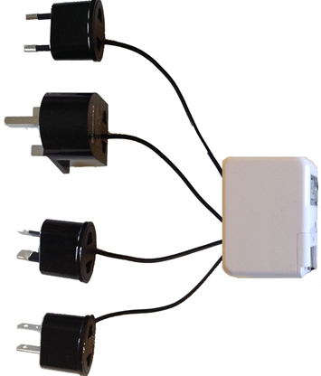
CDMH I: FDA, NCATS, NLM, ONC, NCI
EHR
ACT
HHS - Surveillance
Sentinel
FDA - Safety
PCORI
OMOP
NIH Clinical Research

Slide 6
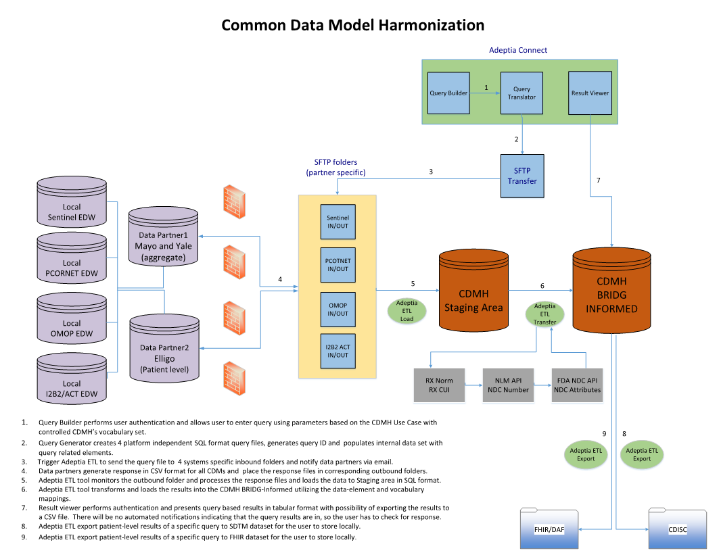
CDMH I: FDA, NCATS, NLM, ONC, NCI

Slide 7
NCATS, FDA, and NCI working together on the tower of babble
Harmonization of Common data models, (PCORMET, Sentinel, OMOP, ACT) FHIR and CDISC
Meta data initiative makes the meaning of data publicly available and reusable in human and machine-readable
FHIR
PCORNET
OHDSI
Sentinel
CDISC
BRIDG
I2b2/ACT
_
FHIR
PCORNET
OHDSI
Sentinel
CDISC
BRIDG
I2b2/ACT
CDMs
FHIR
CDISC
(FDA)

Slide 8
NCI CaDSR CDMS AS METADATA
NCIt
FHIR
PCORNET
OHDSI
Sentinel
CDISC
BRIDG
I2b2/ACT
Metadata Registration
Makes the meaning of data publicly available and reusable in human and machine-readable format
- data interpretation, data validation, data transformation
Persistent, unique identifier including version number
Normalizes the meaning of the fields and the data values using standard NCIt terminology
Enables interoperability for data that is not born interoperable
Model | CDMH v1.0 |  |  | PCORnet v 4.0 |  |  | Sentinel v 6.0.2 |  |  | i2B2ACT v 1.4 |  |  | OMOP v 5.2
Field Label | Ethnicity |  |  | hispanic |  |  | Hispanic |  |  | Hispanic |  |  | ethnic_concept_id
Public ID | 6153917v1.0 |  |  | 6153919v1.0 |  |  | 6153920v1.0 |  |  | 6153918v1.0 |  |  | 6153921v1.0
BRIDG Name | Person Biological Entity Ethnic Group |  |  | Person Biological Entity Ethnic Group |  |  | Person Biological Entity Ethnic Group |  |  | Person Biological Entity Ethnic Group |  |  | Person Biological Entity Ethnic Group
BRIDG Concepts | C25190:C28226:C51070 |  |  | C25190:C28226:C51070 |  |  | C25190:C28226:C51070 |  |  | C25190:C28226:C51070 |  |  | C25190:C28226:C51070
CDM Value Domain | CDMH HL7 FHIR v3 Ethnicity Category Code |  |  | PCORnet CDM Hispanic Code |  |  | Sentinel CDM Hispanic Indicator |  |  | ACT I2B2 CDM Hispanic Indicator |  |  | OMOP CDM Ethnicity Category Code
Permissible Value(s) | 6 Permissible Value(s) |  |  | 6 Permissible Value(s) |  |  | 3 Permissible Value(s) |  |  | 3 Permissible Value(s) |  |  | 2 Permissible Value(s)
 | Data Value | Data Value Concept |  | Data Value | Data Value Concept |  | Data Value | Data Value Concept |  | Data Value | Data Value Concept |  | Data Value | Data Value Concept
 | UNK | C17998 |  | UN | C17998 |  | U | C17998
 | NI | C53269 |  | NI | C53269 |  |  |  |  | NI | C53269
 | 2135-2 | C17459 |  | Y | C17459 |  | Y | C17459 |  | Y | C17459 |  | 38003563 | C17459
 | 2186-5 | C41222 |  | N | C41222 |  | N | C41222 |  | N | C41222 |  | 38003564 | C41222
 | OTH | C17649 |  | OT | C17649
 | ASKU | C79729 |  | R | C79729

Slide 9
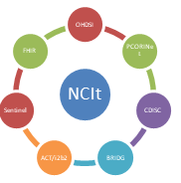
Code Map Service
Ontologies
CMDs
(Act, OMOP, PCORI, Sentinel)
Model Definitions
CaDSR
FHIR Model
Definitions
SnoMed
BRIDGE
Model
Definitions
Code Map
Service
ICD
NCit
Value Domain Definitions
(Advise Mapping)
HL7
Map
Definition
Process
HPO
Code System; Version, Content
Concept Maps
NDC
LOINC
VSAC
Services
FHIR
Term
Services
RxNorm
Value Set Definitions
Mapping Experts

Slide 10
CDMH II Architecture
CQL to FHIR Converter
Query Validator
CQL Builder
CSV Export
NIH
FHIR Repository
Data
Aggregator
Data Repository
1. Institutional Value Sets → FHIR
2. Standard Terminologies → FHIR
Results Agent
FHIR
HHS
Blue:
clinical data
FHIR to BRIDG
1a
1b
contributor
Green:
Data
Consumer
2
BRIDG to SDTM
FDA Gateway
FDA
CDM Adapter: Bidirectional
FHIR ⬄CDMs
(OMOP, PCORI, i2b2ACT, Sentinel)
Identified Warehouse
CDM to FHIR
ETL: Bulk/HL7-2.X
EHR / RDW to
FHIR Warehouse
Multiple Exports formats
i.e., FDA, NIH
FHIR → BRIDG → CDISC
RxNorm → NDC
EHR
NCATS Service Stack
Query Management
Data Services (validation, CQL engine)
Results Manager
Terminology Services etc.
NCI CaDSR
Code Map Services

Slide 11
Open Source CQL Tools
Configured with source data provider and terminology service URLs
CQL Runner
(Formatting + Evaluation)
CQL Execution Service
HAPI FHIR Server
invokes
invokes
Gets response
Gets response
CQL Engine
Configured with CQL Engine URL
https://github.com/DBCG

Slide 12
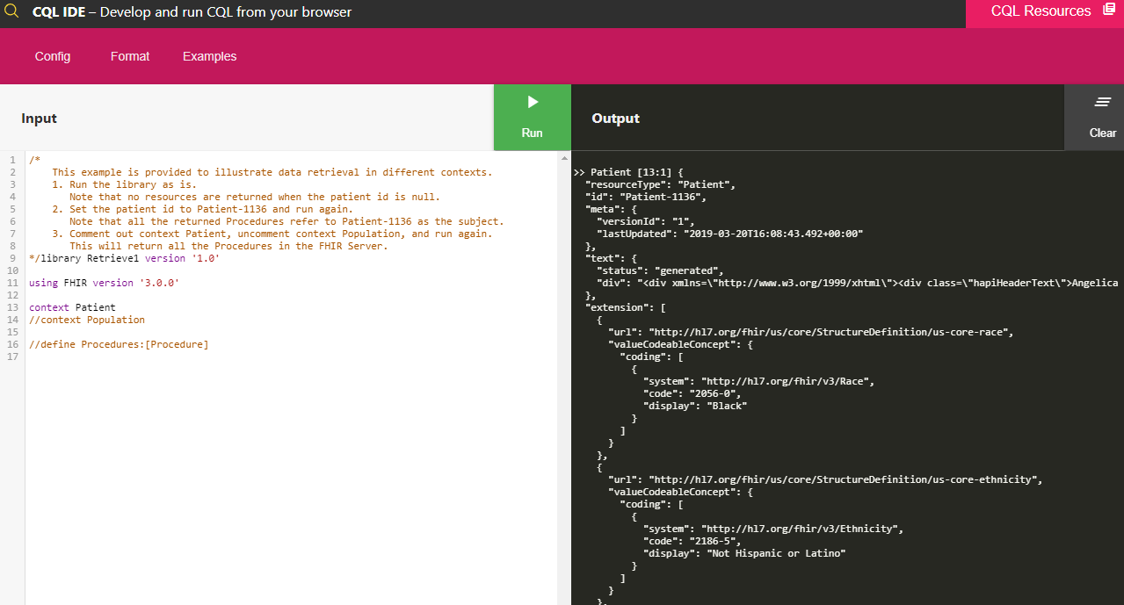
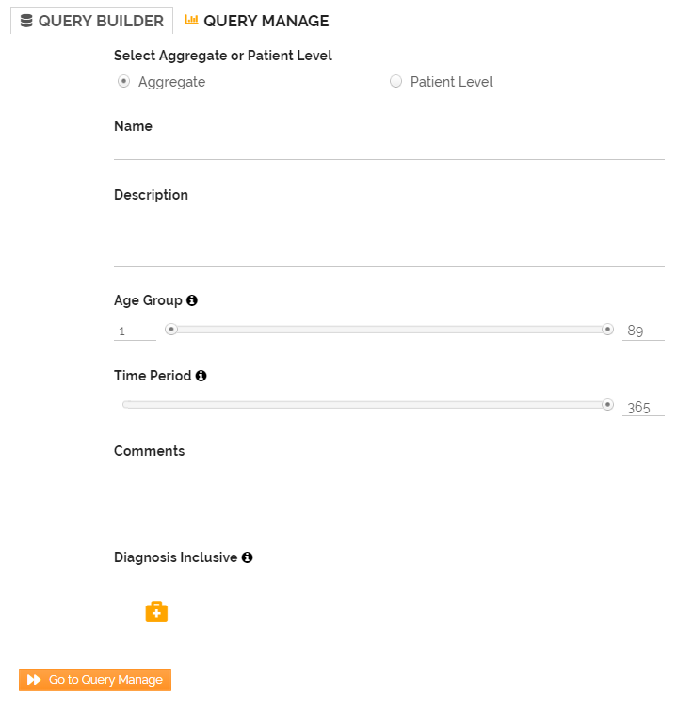
Query Builder Options: Text Editor / Authoring Tool
CQL Engine, CQL Execution Service and CQL Runner 1 & 2 https://github.com/DBCG
CDS Connect Authoring Tool - Components 3 & 4 https://cds.ahrq.gov/cdsconnect/authoring
1
CQL Editor for complex queries
2
Convert CQL query to FHIR query
(CQL Engine)
Query Approved? (Agent)
3
4
FHIR Query
CQL Query Builder
Clinical Decision Support (CDS) Authoring Tool
Cont’d… as in Clinical Adapter Diagram

Slide 13
CDMH II Architecture
CQL to FHIR Converter
Query Validator
CQL Builder
CSV Export
NIH
FHIR Repository
Data
Aggregator
Data Repository
1. Institutional Value Sets → FHIR
2. Standard Terminologies → FHIR
Results Agent
FHIR
HHS
Blue:
clinical data
FHIR to BRIDG
1a
1b
contributor
Green:
Data
Consumer
2
BRIDG to SDTM
FDA Gateway
FDA
CDM Adapter: Bidirectional
FHIR ⬄CDMs
(OMOP, PCORI, i2b2ACT, Sentinel)
Identified Warehouse
CDM to FHIR
ETL: Bulk/HL7-2.X
EHR / RDW to
FHIR Warehouse
Multiple Exports formats
i.e. , FDA, NIH
FHIR → BRIDG → CDISC
RxNorm → NDC
EHR
NCATS Service Stack
Query Management
Data Services (validation, CQL engine)
Results Manager
Terminology Services etc.
NCI CaDSR
Code Map Services

Slide 14
Highlights of Systems Architecture and Design
Automated deployment, versioning and provisioning of AWS cloud infrastructure (GitHub, Terraform, Jenkins)
Separation of agency and partner Virtual Private Cloud (VPC) with the layers of network & access security
Automation of server patching and preparation for application deployment and operations and management
Secure vault set up for encrypting passwords to both agency and partner resources.
Automated mechanism to request time-bound access to cloud resources

Slide 15
Service Stack- Agent
CQL
(e.g. CQL Runtime Services)
Code Map Services
(Vocab & Terminology Services, Validation)
Supplemental Data Collection Services
Triggers:
Subscription (data),
CDS Hook (event)
Results Manager
Bulk FHIR
(De-ID, Hashing, Anonymization, Linking)
Notes:
Provide overview of modularity of this approach, and introduce the three layers at a high level
Policy & Trust Service
Query Management
Data Services (validation, CQL engine)
Results Manager
Terminology Services etc.

Slide 16
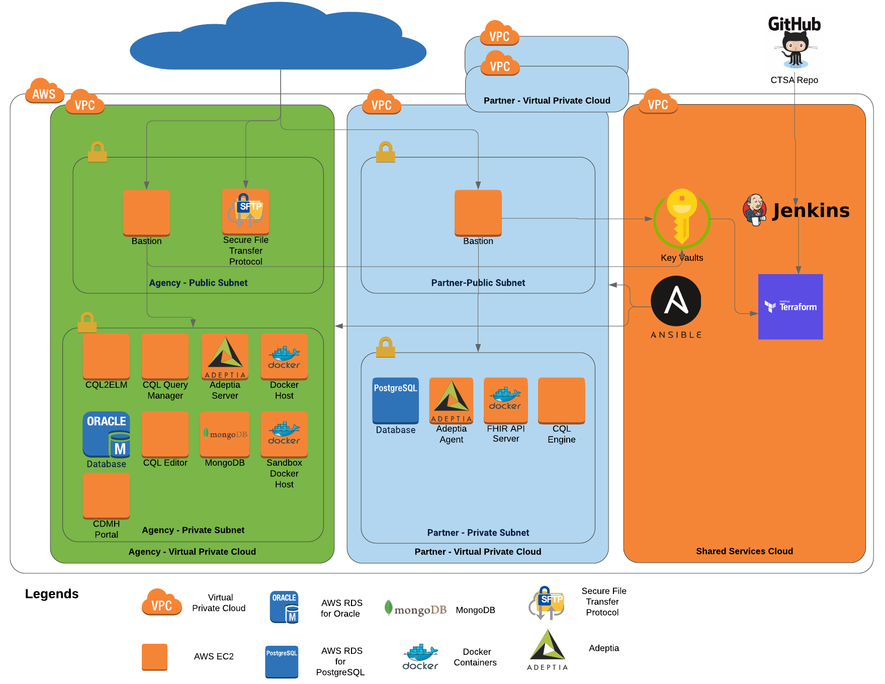
High-level Systems Architecture (DEV)

Slide 17
CodeX
Steve Bratt (sbratt@mitre.org)

Slide 18
Introduction to mCODETM and the CodeXTM HL7 FHIR Accelerator
Steve Bratt (sbratt@mitre.org)
Lead, CodeX HL7 FHIR Accelerator
Tuesday May 19th, 2020
Approved for Public Release; Distribution Unlimited. Case Number 19-2023

Slide 19
Contents
mCODE standard
HL7 standard language for cancer data collection and sharing
CodeX HL7 FHIR Accelerator Community
A community building valuable, mCODE-based implementations to improve cancer care and research
Example Use Case: Registry Reporting

Slide 20
The Path to Meaningful Interoperability
FHIR establishes high-level syntax & interfaces for exchange
Argonaut and USCDI standardize foundational patient data
Da Vinci and Carin formalize targeted exchange frameworks
Discipline focused modeling provides detail needed for semantic interoperability
Semantic Interoperability
Other
Disciplines
(e.g., Cardiology)

Slide 21
minimal Common Oncology Data Elements

Slide 22
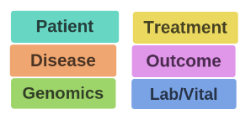
minimal Common Oncology Data Elements
Small, stable set of critical data elements
Recommended by top oncologists
Applicable across key cancer use cases
Standardized for collection and sharing, using FHIR
Leading to better cancer care and research
Patients
Providers
Research
CANCER
Payers
Vendors
Government / Regulatory
mCODE Release 1 STU1 :
http://hl7.org/fhir/us/mcode/

Slide 23
Early Collaborators
®
TM
®
TM
®
®
®
®
®
®

Slide 25
A New HL7 FHIR Accelerator
A community and platform to accelerate interoperable data modeling and implementation
around mCODE, leading to
step-change improvements in
cancer care and research
http://hl7.org/CodeX

Slide 26
Vision: Patient Data Collected Once to Support Many Use Cases Data are collected and shared via the mCODE standard and CodeX extensions
ACADEMIC

Slide 27
Approach
Gather an influential community that collaborates to:
Prioritize use cases around interest and impact
Create new data models and FHIR IGs to augment mCODE when needed
Build reference implementations
Provide test datasets in mCODE and extensions
Execute pilots to demonstrate feasibility and value
Enable early adoption and scale by engaging health systems and industry

Slide 28
CodeX Use Cases (so far)
| 28 |
0
mCODE Extraction
1
EHR Endpoints for Clinical Trials (future extensions of ICAREdata)
5
Radiation Therapy Data for Care Coordination
2
Empowering Patients to
Find Clinical Trials
6
Prior Authorization for Cancer Care
3
7
Alternative Payment Model Data Reporting
Registry Reporting
4
Oncology Clinical
Pathways Navigation
8
Drug Value Based Agreements
Active
In Discovery

Slide 29
Health System to Registry Level
Benefits
State
Registries
Registries require a low-burden approach to data reporting from clinical sites
Treatment effectiveness and other research
FHIR Endpoints
with
Automated Solution
Patient Information
EHR-Based Data
Patient Interaction
FHIR mCODE ++
Treatment Data
Public health monitoring
Accountable care
mCODE++: leveraging mCODE with possible extensions

Slide 30
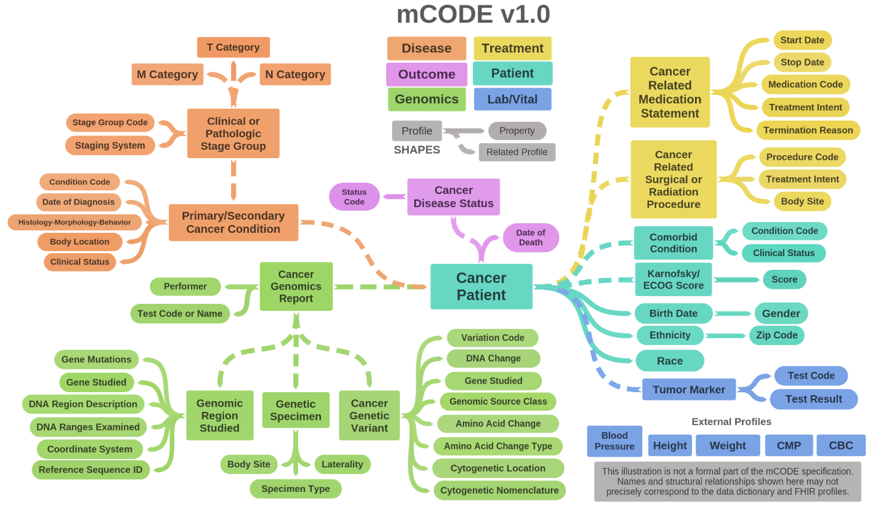
HL7 FHIR Implementation Guide: minimal Common Oncology Data Elements
Release 1 - US Realm | STU1 | http://hl7.org/fhir/us/mcode/

Slide 31
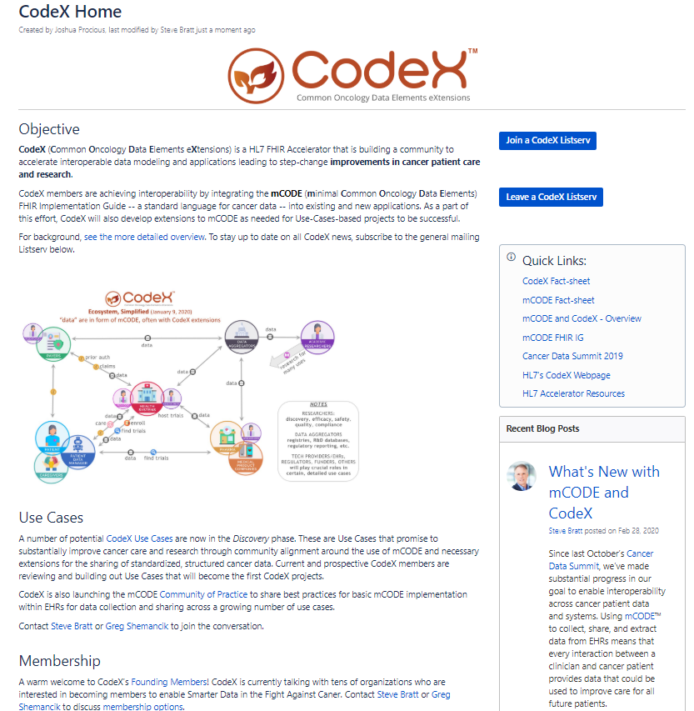
Public Resources to Build the Community
| 31 |
Greg Simon
Executive outreach
CodeX Email List
500 people
200 organizations
Virtual HIMSS20
Steve Bratt (panel, audio)
Greg Shemancik (videos: talk, interview)
Materials
CodeX Fact Sheet
https://confluence.hl7.org/display/COD/CodeX+Home

Slide 32
Discussion

Slide 33
Upcoming MedMorph Meetings
Next Full TEP Meeting
Tue 6/16/2020 @ 3-4pm ET / 2-3pm CT / 1-2pm MT / 12-1pm PT
Technical Workgroups (Weekly)
Reference Architecture/Authorities/Policies:
Wednesdays @ 1-2pm ET / 12-1pm CT / 11am-12pm MT / 10-11am PT
Evaluation Workgroup
Starting Soon – Doodle Poll will be sent to Evaluation WG members by the end of this week

Slide 34
Contacts
CDC Team
Maria Michaels: ktx2@cdc.gov
Wendy Blumenthal: wfb6@cdc.gov
Arun Srinivasan: fos2@cdc.gov
Syed Sameemuddin: puv5@cdc.gov
Abigail Vail: bzv3@cdc.gov
Aaron Harris: ieo9@cdc.gov
Brian Gugerty: vaz6@cdc.gov
Cynthia Bush: pdz1@cdc.gov
Laura Conn: lbk1@cdc.gov
TEP Co-Chairs
John Loonsk: john.loonsk@jhu.edu
Bill Lober: lober@uw.edu
Technical Leads
Nagesh “Dragon” Bashyam: nagesh.bashyam@drajer.com
Support Team
Becky Angeles: becky.angeles@carradora.com
Jamie Parker: jamie.parker@carradora.com
Kishore Bashyam: kishore.bashyam@drajer.com
Mike Flanigan: mike.flanigan@carradora.com
Technical SME
Brett Marquard: brett@waveoneassociates.com

Slide 35
Appendix A: MedMorph General Information

Slide 36
Making EHR Data More Available for Research and Public Health
Technical Expert Panel:
End Users, Data Recipients, Stakeholders – Including representatives of additional use cases
Foundation of standards supported by health IT certification (CCDS/USCDI, APIs, FHIR)
Fully Modeled Use Cases
Hepatitis C, Cancer, Healthcare Surveys
Fully Modeled Use Cases
Hepatitis C, Cancer, Healthcare Surveys
Implementation Guides
For general use and for each use case
Technological Strategies
To develop scalable and extensible architecture
Technological Strategies
To develop scalable and extensible application
Agile Development: Iterative Design-Build-Test Cycles (test case: Hepatitis C)
CCDS: Core Clinical Data Set
USCDI: US Core Data for Interoperability
APIs: Application Programming Interfaces
FHIR: Fast Healthcare Interoperability Resources
PRODUCTS: Reference Architecture, Reference Implementation
(Open Source Software) & Balloted Implementation Guides, Roadmap for Scalability and Sustainability
National Test Collaborative
Including a variety of clinical organizations and their EHR platforms
Software
Clinical organization
EHR platform
Other testing partners (e.g., public health departments, registries, health IT developers, etc.)
Evaluation Planning
Measure and Evaluate

Slide 37
Evaluation WG
Short-term evaluation: focused on Hep C pilot
Long-term evaluation: focused on broader impacts to research and public health

Slide 38
Appendix B: HL7 FHIR Resources

Slide 39
Helpful FHIR Links
FHIR Home Page & Summary:
https://hl7.org/fhir/
https://hl7.org/fhir/summary.html
FHIR Overview by user type:
General: https://www.hl7.org/fhir/overview.html
Developer: https://www.hl7.org/fhir/overview-dev.html
Clinical: https://www.hl7.org/fhir/overview-clinical.html
Architects: https://www.hl7.org/fhir/overview-arch.html
FHIR Implementation Guide Publishing: https://confluence.hl7.org/display/FHIR/IG+Publisher+Documentation
FHIR Implementation Guide Process Flow: https://confluence.hl7.org/display/FHIR/FHIR+Implementation+Guide+Process+Flow

