Slide 1
June 21st, 2022
Making EHR Data More Available for Research and Public Health (MedMorph)
Technical Expert Panel (TEP)
Co-Chairs:
Bill Lober
University of Washington
John Loonsk
Johns Hopkins University

Slide 2
MedMorph TEP Meeting Agenda – 06/21/2022
TOPIC |  | LEAD(S) | TIME (ET)
1 | Logistics & Welcome | Maria Michaels TEP Co-Chairs: Bill Lober, John Loonsk | 3:00 - 3:05
2 | Project At-a-Glance and Announcements | Jamie Parker | 3:05 - 3:10
3 | HL7 MedMorph Content IGs and RA IG Ballot Updates | Becky Angeles | 3:10 - 3:20
4 | Pilots | Maria Michaels | 3:20 - 3:25
5 | Partnering for Mutual Benefit | Maria Michaels | 3:25 - 3:30
6 | Interactive Working Session: MedMorph RoadMap | Moderator: Maria Michaels All TEP Members | 3:30 - 3:50
7 | Next Steps | Jamie Parker | 3:50 - 3:55
8 | Closing Next Meeting July 19th | Jamie Parker | 3:55 - 4:00
Notes:
Update
“Money” slide
Pilot progress

Slide 3
Project At-a-Glance and Announcements
Jamie Parker

Slide 4
MedMorph 2021-2022 Timeline
2021
May
June
July
Aug
Sept
Oct
Nov
Dec
January 2022
March
May
July
RA Ballot Disposition
Develop MedMorph Use Case Content IGs
Finalize Content IG
IHE Connectathon
HIMSS Interoperability Showcase
Submit Content IG Proposals
FHIR Connectathon
Sept FHIR Connectathon
HL7 WGM
HL7 WGM
Legend
Submit Use Case Content IG NIBs
Disposition Content IGs Ballot Comments
HL7 Processes
MedMorph Project Activities
Submit Use Case Content IGs for Ballot
Update RA IG and Republish
HL7 Event
Real World Pilot Testing & Evaluation of the MedMorph RA IG (timeframe: 1 year)
MedMorph Event

Slide 5
Announcements
Making EHR Electronic Data More Available for Research and Public Health(MedMorph)
New Name Same Acronym: Making Electronic Data More Available for Research and Public Health (MedMorph)
Backend Service Application (BSA) is now the Health Data Exchange App (HDEA)

Slide 6
HL7 MedMorph Content IGs and RA IG Ballot Updates
Becky Angeles

Slide 7
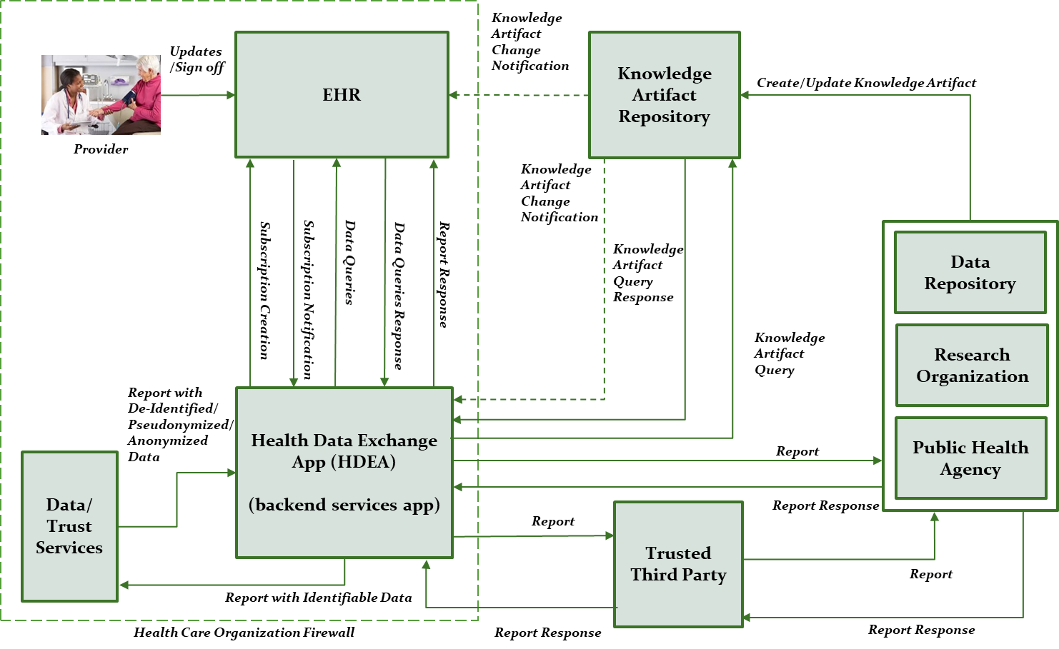
MedMorph Abstract Model of Actors and Systems
KEY FEATURE of MedMorph RA:
Architecture is decoupled from content
The abstract model of actors and systems is used to define the common workflows identified in the use cases, which include:
Provisioning
Notification
Data Collection and Submission Report Creation
Data Submission
Receiving Response/ Acknowledgement
Can use FHIR R4 API or Bulk FHIR API for data queries
Data Queries
http://hl7.org/fhir/us/medmorph/2022Jan/usecases.html

Slide 8
MedMorph Content IGs
Artifact | Description | Balloted IG
Health Care Surveys Content Implementation Guide | Automated data extraction from inpatient and ambulatory EHRs or clinical data repositories. There are 2 user stories: Ambulatory and Inpatient/ED | http://hl7.org/fhir/us/health-care-surveys-reporting/2022Jan/index.html
Central Cancer Registry Reporting Implementation Guide | Transmit cancer case information to state Central Cancer Registries. There is 1 user story: Reporting based on specific criteria with an alternate flow to report on every encounter | https://hl7.org/fhir/us/central-cancer-registry-reporting/2022Jan/index.html
MedMorph Research Data Exchange | Data collection for research. There are 2 user stories: Onboarding a new data partner and Requesting data not regularly collected. Only user story 1: Onboarding was balloted | https://hl7.org/fhir/us/medmorph-research-dex/2022Jan/index.html
Hepatitis C Reporting | Reusing eCR FHIR IG | http://build.fhir.org/ig/HL7/case-reporting/ (continuous build site)

Slide 9
Content IG Ballot Results
Central Cancer Registry Reporting Content Implementation Guide
Voters - Total Eligible: 148
Affirmative: 27
Negative: 30
Abstain: 57
Approval Status: Not Passing (so far)
# of Comments: 60/44/32/23/9/2
Block Vote 1 (16 comments) – March 10
Block Vote 2 (12 comments) – April 14
Block Vote 3 (9 comments) – April 21
Block Vote 4 (14 comments) – May 19
Block Vote 5 (7 comments) – June 9
Remaining 2 comments scheduled for a vote on June 23
Health Care Surveys Content Implementation Guide
Voters - Total Eligible: 136
Affirmative: 20
Negative: 25
Abstain: 60
Approval Status: Not Passing (so far)
# of Comments: 36/24/13/1
Block Vote 1 (12 comments) – March 31
Block Vote 2 (11 comments) – April 21
Block Vote 3 (12 comments) – June 9
Remaining 1 comment scheduled for a vote on June 23
MedMorph Research Data Exchange Implementation Guide
Voters - Total Eligible: 149
Affirmative: 39
Negative: 23
Abstain: 57
Approval Status: Passing
# of Comments: 31/3
Block Vote 1 (28 comments) – June 9
Remaining 3 comments scheduled for a vote on June 23

Slide 10
Reference Architecture IG Update
All ballot comments have been dispositioned and approved by the Public Health Workgroup!!
Next Steps
Add the CREDs acknowledgement (agreed upon statement by the CREDs team) in the RA introduction
Look at Hybrid/Intermediary IG (FAST) project to determine impact/integration
Make final changes/updates based on ballot comments
Submit RA IG to HL7 for approval to publish
http://build.fhir.org/ig/HL7/fhir-medmorph/

Slide 11
Pilots
Maria Michaels

Slide 12
Real-World Pilot #1: Chronic Hepatitis C Surveillance
Pilot Objectives:
Apply RA IG in real-world setting to continue learnings from HL7® FHIR® Connectathons
Demonstrate RA IG can facilitate data exchange using FHIR® across multiple EHR platforms and can be used by different types of health care organizations
Evaluate quantitative (e.g., completeness, timeliness, accuracy) and qualitative (e.g., perceptions of using an approach like MedMorph before and after implementation, organizational buy-in) aspects of the pilot
Pilot Design:
Data senders
Different clinical site types (e.g., academic medical center, FQHC, specialty clinic) on three different EHR platforms – Currently recruiting clinical sites / EHR vendors
Onboard: MDLand/[clinical client]
Onboard: InSync/Addiction Care Interventions (ACI)
In Progress: Epic/Weill Cornell Medical Center (+ INSIGHT CRN (a PCORnet node) as a research organization)
Data receivers
Public Health Agency – New York City Department of Health and Mental Hygiene
Research Organization – Westat
Content:
Uses the electronic initial case report (eICR) data as described in the eCR FHIR® IG
Notes:
Hep C chosen for pilot due to its relation to the opioid epidemic (e.g., Hep C cases tend to rise with increased needle sharing related to certain opioid use)

Slide 13
Pilots & Alignments In Progress (1)
Central Cancer Registry Reporting – pilot (content IG already developed)
Health Care Surveys – pilot (content IG already developed)
Influenza Hospitalization Surveillance – content IG development and pilot
Vital Statistics: Birth Reporting IG – alignment with MedMorph RA
HRSA Uniform Data System (UDS) Reporting from FQHCs – content IG development and pilot
HRSA’s Uniform Data System patient-level submission, or UDS+, is a redesign of parts of the UDS to increase data granularity and reduce annual reporting burden by aligning with interoperability standards described in the MedMorph Reference Architecture IG
Beginning in the CY 2023 reporting period, which is due in 2024, HRSA’s Bureau of Primary Health Care (BPHC) will accept de-identified patient-level report data
Submissions can be via either Bulk FHIR or manual file upload (XML)
NOTE: There is interest from the international community in moving MedMorph to Universal Realm (it is currently US Realm)

Slide 14
Pilots & Alignments In Progress (2)
Discussions started:
CMS Quality Reporting
Vulcan: Real World Data, FHIR to OMOP, Adverse Events, Phenopackets
CIC WG: “Registry of Registries” – alignment to MedMorph RA
LHS WG” “Project of Projects” – bringing together existing IGs, accelerators, projects, and other efforts to help show how they can fit together to support the learning health system
NLM: ClinicalTrials.gov
FDA: SHIELD
CDC/FDA/ONC: Patient-Generated Health Data (from consumer medical devices)
NIDDK/AHRQ: Shared eCare Plans

Slide 15
The Future of the MedMorph Reference Architecture in Supporting Public Health & Beyond
Potential Additional Data Sources
Health Information Exchanges (HIEs)
Registries (e.g., immunization)
eCare Plans
Lab/Pharmacy/Radiology Systems
Electronic Birth Registration Systems (EBRS)
Patient-generated health data from consumer medical devices
ClinicalTrials.gov (NLM)
Non-EHR hospital systems
Potential Additional Data Repositories
CDC Data Lake/ Enterprise Data Analytics and Visualization (EDAV)
Health Information Exchanges (HIEs)
Registries
eCare Plans
EBRS
HRSA Uniform Data System (UDS)
CMS Quality Reporting Systems
ClinicalTrials.gov (NLM)
Additional Research Networks
Potential Ways to Leverage Distributed Knowledge via the Knowledge Artifact Repository
Any use case that needs broad sharing and updating of trigger codes, value sets, rules, etc. for reporting or knowledge sharing (e.g., multiple public health programs, quality measurement, research, etc.)

Slide 16
Partnering for Mutual Benefit
Maria Michaels

Slide 17
Example: MedMorph and CodeX Synergies
MedMorph
Leverages mCODE in the content for the Central Cancer Registry Reporting IG
Has received helpful input from the CodeX community (FHIR© accelerator for cancer) on the MedMorph Reference Architecture & Central Cancer Registry Reporting IGs
CodeX
Leverages the MedMorph Reference Architecture & Central Cancer Registry Reporting IGs as the foundation for its technical requirements in a real-world pilot, allowing more effort to focus on testing rather than developing IGs
Has received input from MedMorph team members on the pilot
This mutual benefit has helped both MedMorph & CodeX progress faster and more robustly in their respective work and ultimately helps eliminate another “one off” approach that would add burden to the data senders and receivers

Slide 18
Example: MedMorph and Clinical Registry Extraction and Data Submission (CREDS)
MedMorph
The MedMorph RA can support multiple use cases through content IGs based on the MedMorph RA IG, which leverages standard FHIR APIs. Use cases that need to obtain data not available via FHIR APIs (e.g., HL7 CDA documents, and HL7 V3 messages) should consider the use of CREDS to extract the data.
CREDS
Once a CREDS FHIR bundle is created from the extracted data, the MedMorph RA could be used for transport.
MedMorph and CREDS are complementary in supporting FHIR® data exchange and data extraction for non-FHIR formats and transforming them to FHIR, respectively.

Slide 19
Supporting Helios: Synergies with Helios Priorities
HELIOS PRIORITY | HOW MEDMORPH REFERENCE ARCHITECTURE (RA) CAN SUPPORT HELIOS PRIORITY
Make Data in Public Health Systems Available in Bulk Ensure authorized users of Immunization Information systems can access vaccination data in bulk. | The MedMorph RA supports bulk data exchange, leveraging the Bulk FHIR API in combination with the Health Data Exchange App (HDEA) and Knowledge Artifact Repository (KAR) Helios could leverage RA to access vaccination data in bulk, and then develop the data requirements to incorporate in knowledge artifacts in a KAR and pilot*
Deliver Aggregate Information to Public Health Provide public health critical data needed on healthcare resource capacity during emergencies and other events of public health importance | The MedMorph RA can support exchange of aggregate data by defining the aggregate measures, etc. as part of the knowledge artifacts (algorithms, value sets, etc.) that define the way the HDEA would query the source system(s) and process the data received Helios could leverage RA for aggregate data and then define a measures framework, etc. to incorporate in knowledge artifacts in a KAR and pilot*
Align and Optimize Public Health Data Sharing Identify commonalities and assess optimal ways for public health to access data in EHRs that would not easily be available under existing data channels | The MedMorph RA already supports public health data sharing from EHRs for multiple use cases through the HDEA and Knowledge Artifact Repository and leveraging standard FHIR APIs (e.g., R4 & Bulk FHIR), and can potentially support additional data sources Helios could leverage RA to support data sharing from EHRs and then develop data requirements to incorporate in knowledge artifacts in a KAR and pilot*
*May require a content IG or some additional architectural development

Slide 20
Leveraging the MedMorph Reference Architecture: Beyond the Initial Use Cases
Discussions or work towards leveraging MedMorph have started with the following partners:
HL7® WORK GROUPS (WGs) |  | FHIR® ACCELERATORS
Public Health (PH) |  | Helios (Public Health)
Clinical Decision Support (CDS) |  | Vulcan (Research)
Clinical Quality Information (CQI) |  | Gravity (Social Determinants of Health)
Clinical Interoperability Council (CIC) |  | CodeX (Cancer)
Biomedical Research and Regulation (BR&R)
Learning Health System (LHS)
FEDERAL PARTNERS
Multiple CDC Programs | CMS (Quality Reporting) | NIDDK/AHRQ (eCarePlans) | NIDDK/AHRQ (eCarePlans)
HRSA (UDS Reporting) | FDA (SHIELD) | NLM (ClinicalTrials.gov) | NLM (ClinicalTrials.gov)

Slide 21
Interactive Working Session: MedMorph Roadmap
Moderator: Maria Michaels
Participants: TEP Members

Slide 22
Next Steps
Jamie Parker

Slide 23
MedMorph Next Steps
Reference Architecture Workgroup
Work with the PH WG to complete ballot reconciliation for RA and Content Implementation Guides (IG)
Publish RA IG
Finalize Ballot Disposition process for the Content IGs
Publish Content IGs
Real World Pilot Testing
Continue piloting
Evaluation Workgroup
Execute Short Term Evaluation in Real World Pilots
Develop Plan to execute Long Term Evaluation
Draft Project Roadmap
Completion slated for July 2022
Participate and monitor the HL7 Helios project (FHIR Accelerator for Public Health)

Slide 24
Closing
Jamie Parker

Slide 25
Upcoming MedMorph Meetings
Next Full TEP Meeting
Tuesday July 19th, 3-4 pm ET / 2-3pm CT / 1-2 pm MT / 12-1 pm PT
Reference Architecture Workgroup (Weekly)
Wednesdays @ 1-2pm ET / 12-1pm CT / 11am-12pm MT / 10-11am PT
HL7 Public Health WG Meetings (Weekly)
MedMorph presents ballot comment dispositions for vote and approval
Thursdays @ 4-5 pm ET/ 3-4 pm CT/ 2-3 pm MT/ 1-2 pm PT
https://confluence.hl7.org/pages/viewpage.action?pageId=4489402
Helios
Mondays from 12-1 pm ET: Bulk Data
Mondays from 2-3 pm ET: Aggregate Data
Wednesdays from 2-3 pm ET: Align and Optimize
To add these invites and the call-in details to your calendar, you need to be subscribed to the Helios Listserv: http://www.hl7.org/myhl7/managelistservs.cfm?ref=common (Helios)

Slide 26
Contacts
CDC Team
Maria Michaels: ktx2@cdc.gov
Brian Gugerty: vaz6@cdc.gov
Cynthia Bush: pdz1@cdc.gov
Jenny Couse: lrz3@cdc.gov
Kasey Diebold: ykl4@cdc.gov
Sandy Jones: sft1@cdc.gov
TEP Co-Chairs
John Loonsk: john.loonsk@jhu.edu
Bill Lober: lober@uw.edu
Technical Lead
Nagesh “Dragon” Bashyam: nagesh.bashyam@drajer.com
Support Team
Becky Angeles: becky.angeles@carradora.com
Jamie Parker: jamie.parker@carradora.com
Kishore Bashyam: kishore.bashyam@drajer.com
Mike Flanigan: mike.flanigan@carradora.com
Technical SME
Brett Marquard: brett@waveoneassociates.com

Slide 27
MedMorph Resources
MedMorph Description: https://www.cdc.gov/csels/phio/making_rapid_data_exchange_reality.html
MedMorph Reference Architecture IG: http://hl7.org/fhir/us/medmorph/2022Jan/
Content IGs
Healthcare Surveys Reporting: https://build.fhir.org/ig/HL7/fhir-health-care-surveys-reporting-ig/index.html
Central Cancer Registry Reporting: https://build.fhir.org/ig/HL7/fhir-central-cancer-registry-reporting-ig/index.html
Research Data Exchange: http://build.fhir.org/ig/HL7/fhir-medmorph-research-dex-ig/branches/master/index.html
Hep C (eCR FHIR IG): http://hl7.org/fhir/us/ecr/
GitHub: https://github.com/HL7/fhir-medmorph NOTE: You may need to be logged in to GitHub

Slide 28
Appendix A: MedMorph General Information

Slide 29
Making EHR Data More Available for Research and Public Health (MedMorph) - Background
Funded by the Patient-Centered Outcomes Research Trust Fund (PCORTF) via the U.S. Department of Health and Human Services (HHS) Assistant Secretary for Planning and Evaluation (ASPE)
Total project timeline: 3 years
PROBLEM: Patient-centered outcomes researchers and public health professionals need better ways to get data from different electronic health record (EHR) systems without posing additional burden on health care providers
GOAL: Create a reliable, scalable, generalizable, configurable, interoperable method to get EHR data for multiple public health and research use cases
OBJECTIVE: Develop a reference architecture and demonstrate a reference implementation (including implementation guides)
https://www.cdc.gov/csels/phio/making-ehr-data-more-available.html
Notes:
https://aspe.hhs.gov/making-electronic-health-record-ehr-data-more-available-research-and-public-health

Slide 30
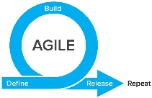
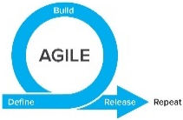
TIME
WE ARE HERE
SMEs: Hepatitis C
Research
Research
MedMorph Workgroups
Technical Experts
SMEs: Hepatitis C
Use Cases
(Public Health & Research)
Technical Experts
SMEs: Cancer
Use Case WG
SMEs: Cancer
Technical Experts
Technical Experts
SMEs: Health Care Surveys
SMEs: Health Care Surveys
Technical Experts
Technical Experts
Evaluation
WG
Evaluation Planning
Evaluation
Roadmap
Data Flows & Clinical Workflows
Reference Architecture/Authorities/Policies
SMEs: All use cases
SMEs: All use cases
Technical
Requirements
Reference Architecture WG
Data Flows & Clinical Workflows
Data Standards
SMEs: All use cases
SMEs: All use cases
Data Standards
Reference Architecture/Authorities/Policies
SMEs: All use cases
SMEs: All use cases
Notes:
Began with one workgroup per use case to be modeled for public health purposes (i.e., Hepatitis C Reporting, Cancer Reporting, Health Care Surveys), which included SMEs from other use cases as well, and across all use cases for a “Research Use Case”.
Switched to technical workgroups to identify Data Flows & Clinical Workflows, Data Standards, and Reference Architecture/Authorities/Policies based on the use case requirements drafted. Each of the technical workgroups had a mix of use case SMEs.
Eventually combined use case workgroups into one consolidated use case workgroup in order to better identify commonalities and differences. This workgroup will take the lead on defining requirements for content implementation guides (IGs), where applicable.
When each use case defined its requirements and then further identified commonalities and differences, a consolidated “Reference Architecture (RA)” WG focuses on technical requirements for the RA IG, and eventually the use case content IGs, where applicable. There may be iteration between the use case WG and RA WG, in agile fashion.
An evaluation workgroup works in parallel to the use case and RA WGs to develop short-term and long-term evaluation plans. The short-term evaluation plan will be part of the real-world pilots, and the long-term evaluation plan will be part of the roadmap (i.e., long-term evaluation is beyond the current scope of MedMorph, which is a time-limited PCORTF project).
Initial testing occurred in sandbox environments and then will be moving to real-world pilots.

Slide 31
The Data Lifecycle & Impacts to the Public’s Health
Guidelines
Recommendations
Guidance
Public Health Policies or
Mandates
Point of Care
Emergency Response
Public Health Departments
Community Services
Delivering actionable knowledge
ACTION
HEALTH
IMPACTS &
OUTCOMES
KNOWLEDGE
UPDATING
SCIENTIFIC
EVIDENCE
Fast Healthcare Interoperability Resources (FHIR®)
INFORMATION
DATA
Analyzing data to advance evidence
EHRs
Registries
Public Health Info Systems
Community Info Systems
…many potential sources
Data Science Analytics
Data Linkages
Data Visualization
Notes:
Structuring recommendations and using standards-based shareable CDS ultimately helps the data lifecycle. Computable guidelines (recommendations, guidance, etc.) help apply the evidence in practice more consistently since they are translated from the source of truth. Data resulting from the actions taken in practice would be more easily extracted to perform analyses that lead to information that can be incorporated into the knowledge that gets translated to practice… and the cycle begins anew. FHIR can help facilitate the data lifecycle by providing an interoperability standard for data exchange on its own or in partnership with existing widely used standards.
Data to Action patient-generated examples:
Patient takes a walk, pedometer records data that can be uploaded to patient’s chart
Patient uses CPAP, machine records sleep-related data, data is accessed remotely

Slide 32
Technical Expert Panel (TEP): Participating Partner Groups
Federal Partners
Health IT developers
Clinicians/ Healthcare Organizations
Medical Societies
Public Health Organizations
Evaluation experts
Laboratory Professional Groups
Standards experts
Clinical decision support developers
Clinical quality measure developers
Policy or technical support for implementation

Slide 33
Technical Expert Panel:
End Users, Data Recipients, Stakeholders – Including representatives of additional use cases
Foundation of standards supported by health IT certification (CCDS/USCDI, APIs, FHIR)
Fully Modeled Use Cases
Hepatitis C, Cancer, Healthcare Surveys
Fully Modeled Use Cases
Hepatitis C, Cancer, Healthcare Surveys
Implementation Guides
For general use and for each use case
Technological Strategies
To develop scalable and extensible architecture
Technological Strategies
To develop scalable and extensible application
Agile Development: Iterative Design-Build-Test Cycles (test case: Hepatitis C)
CCDS: Core Clinical Data Set
USCDI: US Core Data for Interoperability
APIs: Application Programming Interfaces
FHIR: Fast Healthcare Interoperability Resources
PRODUCTS: Reference Architecture, Reference Implementation
(Open Source Software) & Balloted Implementation Guides, Roadmap for Scalability and Sustainability
National Test Collaborative
Including a variety of clinical organizations and their EHR platforms
Software
Clinical organization
EHR platform
Other testing partners (e.g., public health departments, registries, health IT developers, etc.)
Evaluation Planning
Measure and Evaluate

Slide 34
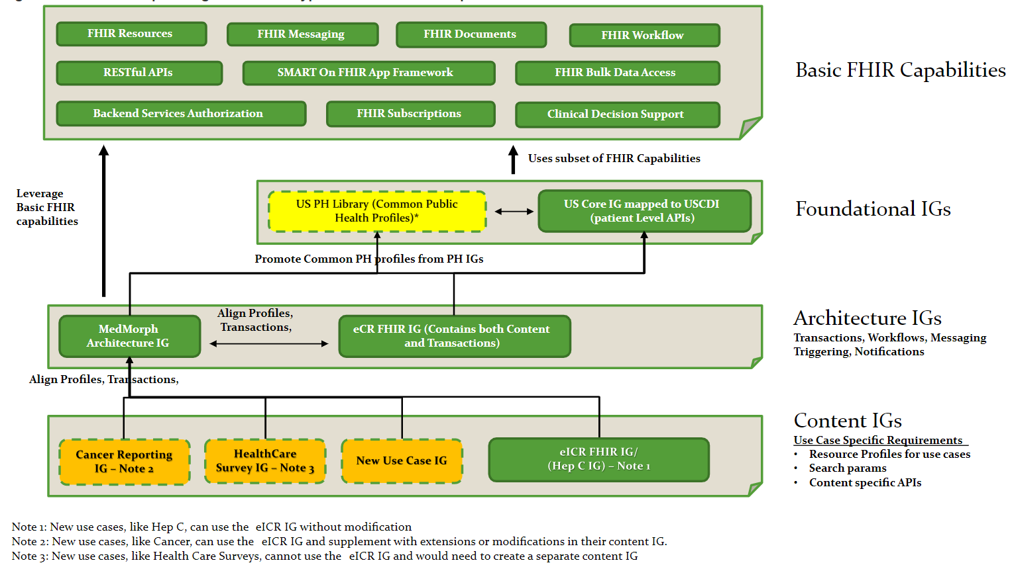
Relationship among Different IG Types and Basic FHIR Capabilities
http://hl7.org/fhir/us/medmorph/2022Jan/background.html

Slide 35
Appendix B: HL7 FHIR Resources

Slide 36
Helpful FHIR Links
FHIR Home Page & Summary:
https://hl7.org/fhir/
https://hl7.org/fhir/summary.html
FHIR Overview by user type:
General: https://www.hl7.org/fhir/overview.html
Developer: https://www.hl7.org/fhir/overview-dev.html
Clinical: https://www.hl7.org/fhir/overview-clinical.html
Architects: https://www.hl7.org/fhir/overview-arch.html
FHIR Implementation Guide Publishing: https://confluence.hl7.org/display/FHIR/IG+Publisher+Documentation
FHIR Implementation Guide Process Flow: https://confluence.hl7.org/display/FHIR/FHIR+Implementation+Guide+Process+Flow

