Slide 1
July 21, 2020
Making EHR Data More Available for Research and Public Health (MedMorph)
Technical Expert Panel (TEP)
Co-Chairs:
Bill Lober
University of Washington
John Loonsk
Johns Hopkins University

Slide 2
MedMorph TEP Meeting – 07/21/2020
TOPIC |  | LEAD(S) | TIME (ET)
1 | Roll Call & Welcome | Maria Michaels TEP Co-Chairs: Bill Lober John Loonsk | 3:00 - 3:05
2 | HL7 and MedMorph Project Update | Nagesh Bashyam, Jamie Parker | 3:05-3:10
3 | MCC eCare and MedMorph Projects -Opportunities for Collaboration | Jenna Norton, MPH National Institutes of Health National institute of Diabetes and Digestive and Kidney Disease (NIDDK) | 3:10 - 3:25
4 | Exploring Interoperability Between Electronic Health Records (EHRs) and Electronic Death Registration System (EDRS) using FHIR | Prachi Mehta Cindy Bush CDC National Center Health Statistics, Division of Vital Statistic (NCHS, DVS) | 3:25 - 3:40
5 | Discussion | Entire TEP | 3:40 - 3:55
6 | Questions, Next Steps Next Meeting – August 18th, 2020 | Bill Lober John Loonsk MedMorph Project Team | 3:55 - 4:00

Slide 3
HL7 and Project Update
Nagesh Bashyam
Jamie Parker

Slide 4
Timeline: MedMorph Activities & IG Balloting
March
April
May
June
July
August
September
October
November
December
January 2021
HL7 PSS Submitted
MedMorph Use Case Development
End to End Use Case Review
HL7 Notice for Intent to Ballot Due
Finalize Use Cases
HL7 RA FHIR IG submitted
Prepare HL7 Reference Architecture (RA) FHIR IG
Legend
HL7 Working Group Meeting
HL7 Processes
HL7 Sept 2020 FHIR Connectathon
MedMorph Project Activities

Slide 5
MedMorph: Deliverables and Artifacts
Artifact | Location | Use
Reference Architecture Confluence Page | https://carradora.atlassian.net/wiki/spaces/MedMorph/pages/545914881/Reference+Architecture+Document | Content will feed into the RA HL7 FHIR Ballot
Health Care Survey Use Case Confluence Page | https://carradora.atlassian.net/wiki/spaces/MedMorph/pages/692060180/Health+Care+Survey+Use+Case+-+DRAFT | User story should be supported by the RA
Hepatitis C Use Case Confluence Page | https://carradora.atlassian.net/wiki/spaces/MedMorph/pages/694452251/Hepatitis+C+Use+Case+-+DRAFT | User story should be supported by the RA
Cancer Use Case Confluence Page | https://carradora.atlassian.net/wiki/spaces/MedMorph/pages/699990019/Cancer+Use+Case+-+DRAFT | User story should be supported by the RA

Slide 6
HL7: Deliverables and Artifacts
Date | Artifact | Status
February 20, 2020 | Draft PSS Presented to the HL7 Supporting WG | Completed
February 21, 2020 | Submit PSS Scope Statement for September 2020 Ballot Cycle | Completed https://confluence.hl7.org/display/PHWG/Making+EHR+Data+More+Available+for+Research+and+Public+Health+%28MedMorph%29+Reference+Architecture+HL7+FHIR+Implementation+Guide
April 19, 2020 | HL7 Steering Division Approval | Completed, PSS Approved
July 21st | Connectathon Proposal
September 9th-11th | HL7 FHIR Connectathon – Virtual (https://www.hl7.org/events/fhir/connectathon/2020/09/
September 21st-25th, 2020 | HL7 Workgroup Meeting – Virtual https://www.hl7.org/events/working_group_meeting/2020/09/index.cfm?utm_source=HL7+Members+Verified+Oct+2019+Large+List&utm_campaign=1c006492ee-EMAIL_CAMPAIGN_2018_01_29_COPY_01&utm_medium=email&utm_term=0_06eea0748f-1c006492ee-55792321
Submit FHIR IG Proposal | October 18th
Submit Notice For Intent to Ballot | November 1st
Substantive IG complete | November 1st
Ballot Due | November 24th
Ballot opens for voting | December 13th
January HL7 Connectathon | January 16-17, 2021
January HL7 WG Meeting | January 18-22, 2021

Slide 7
MCC eCare and MedMorph Projects Opportunities for collaboration
Jenna Norton, MPH

Slide 8
MCC eCare and MedMorph Projects Opportunities for collaboration
Jenna Norton, MPH
National Institute of Diabetes and Digestive and Kidney Diseases

Slide 9
Lack of infrastructure to share patient data across settings impedes clinical care
and research
Clinician
Clinician
Investigator
Patient
Clinician
Notes:
Creates a burden for patients and clinicians to track down data.
Burden also on researchers who try to leverage EHR data in pragmatic trials or health systems research, who may not be able to access complete medical data for a study participant. And worse, may not even know what data are missing.

Slide 10
Care coordination & research challenges are exacerbated in people with multiple chronic conditions
MCC are common and burdensome
Require coordination across a large care team for optimal outcomes
Complex mix of medical, social, cognitive and functional issues
Often excluded from randomized controlled trials
Limited evidence base for effective management

Slide 11
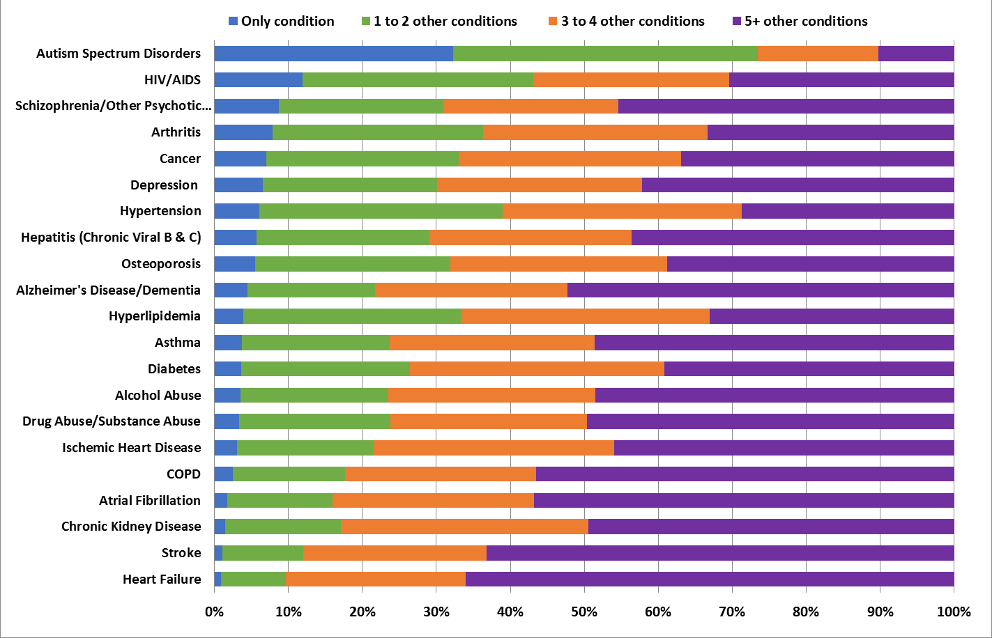
Comorbidity in Fee-for-Service Medicare Beneficiaries by Chronic Condition (2017)

Slide 12
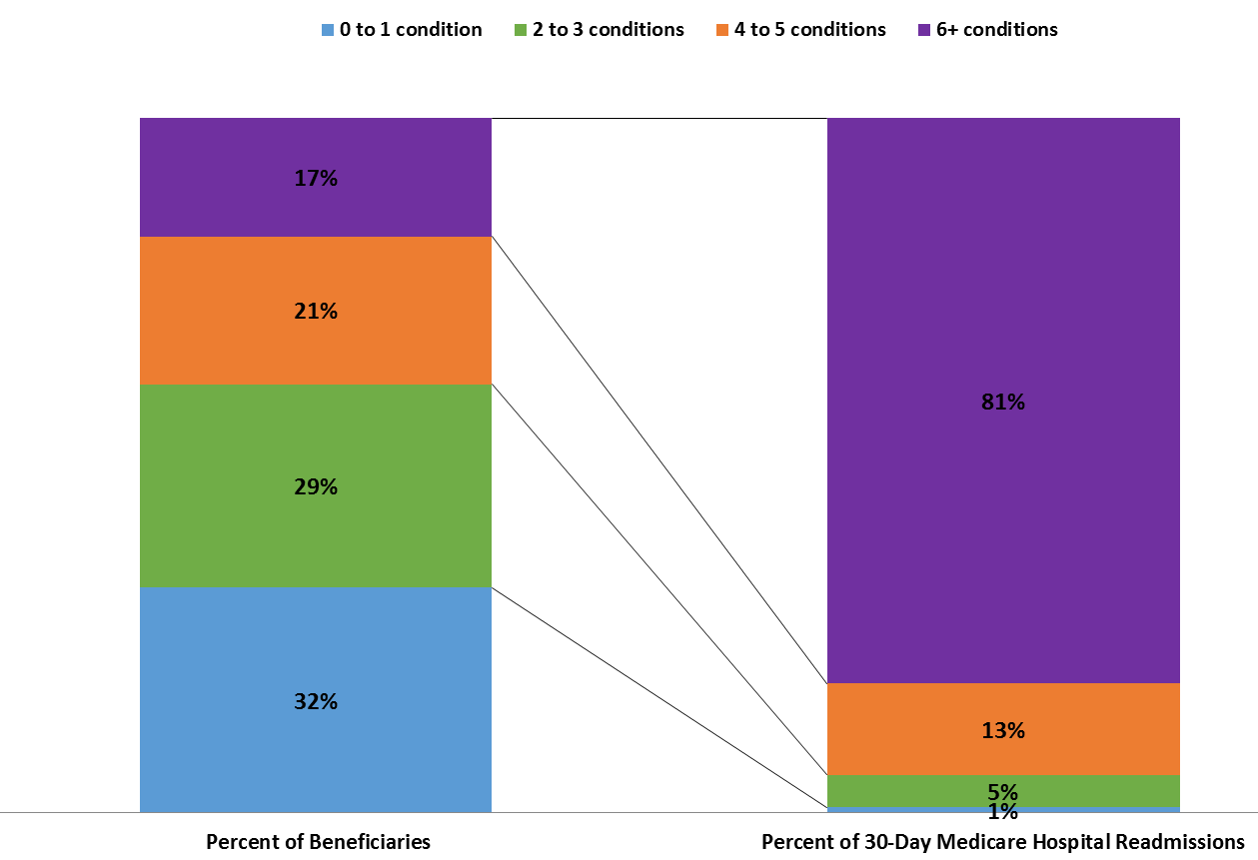
Hospital Readmissions by Number of Comorbidities among Medicare Beneficiaries (2017)

Slide 13
The e-care plan uses data standards to enable access to/sharing of comprehensive, person-centered information
Status Quo
eCare Plan
Clinician
Investigator
Clinician
Investigator
Patient Data
Clinician
Clinician
Patient
Patient
Clinician
Clinician
Notes:
The eCare Plan aims to:
consolidate and streamline key patient data
move that data between patients and their providers, across a variety of care settings,
allow patients and their care teams to access the information when they need it.

Slide 14
Comprehensive Shared Care Plan Definition: US Department of Health and Human Services 2015 stakeholder panel
Gives the person direct access to health data
Puts the person’s goals at the center of decision-making
Is holistic, including clinical and nonclinical data (e.g., home- and community-based, social determinants needs and services)
Follows the person through both high-need episodes (e.g., acute illness) and periods of health improvement and maintenance
Allows care team coordination. Clinicians able to 1) view information relevant to their role, 2) identify which clinician is doing what, and 3) update other members of an interdisciplinary team
Baker, et al. Making the Comprehensive Shared Care Plan a Reality. NEJM Catalyst. 2016: https://catalyst.nejm.org/making-the-comprehensive-shared-care-plan-a-reality/
Notes:
A panel convened by HHS including physicians, nurses, policymakers and patient advocates identified similar key elements for a comprehensive shared care plan…
Common themes:
Person-centered/focus on person’s goals
Access to information for all key stakeholders: clinicians (medical and community-based), patients, caregivers
Follow the person over time

Slide 15
Our Shared Goal: Make EHR Data More FAIR for Research, Healthcare and Public Health
MCC eCare Plan Project | MedMorph
Build capacity for pragmatic, patient-centered outcomes research (PCOR) by developing an interoperable electronic care plan to facilitate aggregation and sharing of critical patient-centered data across home-, community-, clinic- and research- based settings for people with multiple chronic conditions (MCC). | Create a reliable, scalable, and interoperable method to get electronic health record data for multiple public health and research scenarios (use cases). The development of a reference architecture and demonstrated implementation will reduce the burden on healthcare providers and help provide the standards and methods to receive and send data from EHRs for a variety of public health and research purposes.
But we are taking unique (complementary?) approaches!

Slide 16
Comorbidity in Fee-for-Service Medicare Beneficiaries by Chronic Condition (2017)
MedMorph
MCC eCare

Slide 17
AHRQ-NIDDK Project Deliverables
Multiple chronic conditions (MCC) Data elements, clinical information models (CIM), and FHIR mappings to enable standardized transfer of data across health settings for kidney disease, diabetes, cardiovascular disease & chronic pain
Pilot tested patient- and clinician-facing e-care plan applications that integrate with the EHR to pull, share & display key patient data
HL7® Fast Health Interoperability Resource (FHIR®) Implementation Guide based on defined use cases and MCC data elements, balloted for trial use
* All deliverables will be open-source & freely available

Slide 18
MCC Plan Roadmap for Sept 19 –Sept 20
Mar - Apr 20
May – Jun 20
Nov – Dec 19
Jan – Feb 20
Sep - Oct 19
Jul – Sep 20
Identify Candidate CIMS
1
CIMs
Conduct CIM Gap Analysis
Modify and Develop new CIMs
Identify Use Cases
Develop Draft FHIR Implementation Guide for testing
2
HL7 Patient Care Work Group Coordination
eCare Plan FHIR IG
AHRQ ACTION III Pilot Coordination
Technical Expert Panel Coordination
Create Development and Testing Environment
3
Develop SMART on FHIR Application
eCare Plan APP
Continuous integration and testing
HL7 May FHIR Connectathon
MILESTONES
Project Kick-Off 20190923
APP & IG Ready for Testing at HL7 FHIR Connectathon SEP 2020
HL7 PSS Due JAN 2020
WE ARE HERE

Slide 19
Multiple Chronic Conditions eCare Plan Roadmap
2019
2020
2021
2022
Q1
Q2
Q4
Q3
Q4
Q1
Q2
Q3
Q4
Q1
Q2
Q3
1. Develop eCare Plan FHIR IG and APP
Expand e-care plan app & IG to include CVD, T2D, Pain and Pilot feedback
Develop CIM, e-care plan app & IG for CKD
2. Facilitate Pilots
Implement, test & evaluate e-care plan APP
Identify Pilot Sites
Coordination with pilot sites
3. Establish Collaborative
Establish HL7 Patient Care Care Plan WG
Establish TEPs
Establish AHRQ NIH Confluence
4. Expand the DESS
Expand e-care plan data elements & standards: CVD, T2D, Pain
5. Disseminate project deliverables
Disseminate deliverable through open source channels
First Testing of draft FHIR IG
Milestones
Key
Project Scope Statement
Ballot Supporting Materials
Ballot Due
Ballot Opens for Voting
Ballot Reconciliation Starts
Notice of Intent to Ballot
FHIR Connectathon
Ballot Reconciliation Deadline
Project Kick-Off 20190923
WE ARE HERE

Slide 20
Technical Expert Panel
Patients
Richard Knight, MBA, American Association for Kidney Patients
Shabina Khan, PCORI Ambassador
Julisa Voinche, Patient
Sharon McDaniel, Patient
Internal Med/ Primary Care
Theresa Cullen, MD, MS, FAMIA, Regenstrief Institute
Alex Krist, MD, MPH, Virginia Commonwealth University
Bob Philips, MD, MSPH, ABFM
Christine Everett, PA, PhD, MPH, Duke University
Neda Laiteerapong, MD, MS, University of Chicago
David A. Dorr M.D., M.S., OHSU
James Ralston, Kaiser Permanente
Ashok Reddy, MD, VHA
Melissa Wei, MD, MPH, Michigan
Nephrology
Ian J. Stewart, MD, David Grant Medical Center
Cardiology
David Schopfer, MD
Pain Medicine
Sean Mackey, MD, Stanford
Addiction Medicine
Anika Alvanzo, MD, MS, Hopkins
Geriatrics
Malaz A Boustani, MD, Indiana
Cynthia Boyd, MD, Johns Hopkins
Aanand Naik, MD, Baylor
Psychology
David Thomas, PhD, NIH
Nursing
Laura Kierol Andrews, PhD, APRN, ACNP-BC, Yale
Sarah DeSilvey, APRN-C, Yale
Felicidad Green, BSN, RNC, Walter Reed
Social Work
Karol Tapias, MSW, N4A
Tiffany Washington, PhD, MSW, University of Georgia
Nancy Kusmaul, PhD, LMSW, University of Maryland
Nicole Ruggiano, PhD, University of Alabama
Pharmacy
Chanel Whittaker, PharmD, University of Maryland
Mary Lynn McPherson, PharmD, MA, BCPS, CPE, University of Maryland
Shelly Spiro, PharmD, Pharmacy Health IT Collaborative
Public Health/Health Policy
Maureen Henry, PhD, JD, CVP
John D Piette, PhD, Michigan
Jennifer Wolf, PhD, Johns Hopkins
Evelyn Gallego, MBA, MPH, CPHIMS, EMI Advisors
Clinical/Health Informatics
Stan Huff, MD, Intermountain
Douglas B. Fridsma, MD, PhD, FACP, FACMI, AMIA
Patricia C. Dykes, DNSc, RN, FACMI, Harvard University
Kenrick Cato, PhD, Columbia
Laura Heermann Langford, PhD, Intermountain
George (Holt) Oliver, MD, Parkland
Lindsey Hoggle, MS, Iris Health
Blackford Middleton, MD, MPH, MSc, Harvard University
Daniel J. Vreeman, PT, DPT, MS, FACMI, RTI International
Julia Skapik, MD, NACHC
CAPT Veronica Gordon, DoD-VA Interagency Program Office
Christopher Harle, PhD, Indiana
Developers/Vendors
Dave Carlson, MBA, PhD, Clinical Cloud Solutions
Marc Overhage, MD, PHD, Cerner

Slide 21
Federal Team
Name | Agency
Susan M. Jenkins, PhD | Agency for Community Living
Shari Ling, MD; Tara McMullen, PhD; Ellen Blackwell, MSW; Beth Conner, RN, MS & Kerry Lida, PhD | Centers for Medicare & Medicaid Services
Judith Steinberg, MD, MPH | Health Services & Research Administration
RADM Michael Toedt, MD & Susy Postal, PhD | Indian Health Service
Ashley Wilder Smith, PhD MPH | NIH/National Cancer Institute (PROMIS)
Erin Iturriaga, MSN & David Schopfer, MD | NIH/National Heart Lung and Blood Institute
Marcel Salive | NIH/National Institute on Aging
Clem McDonald, MD & Liz Amos, MLIS | NIH/National Library of Medicine
Stephanie Garcia, MPH & Elizabeth Palena Hall, MIS, MBA, RN | Office of the National Coordinator for Health IT
Maryan Zirkle, MD, MS, MS | Patient-Centered Outcomes Research Institute
Susan Crowley, MD | Veteran’s Health Administration

Slide 22
Expand e-care plan data elements & standards: …building from CKD
CKD

Slide 23
Expand e-care plan data elements & standards: …expanding to IHD, CHF, HTN, Pain, Opioids, Type 2 Diabetes
IHD, CHF,
HTN
CKD
Chronic
Pain &
Opioids
Type 2
Diabetes

Slide 24
Expand e-care plan data elements & standards: …beyond the work we are doing at NIDDK
eLTSS
Project
IHD, CHF,
HTN
CKD
Chronic
Pain &
Opioids
Sync for
Science
Type 2
Diabetes
SIREN
Gravity
Project

Slide 25
Expand e-care plan data elements & standards: …beyond the work we are doing at NIDDK
*
Cancer
(MedMorph)
eLTSS
Project
*
Hep C (MedMorph)
COVID 19
Bladder
Health
IHD, CHF,
HTN
CKD
Chronic
Pain &
Opioids
SAMHSA
OCP
Type 2
Diabetes
SIREN
Gravity
Project
Alzheimer’s
& Dementia

Slide 26
Expand e-care plan data elements & standards: …beyond the work we are doing at NIDDK
*
FHIR for research
(MedMorph)
*
Cancer
(MedMorph)
eLTSS
Project
*
Hep C (MedMorph)
COVID 19
Use of
Clinical
Terminology
Bladder
Health
IHD, CHF,
HTN
CKD
Chronic
Pain &
Opioids
SAMHSA
OCP
Type 2
Diabetes
SIREN
Gravity
Project
Alzheimer’s
& Dementia
HIEs

Slide 27
For more information:
eCare Plan Project Confluence Page: https://ecareplan.ahrq.gov/collaborate/
Health Level 7 (HL7) Project Page: https://confluence.hl7.org/display/PC/Multiple+Chronic+Conditions+%28MCC%29+eCare+Plan
Feel free to email me: jenna.norton@nih.gov

Slide 28
Exploring Interoperability Between Electronic Health Records (EHRs) and Electronic Death Reporting System (EDRS) using FHIR
Prachi Mehta and Cindy Bush National Center for Health Statistics

Slide 29
Exploring Interoperability Between Electronic Health Records (EHRs) and Electronic Death Registration System (EDRS) using FHIR
Prachi Mehta and Cindy Bush National Center for Health Statistics Presented to MedMorph, TEP July 21, 2020

Slide 30
Current Mortality Data Flow
Medical
Health Record Systems
Physicians
Medical History
EHR
Manual entry – No interoperability
Various formats
National Analyses and Reports
Death Scene
EDRS
Flat file
Medical Examiners & Coroners
Director of Division of Vital Statistics
Autopsy
State
Registrars
Death Registration Systems
National Vital Statistics System
ME/C Case Management Systems
Toxicology
Various formats – flat files
Manual entry – No interoperability
Demographic
RIP
Surveillance, Public Use, and Restricted Data
Funeral Home System
State Surveillance, Public Use, and Restricted Data
Funeral Home Directors
Demographic
Data

Slide 31
Future Mortality Data Flow
Medical
Health Record Systems
Physicians
Medical History
EHR
National Analyses and Reports
Death Scene
EDRS
Medical Examiners & Coroners
Autopsy
State
Registrars
Director of Division of Vital Statistics
ME/C Case Management Systems
Death Registration Systems
National Vital Statistics System
Toxicology
Demographic
RIP
Funeral Home System
Surveillance, Public Use, and Restricted Data
Funeral Home Directors
Demographic
Data

Slide 32
Problem Statement
A large percentage of death certificates are certified manually by physicians using paper-based approaches which compromises the timeliness and accuracy of mortality data
Duplicate data entry between EHR and Electronic Death Registration System (EDRS)
Having to log into multiple systems/sources to get information needed to certify the cause and manner of death for deaths- cumbersome and time-consuming process.

Slide 33
Objectives
Improve the timeliness in the creation of a death certificate in the EDRS
Decrease the re-entry of demographic data into the EDRS for the death certificate
Provide clinical information to physicians for cause and manner of death determination (from the EHR) when certifying the cause and manner of death
Maintain or improve data accuracy in the death certification process

Slide 34
Alignment with MedMorph Use cases
Identify triggers from the EHRs that would indicate a death happened
Demonstrate information from the EHR that can be prepopulated in the EDRS to help physicians complete a death certificate
Demonstrate display of relevant clinical information from the EHR in the EDRS to help physicians make a cause of death determination

Slide 35
High Level Overview: Hospital Mortality Encounter
Creates a record in the EDRS
Does a record exist?
N
Pt. Dies
Provider makes entries in an EHR
Saved in the EHR FHIR server
Merges bundle into an existing record based on unique ID
EHR Environment
Y
EDRS Environment

Slide 36
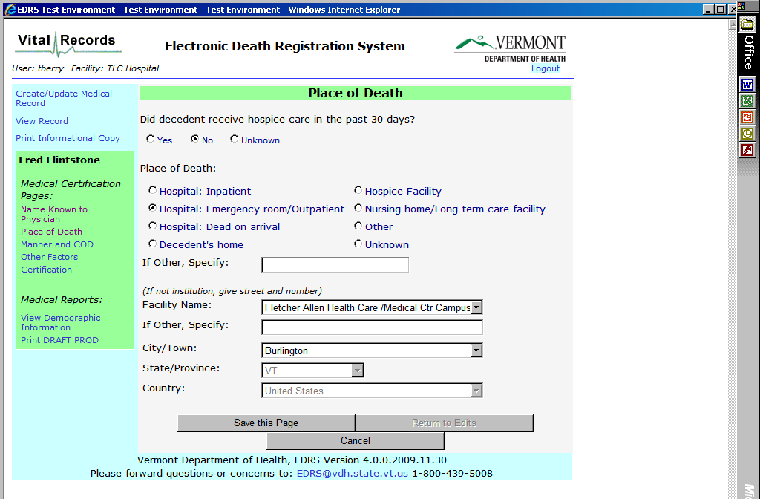
Hospital Mortality Encounter and Death Reporting
EHR FHIR
Server or
Services
Case id assigned in
EDRS
1.
2.
1.
Provider enters “pt expired order” and/ or changes pt demographic info to include a date of death
Provider completes discharge summary and/or discharge order in EHR
Create new or merge with existing
EDRS Screen
Patient
Dies In
Hospital
Time lag
2.
Display only
encounter.status = finished
EDRS case ID sent to EHR
patient.deceased=DateTime patient.deceased=true
Data Elements - Supplemental Death Report
Cause of Death (IF available) Significant Conditions Contributing to Death (If available) Autopsy performed? (If Available) Clinical notes (discharge summary) Health Concerns Problems Pt DOB Labs Procedures Vital signs Case ID (assigned in EDRS)
Fields prepopulate
Relevant clinical information is displayed from the EHR screen to the EDRS screen
Data Elements - Initial Inpatient Death Report
First Name Last Name Actual or Presumed Date/ Time of Death* Pronounced Dead Date/ Time * Place of Death* Previous Name Middle Name (incl Middle Initial) Suffix Death Pronouncement Performer | Birth Sex Date of Birth Race Ethnicity Preferred Language Current Address Previous Address Phone Number Phone Number Type Smoking status
*= Non-USCDI V1 data element but presumed
obtainable from EHR
trigger
EHR
EDRS

Slide 37
Considerations (MedMorph)
Needs a human review of mortality information before finalizing in the EDRS
Needs further investigation
Does it improve physicians' workflow efficiency?
Impact on data quality for cause of death determination?

Slide 38
USCDI and Death Certificate Data Elements
VRDR | Data Classes In USCDI | Data Elements in the Death Certificate and USCDI | Data Elements in the Death Certificate and not in USCDI
Decedent (US Core patient profile) Demographic Information | Patient demographics | First Name Last Name Previous Name Middle Name (incl Middle Initial) Suffix Birth Sex Date of Birth Race Ethnicity Preferred Language Current Address Previous Address Phone Number Phone Number Type | Age Birthplace Inside City Limits Ever in Armed Forces Marital Status at time of death Surviving Spouse’s Name Father’s Name Education Usual occupation

Slide 39
Death Certificate Date Elements not in USCDI
VRDR | Data Class/Element in USCDI? | Future additions to USCDI
Pregnancy | No | LOINC standard that would capture pregnancy (69442-2) to populate death certificate
Decedent (US Core patient profile) Demographic Information | Yes, Patient demographics | Birthplace Inside City Limits Ever in Armed Forces Marital Status at time of death Surviving Spouse’s Name Father’s Name Education Usual occupation
Date Pronounced Dead, Time Pronounced Dead, Actual or Presumed Date of Death, Actual or presumed time of Death, Cause of death (part I and II), Autopsy performed, Injury, Manner of death, Place of Death Did tobacco contribute to death | No | Include individual data elements listed OR Include new data element ‘Death Note’ under clinical notes in the USCDI. Robust clinical information related to the death may be captured in the discharge summary and the death note that can inform cause of death.

Slide 40
Information on Mortality Reporting
National Vital Statistics System (NVSS) Modernization –
Background information, blogs and stories, technical resources
https://www.cdc.gov/nchs/nvss/modernization.htm
https://www.cdc.gov/surveillance/projects/Modernizing-Death-Reporting.html
Vital Records Death Reporting FHIR Implementation Guide:
http://hl7.org/fhir/us/vrdr/

Slide 41
Discussion

Slide 42
Upcoming MedMorph Meetings
Next Full TEP Meeting
Tue 8/21/2020 @ 3-4pm ET / 2-3pm CT / 1-2pm MT / 12-1pm PT
Reference Architecture Workgroup (Weekly)
Wednesdays @ 1-2pm ET / 12-1pm CT / 11am-12pm MT / 10-11am PT
Consolidated Use Case Workgroups (Weekly)
Thursdays @ 12-1pm ET / 11-12 am CT / 10am-11 am MT / 9-10 am PT
Evaluation Workgroup
Thursdays @ 10 -11 am ET/ 9-10 am CT/ 8-9 am MT/ 7-8 am PT

Slide 43
Contacts
CDC Team
Maria Michaels: ktx2@cdc.gov
Wendy Blumenthal: wfb6@cdc.gov
Arun Srinivasan: fos2@cdc.gov
Syed Sameemuddin: puv5@cdc.gov
Aaron Harris: ieo9@cdc.gov
Brian Gugerty: vaz6@cdc.gov
Cynthia Bush: pdz1@cdc.gov
Shaoman Yin: wso3@cdc.gov
Laura Conn: lbk1@cdc.gov
TEP Co-Chairs
John Loonsk: john.loonsk@jhu.edu
Bill Lober: lober@uw.edu
Technical Leads
Nagesh “Dragon” Bashyam: nagesh.bashyam@drajer.com
Support Team
Becky Angeles: becky.angeles@carradora.com
Jamie Parker: jamie.parker@carradora.com
Kishore Bashyam: kishore.bashyam@drajer.com
Mike Flanigan: mike.flanigan@carradora.com
Technical SME
Brett Marquard: brett@waveoneassociates.com

Slide 44
Appendix A: MedMorph General Information

Slide 45
Making EHR Data More Available for Research and Public Health
Technical Expert Panel:
End Users, Data Recipients, Stakeholders – Including representatives of additional use cases
Foundation of standards supported by health IT certification (CCDS/USCDI, APIs, FHIR)
Fully Modeled Use Cases
Hepatitis C, Cancer, Healthcare Surveys
Fully Modeled Use Cases
Hepatitis C, Cancer, Healthcare Surveys
Implementation Guides
For general use and for each use case
Technological Strategies
To develop scalable and extensible architecture
Technological Strategies
To develop scalable and extensible application
Agile Development: Iterative Design-Build-Test Cycles (test case: Hepatitis C)
CCDS: Core Clinical Data Set
USCDI: US Core Data for Interoperability
APIs: Application Programming Interfaces
FHIR: Fast Healthcare Interoperability Resources
PRODUCTS: Reference Architecture, Reference Implementation
(Open Source Software) & Balloted Implementation Guides, Roadmap for Scalability and Sustainability
National Test Collaborative
Including a variety of clinical organizations and their EHR platforms
Software
Clinical organization
EHR platform
Other testing partners (e.g., public health departments, registries, health IT developers, etc.)
Evaluation Planning
Measure and Evaluate

Slide 46
Evaluation WG
Short-term evaluation: focused on Hep C pilot
Long-term evaluation: focused on broader impacts to research and public health

Slide 47
Appendix B: HL7 FHIR Resources

Slide 48
Helpful FHIR Links
FHIR Home Page & Summary:
https://hl7.org/fhir/
https://hl7.org/fhir/summary.html
FHIR Overview by user type:
General: https://www.hl7.org/fhir/overview.html
Developer: https://www.hl7.org/fhir/overview-dev.html
Clinical: https://www.hl7.org/fhir/overview-clinical.html
Architects: https://www.hl7.org/fhir/overview-arch.html
FHIR Implementation Guide Publishing: https://confluence.hl7.org/display/FHIR/IG+Publisher+Documentation
FHIR Implementation Guide Process Flow: https://confluence.hl7.org/display/FHIR/FHIR+Implementation+Guide+Process+Flow

