Slide 1
August 16th, 2022
Making EHR Data More Available for Research and Public Health (MedMorph)
Technical Expert Panel (TEP)
Co-Chairs:
Bill Lober
University of Washington
John Loonsk
Johns Hopkins University

Slide 2
MedMorph TEP Meeting Agenda – 08/16/2022
TOPIC |  | LEAD(S) | TIME (ET)
1 | Logistics & Welcome | Maria Michaels TEP Co-Chairs: Bill Lober, John Loonsk | 3:00 - 3:05
2 | Project At-a-Glance | Jamie Parker | 3:05-3:10
3 | HL7 Content IG Ballot Updates RA IG Update | Becky Angeles | 3:10 - 3:20
4 | Interactive Working Session: Roadmap Draft Review | Moderator: Maria Michaels All TEP Members | 3:20-3:50
5 | Next Steps: RA, Content IGs, Evaluation, RoadMap | Jamie Parker | 3:50 - 3:55
6 | Closing | Jamie Parker | 3:55 - 4:00

Slide 3
Project At-a-Glance
Jamie Parker

Slide 4
MedMorph Year 3 Timeline
...January 2022
March
May
July
August
September
October
Develop MedMorph Use Case Content IGs
Submit Use Case Content IG NIBs
Sept FHIR Connectathon
HL7 WGM
RA Ballot Disposition
Update RA IG and Republish
Submit Use Case Content IGs for Ballot
Disposition Content IGs Ballot Comments
Update Content IGs and Republish
Legend
HL7 Processes
Roadmap Development
MedMorph Project Activities
Real World Pilot Testing & Evaluation of the MedMorph RA IG
HL7 Event
MedMorph Event

Slide 5
HL7 MedMorph Reference Architecture and Content Implementation Guide Updates
Becky Angeles

Slide 6
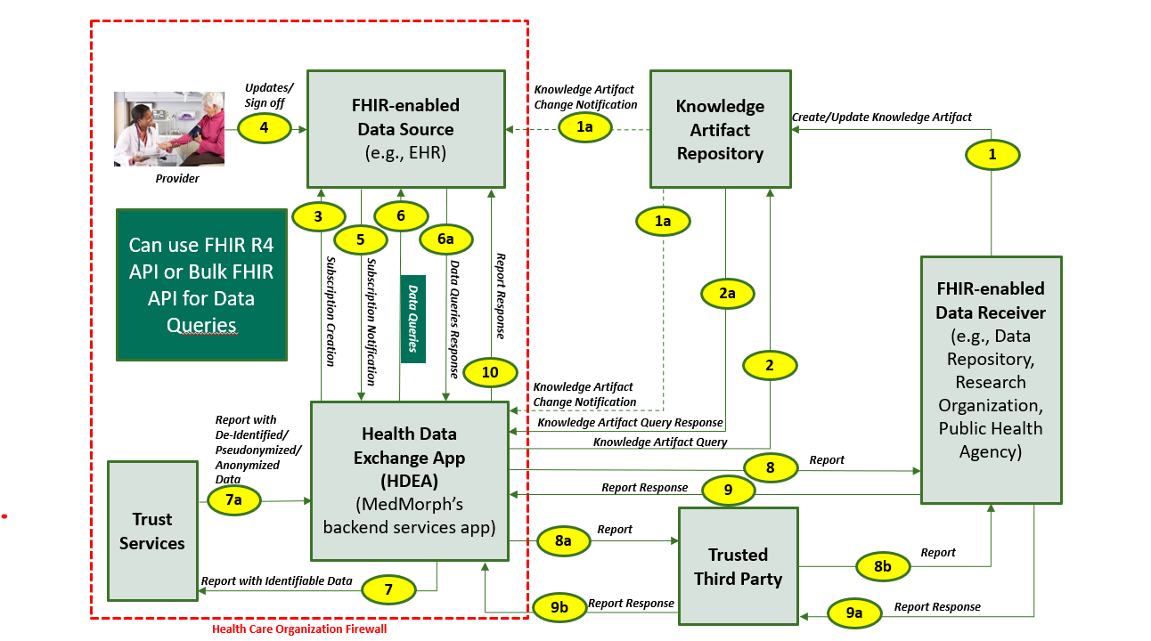
MedMorph Abstract Model of Actors and Systems - Updates
KEY FEATURE of MedMorph RA:
Architecture is decoupled from content
The abstract model of actors and systems is used to define the common workflows identified in the use cases, which include:
Provisioning
Notification
Data Collection and Submission Report Creation
Data Submission
Receiving Response/ Acknowledgement
Data Queries
http://hl7.org/fhir/us/medmorph/2022Jan/usecases.html

Slide 7
Reference Architecture IG Update
All Ballot Comments have been applied and the RA has gone through a beginning to end editorial review
We will be sending the RA IG out to the HL7 Public Health Workgroup and TEP for final review
RA WG Call - August 17th – Walkthrough of the RA IG
RA IG Publication Timeline
August 18th Send RA to TEP and HL7 PH WG for edits
August 24th Edits Due to MedMorph Team
August 24-25th make all edits
August 25th Submit to HL7 PH with Request for Publication
http://build.fhir.org/ig/HL7/fhir-medmorph/

Slide 8
MedMorph Content IGs
Artifact | Description | Balloted IG
Health Care Surveys Content Implementation Guide | Automated data extraction from inpatient and ambulatory EHRs or clinical data repositories. There are 2 user stories: Ambulatory and Inpatient/ED | http://hl7.org/fhir/us/health-care-surveys-reporting/2022Jan/index.html
Central Cancer Registry Reporting Implementation Guide | Transmit cancer case information to state Central Cancer Registries. There is 1 user story: Reporting based on specific criteria with an alternate flow to report on every encounter | https://hl7.org/fhir/us/central-cancer-registry-reporting/2022Jan/index.html
MedMorph Research Data Exchange | Data collection for research. There are 2 user stories: Onboarding a new data partner and Requesting data not regularly collected only user story 1: Onboarding was balloted | https://hl7.org/fhir/us/medmorph-research-dex/2022Jan/index.html
Hepatitis C Reporting | Reusing eCR FHIR IG | http://build.fhir.org/ig/HL7/case-reporting/ (continuous build site)

Slide 9
Content IG Ballot Results
Central Cancer Registry Reporting Content Implementation Guide
Voters - Total Eligible: 148
Affirmative: 29
Negative: 28
Abstain: 57
Approval Status: Not Passing (so far)
# of Comments: 60/44/32/23/9/0
Block Vote 1 (16 comments) – March 10
Block Vote 2 (12 comments) – April 14
Block Vote 3 (9 comments) – April 21
Block Vote 4 (14 comments) – May 19
Block Vote 5 (7 comments) – June 9
2 comments - June 23
Health Care Surveys Content Implementation Guide
Voters - Total Eligible: 136
Affirmative: 22
Negative: 25
Abstain: 60
Approval Status: Not Passing (so far)
# of Comments: 36/24/13/0
Block Vote 1 (12 comments) – March 31
Block Vote 2 (11 comments) – April 21
Block Vote 3 (12 comments) – June 9
1 comment – June 23
MedMorph Research Data Exchange Implementation Guide
Voters - Total Eligible: 149
Affirmative: 40
Negative: 22
Abstain: 57
Approval Status: Passing
# of Comments: 31/0
Block Vote 1 (28 comments) – June 9
3 comments - June 23
Need 35 Affirmative votes to get to 60% Approval (passing)
Need 27 Affirmative votes to get to 60% Approval (passing)

Slide 10
RoadMap Draft Review
Moderator: Maria Michaels
Participants: TEP Members

Slide 11
Project Next Steps
Jamie Parker

Slide 12
HL7 September 2022 Working Group Meeting
FHIR Connectathon
September 17-18
https://www.hl7.org/events/working_group_meeting/2022/09/
36th Annual Plenary and Working Group Meeting
September 19-23, 2022
Renaissance Harbor Place Hotel, Baltimore, MD
https://www.hl7.org/events/working_group_meeting/2022/09/
 | BEFORE AUGUST 26 |  | AFTER AUGUST 26
 | Member | Non-Member | Member | Non-Member
Sunday – Friday (includes Connectathon) | $965 | $1450 | $1255 | $1880
Monday – Friday (WG Meeting Only) | $810 | $1215 | $1100 | $1650
Connectathon: Participant | $450 | $550 | $595 | $695

Slide 13
MedMorph Next Steps
Reference Architecture Workgroup
Publish RA IG
Withdraw Negative Cancer and HCS Content Igs
Update Content IG with ballot dispositions
Publish Content IGs
Real World Pilot Testing
Continue piloting
Evaluation Workgroup
Finalize Roadmap
Finalize Project Roadmap
Completion slated for Early September
Requesting TEP review on the draft distributed on Aug 15, 2022
Participate and monitor the HL7 Helios project (FHIR Accelerator for Public Health)
Participate in the September 2022 HL7 Workgroup Meeting (Sept 17th -23rd)

Slide 14
Closing
Jamie Parker

Slide 15
Upcoming MedMorph Meetings
Next Full TEP Meeting
September TEP meeting will be cancelled due to HL7 Sept WGM
Final Full TEP meeting of the first phase of MedMorph will be Oct 18, 2022
Reference Architecture Workgroup (as needed)
Wednesdays @ 1-2pm ET / 12-1pm CT / 11am-12pm MT / 10-11am PT
HL7 Public Health WG Meetings (Weekly)
Where MedMorph formally presents edited RA, and Content IGs as well as Requests for Publication
Thursdays @ 4-5 pm ET/ 3-4 pm CT/ 2-3 pm MT/ 1-2 pm PT
https://confluence.hl7.org/pages/viewpage.action?pageId=4489402
Helios
Mondays from 12-1 pm ET: Bulk Data
Mondays from 2-3 pm ET: Aggregate Data
Wednesdays from 2-3 pm ET: Align and Optimize
To add these invites and the call-in details to your calendar, you need to be subscribed to the Helios Listserv: http://www.hl7.org/myhl7/managelistservs.cfm?ref=common (Helios)
FHIR Connectathon
September 17-18
https://www.hl7.org/events/working_group_meeting/2022/09/
36th Annual Plenary and Working Group Meeting
September 19-23, 2022
https://www.hl7.org/events/working_group_meeting/2022/09/

Slide 16
Contacts
CDC Team
Maria Michaels: ktx2@cdc.gov
Brian Gugerty: vaz6@cdc.gov
Cynthia Bush: pdz1@cdc.gov
Kasey Diebold: ykl4@cdc.gov
Sandy Jones: sft1@cdc.gov
Keydra Oladapo: cou5@cdc.gov
TEP Co-Chairs
John Loonsk: john.loonsk@jhu.edu
Bill Lober: lober@uw.edu
Technical Lead
Nagesh “Dragon” Bashyam: nagesh.bashyam@drajer.com
Support Team
Becky Angeles: becky.angeles@carradora.com
Jamie Parker: jamie.parker@carradora.com
Mike Flanigan: mike.flanigan@carradora.com
Technical SME
Brett Marquard: brett@waveoneassociates.com

Slide 17
MedMorph Resources
MedMorph Description: https://www.cdc.gov/csels/phio/making_rapid_data_exchange_reality.html
MedMorph Reference Architecture IG: http://hl7.org/fhir/us/medmorph/2022Jan/
Content IGs
Healthcare Surveys Reporting: https://build.fhir.org/ig/HL7/fhir-health-care-surveys-reporting-ig/index.html
Central Cancer Registry Reporting: https://build.fhir.org/ig/HL7/fhir-central-cancer-registry-reporting-ig/index.html
Research Data Exchange: http://build.fhir.org/ig/HL7/fhir-medmorph-research-dex-ig/branches/master/index.html
Hep C (eCR FHIR IG): http://hl7.org/fhir/us/ecr/
GitHub: https://github.com/HL7/fhir-medmorph NOTE: You may need to be logged in to GitHub

Slide 18
Appendix A: MedMorph General Information

Slide 19
Making EHR Data More Available for Research and Public Health (MedMorph) - Background
Funded by the Patient-Centered Outcomes Research Trust Fund (PCORTF) via the U.S. Department of Health and Human Services (HHS) Assistant Secretary for Planning and Evaluation (ASPE)
Total project timeline: 3 years
PROBLEM: Patient-centered outcomes researchers and public health professionals need better ways to get data from different electronic health record (EHR) systems without posing additional burden on health care providers
GOAL: Create a reliable, scalable, generalizable, configurable, interoperable method to get EHR data for multiple public health and research use cases
OBJECTIVE: Develop a reference architecture and demonstrate a reference implementation (including implementation guides)
https://www.cdc.gov/csels/phio/making-ehr-data-more-available.html
Notes:
https://aspe.hhs.gov/making-electronic-health-record-ehr-data-more-available-research-and-public-health

Slide 20
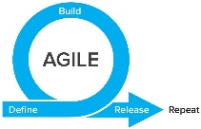
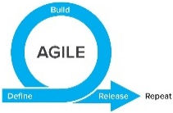
TIME
WE ARE HERE
SMEs: Hepatitis C
Research
Research
MedMorph Workgroups
Technical Experts
SMEs: Hepatitis C
Use Cases
(Public Health & Research)
Technical Experts
SMEs: Cancer
Use Case WG
SMEs: Cancer
Technical Experts
Technical Experts
SMEs: Health Care Surveys
SMEs: Health Care Surveys
Technical Experts
Technical Experts
Evaluation
WG
Evaluation Planning
Evaluation
Roadmap
Data Flows & Clinical Workflows
Reference Architecture/Authorities/Policies
SMEs: All use cases
SMEs: All use cases
Technical
Requirements
Reference Architecture WG
Data Flows & Clinical Workflows
Data Standards
SMEs: All use cases
SMEs: All use cases
Data Standards
Reference Architecture/Authorities/Policies
SMEs: All use cases
SMEs: All use cases
Notes:
Began with one workgroup per use case to be modeled for public health purposes (i.e., Hepatitis C Reporting, Cancer Reporting, Health Care Surveys), which included SMEs from other use cases as well, and across all use cases for a “Research Use Case”.
Switched to technical workgroups to identify Data Flows & Clinical Workflows, Data Standards, and Reference Architecture/Authorities/Policies based on the use case requirements drafted. Each of the technical workgroups had a mix of use case SMEs.
Eventually combined use case workgroups into one consolidated use case workgroup in order to better identify commonalities and differences. This workgroup will take the lead on defining requirements for content implementation guides (IGs), where applicable.
When each use case defined its requirements and then further identified commonalities and differences, a consolidated “Reference Architecture (RA)” WG focuses on technical requirements for the RA IG, and eventually the use case content IGs, where applicable. There may be iteration between the use case WG and RA WG, in agile fashion.
An evaluation workgroup works in parallel to the use case and RA WGs to develop short-term and long-term evaluation plans. The short-term evaluation plan will be part of the real-world pilots, and the long-term evaluation plan will be part of the roadmap (i.e., long-term evaluation is beyond the current scope of MedMorph, which is a time-limited PCORTF project).
Initial testing occurred in sandbox environments and then will be moving to real-world pilots.

Slide 21
The Data Lifecycle & Impacts to the Public’s Health
Guidelines
Recommendations
Guidance
Public Health Policies or
Mandates
Point of Care
Emergency Response
Public Health Departments
Community Services
Delivering actionable knowledge
ACTION
HEALTH
IMPACTS &
OUTCOMES
KNOWLEDGE
UPDATING
SCIENTIFIC
EVIDENCE
Fast Healthcare Interoperability Resources (FHIR®)
INFORMATION
DATA
Analyzing data to advance evidence
EHRs
Registries
Public Health Info Systems
Community Info Systems
…many potential sources
Data Science Analytics
Data Linkages
Data Visualization
Notes:
Structuring recommendations and using standards-based shareable CDS ultimately helps the data lifecycle. Computable guidelines (recommendations, guidance, etc.) help apply the evidence in practice more consistently since they are translated from the source of truth. Data resulting from the actions taken in practice would be more easily extracted to perform analyses that lead to information that can be incorporated into the knowledge that gets translated to practice… and the cycle begins anew. FHIR can help facilitate the data lifecycle by providing an interoperability standard for data exchange on its own or in partnership with existing widely used standards.
Data to Action patient-generated examples:
Patient takes a walk, pedometer records data that can be uploaded to patient’s chart
Patient uses CPAP, machine records sleep-related data, data is accessed remotely

Slide 22
Technical Expert Panel (TEP): Participating Partner Groups
Federal Partners
Health IT developers
Clinicians/ Healthcare Organizations
Medical Societies
Public Health Organizations
Evaluation experts
Laboratory Professional Groups
Standards experts
Clinical decision support developers
Clinical quality measure developers
Policy or technical support for implementation

Slide 23
Technical Expert Panel:
End Users, Data Recipients, Stakeholders – Including representatives of additional use cases
Foundation of standards supported by health IT certification (CCDS/USCDI, APIs, FHIR)
Fully Modeled Use Cases
Hepatitis C, Cancer, Healthcare Surveys
Fully Modeled Use Cases
Hepatitis C, Cancer, Healthcare Surveys
Implementation Guides
For general use and for each use case
Technological Strategies
To develop scalable and extensible architecture
Technological Strategies
To develop scalable and extensible application
Agile Development: Iterative Design-Build-Test Cycles (test case: Hepatitis C)
CCDS: Core Clinical Data Set
USCDI: US Core Data for Interoperability
APIs: Application Programming Interfaces
FHIR: Fast Healthcare Interoperability Resources
PRODUCTS: Reference Architecture, Reference Implementation
(Open Source Software) & Balloted Implementation Guides, Roadmap for Scalability and Sustainability
National Test Collaborative
Including a variety of clinical organizations and their EHR platforms
Software
Clinical organization
EHR platform
Other testing partners (e.g., public health departments, registries, health IT developers, etc.)
Evaluation Planning
Measure and Evaluate

Slide 24
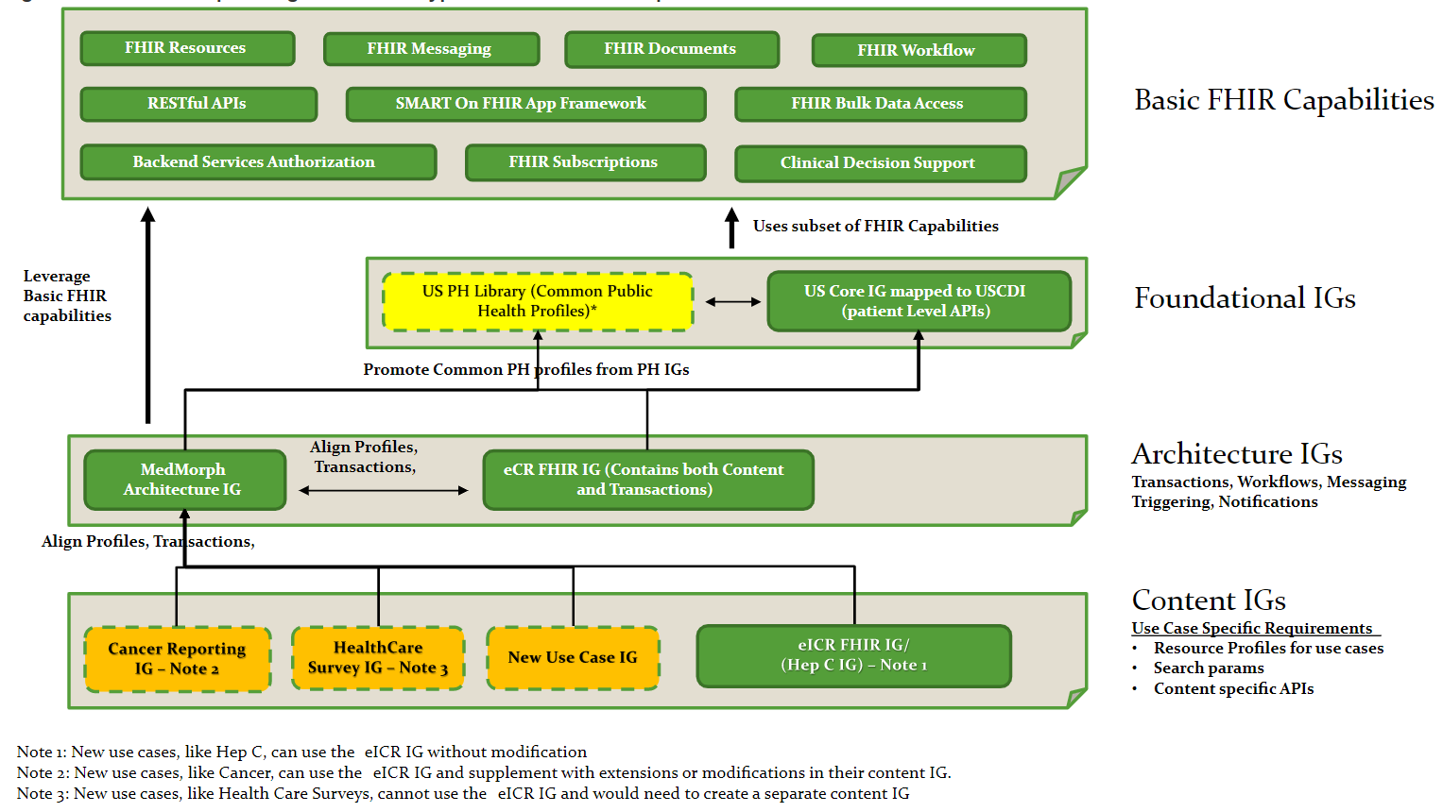
Relationship among Different IG Types and Basic FHIR Capabilities
http://hl7.org/fhir/us/medmorph/2022Jan/background.html

Slide 25
Appendix B: HL7 FHIR Resources

Slide 26
Helpful FHIR Links
FHIR Home Page & Summary:
https://hl7.org/fhir/
https://hl7.org/fhir/summary.html
FHIR Overview by user type:
General: https://www.hl7.org/fhir/overview.html
Developer: https://www.hl7.org/fhir/overview-dev.html
Clinical: https://www.hl7.org/fhir/overview-clinical.html
Architects: https://www.hl7.org/fhir/overview-arch.html
FHIR Implementation Guide Publishing: https://confluence.hl7.org/display/FHIR/IG+Publisher+Documentation
FHIR Implementation Guide Process Flow: https://confluence.hl7.org/display/FHIR/FHIR+Implementation+Guide+Process+Flow

Slide 27
Slides to be Deleted

Slide 28
Pilots & Alignments In Progress (1)
Central Cancer Registry Reporting – pilot (IG already developed)
Health Care Surveys – pilot (IG already developed)
Influenza Hospitalization Surveillance – IG development and pilot
Vital Statistics: Birth Reporting IG – alignment with MedMorph RA
HRSA Uniform Data System (UDS) Reporting from FQHCs – IG development and pilot
NOTE: There is interest from the international community in moving MedMorph to Universal Realm (it is currently US Realm)

Slide 29
Pilots & Alignments In Progress (2)
Discussions started:
CMS Quality Reporting
Vulcan: Real World Data, FHIR to OMOP, Adverse Events, Phenopackets
CIC WG: “Registry of Registries” – alignment to MedMorph RA
LHS WG” “Project of Projects” – bringing together existing IGs, accelerators, projects, and other efforts to help show how they can fit together to support the learning health system
NLM: ClinicalTrials.gov
FDA: SHIELD
CDC/FDA/ONC: Patient-Generated Health Data (from consumer medical devices)
NIDDK/AHRQ: Shared eCare Plans

Slide 30
The Future of the MedMorph Reference Architecture in Supporting Public Health & Beyond
Potential Additional Data Sources
Health Information Exchanges (HIEs)
Registries (e.g., immunization)
eCare Plans
Lab/Pharmacy/Radiology Systems
Electronic Birth Registration Systems (EBRS)
Patient-generated health data from consumer medical devices
ClinicalTrials.gov (NLM)
Non-EHR hospital systems
Potential Additional Data Repositories
CDC Data Lake/ Enterprise Data Analytics and Visualization (EDAV)
Health Information Exchanges (HIEs)
Registries
eCare Plans
EBRS
HRSA Uniform Data System (UDS)
CMS Quality Reporting Systems
ClinicalTrials.gov (NLM)
Additional Research Networks
Potential Ways to Leverage Distributed Knowledge via the Knowledge Artifact Repository
Any use case that needs broad sharing and updating of trigger codes, value sets, rules, etc. for reporting or knowledge sharing (e.g., multiple public health programs, quality measurement, research, etc.)

Slide 31
Pilot Update
Maria Michaels

Slide 32
Real-World Pilot #1: Chronic Hepatitis C Surveillance
Pilot Objectives:
Apply RA IG in real-world setting to continue learnings from HL7® FHIR® Connectathons
Demonstrate RA IG can facilitate data exchange using FHIR® across multiple EHR platforms and can be used by different types of health care organizations
Evaluate quantitative (e.g., completeness, timeliness, accuracy) and qualitative (e.g., perceptions of using an approach like MedMorph before and after implementation, organizational buy-in) aspects of the pilot
Pilot Design:
Data senders
Different clinical site types (e.g., academic medical center, FQHC, specialty clinic) on three different EHR platforms – Currently recruiting clinical sites / EHR vendors
Data receivers
Public Health Agency – New York City Department of Health and Mental Hygiene
Research Organization – Westat
Content:
Uses the electronic initial case report (eICR) data as described in the eCR FHIR® IG

