Slide 1
August 18th, 2020
Making EHR Data More Available for Research and Public Health (MedMorph)
Technical Expert Panel (TEP)
Co-Chairs:
Bill Lober
University of Washington
John Loonsk
Johns Hopkins University

Slide 2
MedMorph TEP Meeting – 08/18/2020
TOPIC |  | LEAD(S) | TIME (ET)
1 | Roll Call & Welcome | Maria Michaels TEP Co-Chairs: Bill Lober John Loonsk | 3:00 - 3:05
2 | The Next Phase of Electronic Birth Defect Reporting (BDR) | Craig Newman Altarum craig.newman@altarum.org | 3:10 - 3:30
3 | Discussion | Entire TEP | 3:30-3:40
4 | HL7 and MedMorph Project Update Connectathon Participation | Nagesh Bashyam, Jamie Parker | 3:40-3:50
5 | Questions, Next Steps Next Meeting – Tentative September 16th during RA WG time | Bill Lober John Loonsk MedMorph Project Team | 3:50 - 4:00
Notes:
Roll Call & Welcome
The Next Phase of Electronic Birth Defect Reporting (BDR)
Discussion
HL7 and MedMorph Project Update
Connectathon Participation
Questions, Next Steps
Next Meeting – Tentative September 16th during RA WG time

Slide 3
The Next Phase of Electronic Birth Defect Reporting (BDR)
Craig Newman

Slide 4
The Next Phase of Electronic Birth Defect Reporting (BDR)
MedMorph TEP - August 18, 2020

Slide 5
The Need for Birth Defect Reporting
Most jurisdictions in the US have a birth defect registry but little data is being exchanged electronically
Electronic data exchange:
Reduces burden
Improves turnaround times
Enhances data quality
Electronic data exchange works best when the community coalesces around a common set of standards
Collected data is critical for providing services to the subject and family
Notes:
In the absence of widely adopted interoperability standards in this domain, reporting complete and accurate information to public health registries has been time consuming, slow and subject to error and other difficulties. This leads to missed cases and undercounting of many conditions. Incomplete reporting of birth defect conditions can slow down progress in measuring the prevalence and impact of these conditions, complicate finding the underlying etiology and delay the development of primary and secondary prevention and intervention strategies. A standardized method will allow more efficient and accurate transmission of birth defects information while reducing the burden on providers, implementers/developers and public health programs.

Slide 6
The Goals for Birth Defect Reporting
Increase the volume of electronic reporting of birth defects both at the time of birth and later in life
Decrease the burden on providers and jurisdictional program staff when collecting data on subjects
Harmonize standards with those use for other vital records reporting standards, most specifically those for birth and fetal death reporting
Notes:
In the absence of widely adopted interoperability standards in this domain, reporting complete and accurate information to public health registries has been time consuming, slow and subject to error and other difficulties. This leads to missed cases and undercounting of many conditions. Incomplete reporting of birth defect conditions can slow down progress in measuring the prevalence and impact of these conditions, complicate finding the underlying etiology and delay the development of primary and secondary prevention and intervention strategies. A standardized method will allow more efficient and accurate transmission of birth defects information while reducing the burden on providers, implementers/developers and public health programs.

Slide 7
Existing Workflows
Most state programs work in either an active or passive mode
Active – the program receives a list of potential subjects and abstracts data from the EHR to the Birth Defect Reporting System (BDRS)
Passive – provider submit data to the program (often as a flat file (CSV)) which is imported to the BDRS
Hybrid – a passive report is submitted followed by active follow up (abstracting)
All methods require substantial work by one party or the other (or both)

Slide 8
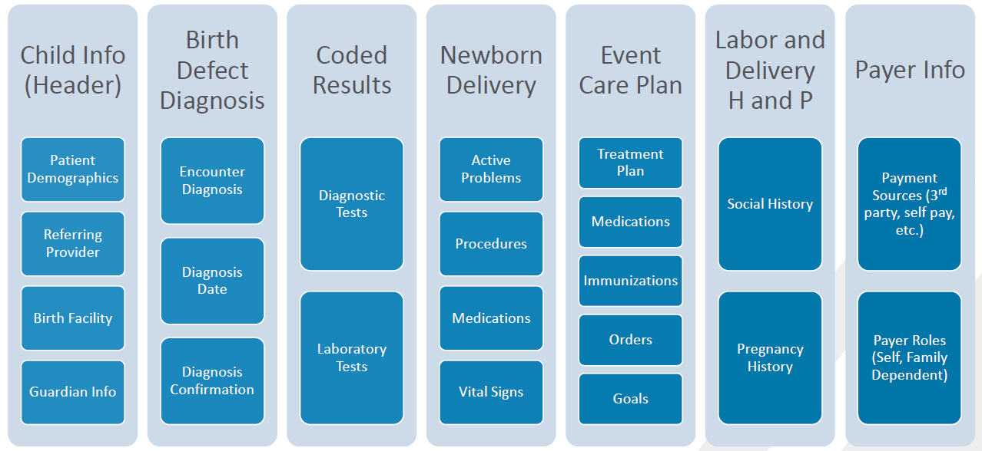
The Need for Birth Defect Reporting
Altarum has worked with the NBDPN and jurisdictional programs to establish a set of core reporting data elements

Slide 9
Evolving Birth Defect Reporting
The CDA birth defect reporting IG for ambulatory and hospital reporting is available for use but has not been widely implemented
Other domains in Public Health are beginning to use FHIR
Case Reporting
Vital Records Reporting
SDoH and Referrals
Some organizations are waiting for FHIR specifications to be available before they begin to implement a solution

Slide 10
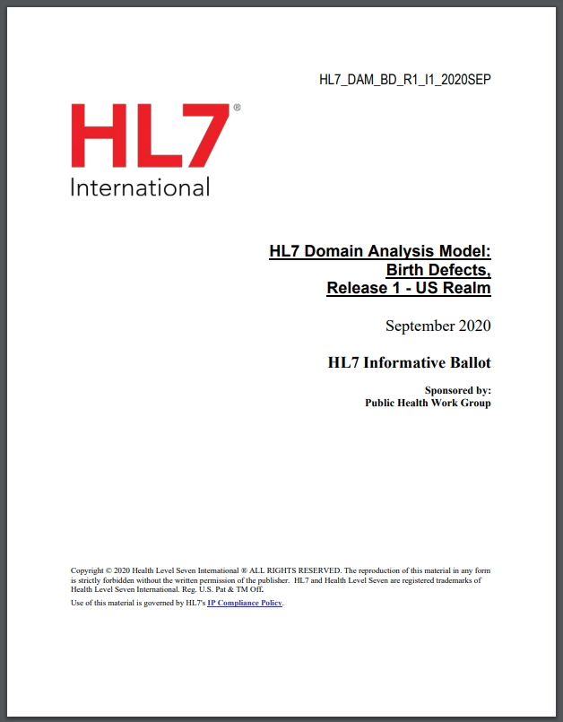
Domain Analysis Model
We have developed a Domain Analysis Model (DAM) which is being balloted through HL7
Began with the existing analysis of data requirements from the CDA implementation guide
The DAM builds off of (and references) the existing Vital Records DAM

Slide 11
FHIR Implementation Guide
We are developing a birth defect reporting (BDR) FHIR IG defining a set of profiles to exchange a subset of the clinical and demographics content in the DAM
Use case scenarios including:
Reporting from an ambulatory clinic or outpatient facility (non-birthing)
Reporting from a birthing facility
Reporting for non-live births (depending on local requirements)
Includes significant overlap with birth certification and fetal death reporting
Work includes a set of common, reusable profiles

Slide 12
FHIR Implementation Guide
FHIR offers many different ways to exchange data (RESTful, messaging transactions, SMART apps, queries, subscriptions, structured data capture, etc)
http://build.fhir.org/ig/HL7/davinci-ehrx/exchanging.html
We are focusing on messaging for the initial IG
This is inline with eCR workflows (which we think matches our basic workflow quite well)
The receiving system needs latitude in data persistence
Reports may be coming form multiple sources, an individual may have multiple conditions

Slide 13
BDR and MedMorph
We think BDR fits well with the evolving MedMorph Reference Architecture
We’ve documented the BDR use case in the MedMorph template

Slide 14
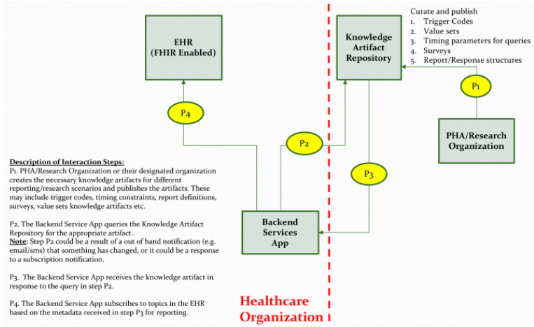
Provisioning (Knowledge Artifacts)
There is expected to be jurisdictional variation in the trigger process
Related (but potentially different) reportable conditions
Variation in other parameters such as patient age (up to 1 year of age in Texas but 12 years in Michigan)
May be some local variation in report content (although we hope the IG will provide a superset of all content – eventually)

Slide 15
Notification Workflow
Triggering is expected to be based on workflow action of the provider in the EHR (documenting a birth defect)
Likely to be similar to eCR and other MedMorph use case triggering events (albeit with a more limited scope)
“close encounter” may be less of a concern to BDR

Slide 16
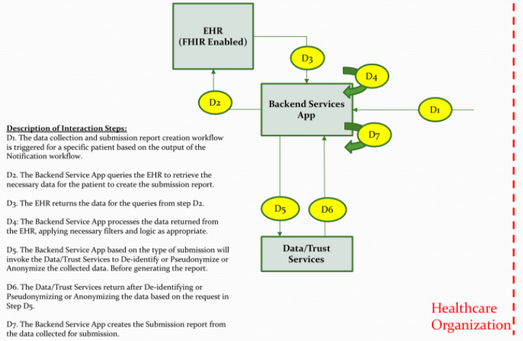
Data Collection and Report Creation
Much of the necessary data is contained within Patient, RelatedPerson and Condition resources
The IG does include a large number Observations (primarily about the pregnancy and delivery)
We have concern about how many of these Observations are actually documented/available in the EHR
List of example Observations
Notes:
The Mother’s information is very important

Slide 17
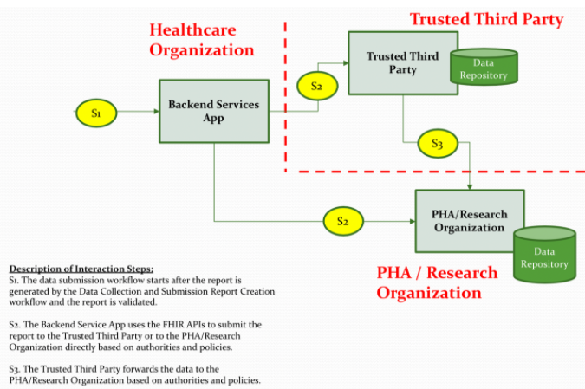
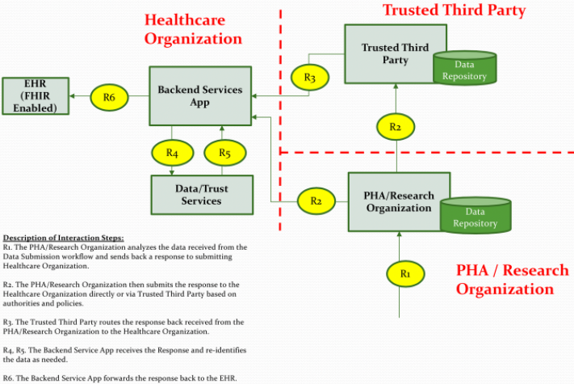
Submission/ Acknowledgement
At this point, submission is one way (Provider to PHA)
There is no response message in scope (could change in the future)
There is not currently any regular reporting from the jurisdictional to national level

Slide 18
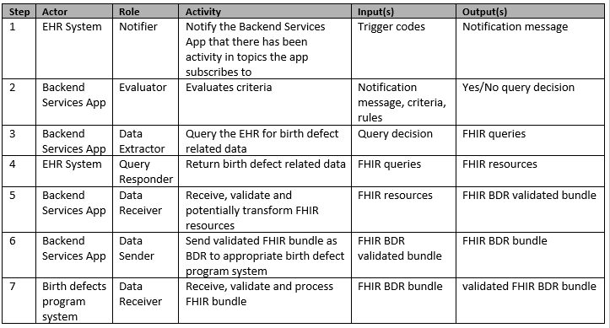
Main Flow

Slide 19
Importance of MedMorph
To date, there hasn’t been wild enthusiasm from EHR vendors to implement any electronic BDR
We hope that the MedMorph Reference Architecture can help make data more accessible
The Birth Defect community is unlikely to be able to develop and support their own knowledge artifact repositories and back end services app
From our point of view, it is CRITICAL that MedMorph (or some related program) provide the infrastructure to support the RA

Slide 20
Questions?
Craig Newman
craig.newman@altarum.org

Slide 21
Discussion

Slide 22
HL7 and Project Update
Nagesh Bashyam
Jamie Parker

Slide 23
Timeline: MedMorph Activities & IG Balloting
March
April
May
June
July
August
September
October
November
December
January 2021
HL7 PSS Submitted
MedMorph Use Case Development
End to End Use Case Review
HL7 Notice for Intent to Ballot Due
Finalize Use Cases
HL7 RA FHIR IG submitted
Prepare HL7 Reference Architecture (RA) FHIR IG
Legend
HL7 Working Group Meeting
HL7 Processes
HL7 Sept 2020 FHIR Connectathon
MedMorph Project Activities

Slide 24
MedMorph: Deliverables and Artifacts
Artifact | Location | Use
Reference Architecture Confluence Page | https://carradora.atlassian.net/wiki/spaces/MedMorph/pages/545914881/Reference+Architecture+Document | Content will feed into the RA HL7 FHIR Ballot
Health Care Survey Use Case Confluence Page | https://carradora.atlassian.net/wiki/spaces/MedMorph/pages/692060180/Health+Care+Survey+Use+Case+-+DRAFT | User story should be supported by the RA
Hepatitis C Use Case Confluence Page | https://carradora.atlassian.net/wiki/spaces/MedMorph/pages/694452251/Hepatitis+C+Use+Case+-+DRAFT | User story should be supported by the RA
Cancer Use Case Confluence Page | https://carradora.atlassian.net/wiki/spaces/MedMorph/pages/699990019/Cancer+Use+Case+-+DRAFT | User story should be supported by the RA

Slide 25
HL7: Deliverables and Artifacts
Date | Artifact | Status
February 20, 2020 | Draft PSS Presented to the HL7 Supporting WG | Completed
February 21, 2020 | Submit PSS Scope Statement for September 2020 Ballot Cycle | Completed https://confluence.hl7.org/display/PHWG/Making+EHR+Data+More+Available+for+Research+and+Public+Health+%28MedMorph%29+Reference+Architecture+HL7+FHIR+Implementation+Guide
April 19, 2020 | HL7 Steering Division Approval | Completed, PSS Approved
July 21st | Connectathon Proposal
September 9th-11th | HL7 FHIR Connectathon – Virtual (https://www.hl7.org/events/fhir/connectathon/2020/09/
September 21st-25th, 2020 | HL7 Workgroup Meeting – Virtual https://www.hl7.org/events/working_group_meeting/2020/09/index.cfm?utm_source=HL7+Members+Verified+Oct+2019+Large+List&utm_campaign=1c006492ee-EMAIL_CAMPAIGN_2018_01_29_COPY_01&utm_medium=email&utm_term=0_06eea0748f-1c006492ee-55792321
Submit FHIR IG Proposal | October 18th
Submit Notice For Intent to Ballot | November 1st
Substantive IG complete | November 1st
Ballot Due | November 24th
Ballot opens for voting | December 13th
January HL7 Connectathon | January 16-17, 2021
January HL7 WG Meeting | January 18-22, 2021
https://confluence.hl7.org/display/HL7/HL7+Calendars#a024f57c-d5fc-4f39-8b26-bf9f1e280100-35717172

Slide 26
Participating in the HL7 Connectathon
Looking for participants to join us in the HL7 Connectathon
Connectathon – September 9-11
Registration: https://www.hl7.org/events/fhir/connectathon/2020/09/
Member $150, Non-Member $250
Part of the Public Health Track: https://confluence.hl7.org/display/FHIR/2020-09+Public+Health+Track

Slide 27
Upcoming MedMorph Meetings
Next Full TEP Meeting
Potential: Wednesday September 16th during the RA WG meeting time 1-2pm ET / 12-1pm CT / 11am-12pm MT / 10-11am PT
Reference Architecture Workgroup (Weekly)
Wednesdays @ 1-2pm ET / 12-1pm CT / 11am-12pm MT / 10-11am PT
Consolidated Use Case Workgroups (Weekly)
Thursdays @ 12-1pm ET / 11-12 am CT / 10am-11 am MT / 9-10 am PT
Evaluation Workgroup
Thursdays @ 10 -11 am ET/ 9-10 am CT/ 8-9 am MT/ 7-8 am PT

Slide 28
Contacts
CDC Team
Maria Michaels: ktx2@cdc.gov
Wendy Blumenthal: wfb6@cdc.gov
Arun Srinivasan: fos2@cdc.gov
Syed Sameemuddin: puv5@cdc.gov
Aaron Harris: ieo9@cdc.gov
Brian Gugerty: vaz6@cdc.gov
Cynthia Bush: pdz1@cdc.gov
Aaron Harris: ieo9@cdc.gov
TEP Co-Chairs
John Loonsk: john.loonsk@jhu.edu
Bill Lober: lober@uw.edu
Technical Leads
Nagesh “Dragon” Bashyam: nagesh.bashyam@drajer.com
Support Team
Becky Angeles: becky.angeles@carradora.com
Jamie Parker: jamie.parker@carradora.com
Kishore Bashyam: kishore.bashyam@drajer.com
Mike Flanigan: mike.flanigan@carradora.com
Technical SME
Brett Marquard: brett@waveoneassociates.com

Slide 29
Appendix A: MedMorph General Information

Slide 30
Making EHR Data More Available for Research and Public Health
Technical Expert Panel:
End Users, Data Recipients, Stakeholders – Including representatives of additional use cases
Foundation of standards supported by health IT certification (CCDS/USCDI, APIs, FHIR)
Fully Modeled Use Cases
Hepatitis C, Cancer, Healthcare Surveys
Fully Modeled Use Cases
Hepatitis C, Cancer, Healthcare Surveys
Implementation Guides
For general use and for each use case
Technological Strategies
To develop scalable and extensible architecture
Technological Strategies
To develop scalable and extensible application
Agile Development: Iterative Design-Build-Test Cycles (test case: Hepatitis C)
CCDS: Core Clinical Data Set
USCDI: US Core Data for Interoperability
APIs: Application Programming Interfaces
FHIR: Fast Healthcare Interoperability Resources
PRODUCTS: Reference Architecture, Reference Implementation
(Open Source Software) & Balloted Implementation Guides, Roadmap for Scalability and Sustainability
National Test Collaborative
Including a variety of clinical organizations and their EHR platforms
Software
Clinical organization
EHR platform
Other testing partners (e.g., public health departments, registries, health IT developers, etc.)
Evaluation Planning
Measure and Evaluate

Slide 31
Evaluation WG
Short-term evaluation: focused on Hep C pilot
Long-term evaluation: focused on broader impacts to research and public health

Slide 32
Appendix B: HL7 FHIR Resources

Slide 33
Helpful FHIR Links
FHIR Home Page & Summary:
https://hl7.org/fhir/
https://hl7.org/fhir/summary.html
FHIR Overview by user type:
General: https://www.hl7.org/fhir/overview.html
Developer: https://www.hl7.org/fhir/overview-dev.html
Clinical: https://www.hl7.org/fhir/overview-clinical.html
Architects: https://www.hl7.org/fhir/overview-arch.html
FHIR Implementation Guide Publishing: https://confluence.hl7.org/display/FHIR/IG+Publisher+Documentation
FHIR Implementation Guide Process Flow: https://confluence.hl7.org/display/FHIR/FHIR+Implementation+Guide+Process+Flow

