Slide 1
October 18th, 2022
Making Electronic Data More Available for Research and Public Health (MedMorph)
Technical Expert Panel (TEP)
Co-Chairs:
Bill Lober
University of Washington
John Loonsk
Johns Hopkins University

Slide 2
MedMorph TEP Meeting Agenda – 10/18/2022
TOPIC |  | LEAD(S) | TIME (ET)
1 | Logistics & Welcome | Maria Michaels TEP Co-Chairs: Bill Lober, John Loonsk | 3:00 - 3:05
2 | Project At-a-Glance | Jamie Parker | 3:05-3:10
3 | USCDI update | Becky Angeles | 3:10-3:15
4 | HL7 Updates Workgroup Meeting Reference Architecture IG Content IG Ballot | Becky Angeles | 3:15 - 3:30
5 | Next Steps | Maria Michaels | 3:30 – 3:45
6 | Questions/Discussion | ALL | 3:45 – 4:00
Notes:
Logistics & Welcome
Project At-a-Glance
USCDI update
HL7 Updates
Workgroup Meeting
Reference Architecture IG
Content IG Ballot
Next Steps
Questions/Discussion

Slide 3
Project At-a-Glance
Jamie Parker

Slide 4
MedMorph Year 3 Timeline
...January 2022
March
May
July
August
September
October
Develop MedMorph Use Case Content IGs
Submit Use Case Content IG NIBs
Sept FHIR Connectathon
HL7 WGM
RA Ballot Disposition
Update RA IG and Republish
Submit Use Case Content IGs for Ballot
Disposition Content IGs Ballot Comments
Update Content IGs and Republish
Legend
HL7 Processes
Roadmap Development
MedMorph Project Activities
HL7 Event
Real World Pilot Testing & Evaluation of the MedMorph RA IG
MedMorph Event

Slide 5
MedMorph Abstract Model of Actors and Systems - Updates
Data Source
(e.g., EHR, HIE)
Organization Hosting KAR
Updates/Sign off
Knowledge Artifact
Change Notification
Knowledge Artifact Repository (KAR)
KEY FEATURE of MedMorph RA:
Architecture is decoupled from content
Provider
Can use FHIR R4 API or Bulk FHIR API for Data Queries
Create/Update Knowledge Artifact
Subscription Creation
Report Response
Data Queries
Subscription Notification
Data Queries Response
The abstract model of actors and systems is used to define the common workflows identified in the use cases, which include:
Provisioning
Notification
Data Collection and Submission Report Creation
Data Submission
Receiving Response/ Acknowledgement
Report with
De-Identified/ Pseudonymized/ Anonymized
Data
Knowledge Artifact
Change Notification
Data Receiver (e.g., Public Health Agency, Research Organization)
Trust Service Provider
Health Data
Exchange App
(HDEA)
(MedMorph’s backend services app)
Knowledge Artifact Query Response
Knowledge Artifact Query
Report
Report with Identifiable Data
Report Response
Report
Intermediaries/ Trusted Third Party
Report
Report Response
Populate Local Data Mart with Data Extracted from Data Source
Acknowledgement
Report Response
Report Response
Local Data Mart
Report
Data Receiver Organization
Data Source Organization
TTP Hosted Data Mart
Trusted Third Party
V1 of MedMorph RA IG will publish soon – http://build.fhir.org/ig/HL7/fhir-medmorph/usecases.html#interactions-between-medmorph-actors-and-systems

Slide 6
MedMorph Implementation Guides (so far)
Content IG | Description
Health Care Surveys Content Implementation Guide | Automated data extraction from inpatient and ambulatory EHRs or clinical data repositories. There are 2 user stories: Ambulatory and Inpatient/ED
Central Cancer Registry Reporting Content Implementation Guide | Transmit cancer case information to state Central Cancer Registries. There is 1 user story: Reporting based on specific criteria with an alternate flow to report on every encounter
MedMorph Research Data Exchange Content Implementation Guide | Data collection for research. There are 2 user stories: Onboarding a new data partner and requesting data not regularly collected only user story 1: Onboarding was balloted
Hepatitis C Reporting | Reusing eCR FHIR IG
Reference Architecture | Description
MedMorph Reference Architecture Implementation Guide | A common framework (e.g., actors, systems, FHIR resources, FHIR APIs, FHIR operations, security mechanisms) leveraged by multiple use cases.

Slide 7
USCDI
Becky Angeles

Slide 8
USCDI
MedMorph project submitted justification for the inclusion of additional Data Elements into the next version of USDCI
Worked with CDC to ensure alignment with CDC data elements
Elements not included (but requested)
Immunization
Completed the next round (4) submission by the due date of September 30th (per USDCI requirements)
Next round of USCDI is expected to be published sometime in 2023

Slide 9
HL7 Updates HL7 Working Group Meeting Reference Architecture IG Content IGs
Becky Angeles

Slide 10
HL7 September 2022 Working Group Meeting
36th Annual Plenary and Working Group Meeting
September 19-23, 2022
Presented updates to the Public Health Workgroup (PH WG)
Project Overview
RA Updates
Content IG updates
Next steps
Few questions/comments around MedMorph and NorthStar Architecture
Comments on Piloting of the MedMorph RA
NYC Department of Health and Clinical System
Presented to Clinical Interoperability Council (CIC) WG during All Things Registries discussion
* NOTE: Learning Health Systems (LHS) WG is working on a project intended to help connect IGs and other projects around the learning health system (MedMorph RA IG is among the identified standards catalogued)

Slide 11
Reference Architecture IG Update
Updated MedMorph RA can be found here: http://build.fhir.org/ig/HL7/fhir-medmorph/index.html
Reference Architecture was reviewed by the Public Health Workgroup
The MedMorph Reference Architecture Request for Publication was submitted and approved
Some issues related to the version of FHIR referenced by the Subscriptions Backport IG need to be addressed in RA IG before publication can move forward (other IGs are affected as well)
Will inform ballot pool and bring these updates back to Public Health Workgroup for review and re-vote for publication
Related revisions will then be made to the content IGs based on the RA IG updates
Once the Public Health Workgroup approves the new publication request, the FHIR Management Group (FMG) must approve and publish

Slide 12
MedMorph Content IGs
Artifact | Description | Balloted IG
Health Care Surveys Content Implementation Guide | Automated data extraction from inpatient and ambulatory EHRs or clinical data repositories. There are 2 user stories: Ambulatory and Inpatient/ED | http://hl7.org/fhir/us/health-care-surveys-reporting/2022Jan/index.html
Central Cancer Registry Reporting Implementation Guide | Transmit cancer case information to state Central Cancer Registries. There is 1 user story: Reporting based on specific criteria with an alternate flow to report on every encounter | https://hl7.org/fhir/us/central-cancer-registry-reporting/2022Jan/index.html
MedMorph Research Data Exchange | Data collection for research. There are 2 user stories: Onboarding a new data partner and Requesting data not regularly collected only user story 1: Onboarding was balloted | https://hl7.org/fhir/us/medmorph-research-dex/2022Jan/index.html
Hepatitis C Reporting | Reusing eCR FHIR IG | http://build.fhir.org/ig/HL7/case-reporting/ (continuous build site)

Slide 13
Content IG Ballot Results
Central Cancer Registry Reporting Content Implementation Guide
Voters - Total Eligible: 148
Affirmative: 36
Negative: 21
Abstain: 57
Approval Status: Passing
# of Comments: 60/44/32/23/9/0
Block Vote 1 (16 comments) – March 10
Block Vote 2 (12 comments) – April 14
Block Vote 3 (9 comments) – April 21
Block Vote 4 (14 comments) – May 19
Block Vote 5 (7 comments) – June 9
2 comments - June 23
Health Care Surveys Content Implementation Guide
Voters - Total Eligible: 136
Affirmative: 29
Negative: 16
Abstain: 60
Approval Status: Passing
# of Comments: 36/24/13/0
Block Vote 1 (12 comments) – March 31
Block Vote 2 (11 comments) – April 21
Block Vote 3 (12 comments) – June 9
1 comment – June 23
MedMorph Research Data Exchange Implementation Guide
Voters - Total Eligible: 149
Affirmative: 40
Negative: 22
Abstain: 57
Approval Status: Passing
# of Comments: 31/0
Block Vote 1 (28 comments) – June 9
3 comments - June 23

Slide 14
Content IG Next Steps
Finalize updating the Content IGs based on ballot comments
Work with HL7 to determine how to coordinate between referenced IGs (e.g., MedMorph RA and Content IGs reference the Subscription IG – but the version being referenced is different then the one published)
Work with HL7 to update publication tooling
Send Content IGs out for PH WG review
Withdraw Negative votes (Cancer and Health Care Surveys)
Update the Ballot Reconciliation Packages with negative votes withdrawn, and all ballot comments addressed
Submit Request For Publication to the PH WG for approval
Once approved submit Content IGs to the FMG for approval and publication

Slide 15
Next Steps
Maria Michaels

Slide 16
Next Steps
Update and publish Reference Architecture IG
Update and publish Content IGs
Cancer Registry Reporting
Health Care Surveys
Research Data Exchange
Complete real-world pilot testing & short-term evaluation
Finalize MedMorph Roadmap
“Close out” the initial phase of MedMorph
Begin next phase – more pilots & more use cases

Slide 17
MedMorph: Beyond the Initial Phase
CDC’s Next Set of Use Cases:
Health Care Surveys
One-year Pilot (including Health Care Surveys Content IG)
Cancer Registry Reporting
One-year Pilot (including Cancer Registry Reporting Content IG)
North American Association of Central Cancer Registries (NAACCR)
Continue to leverage MedMorph RA IG
Hospital Influenza Surveillance (FluSurv-NET)
Implementation Guide + Pilot
May result in some changes to the MedMorph TEP
(e.g., additional or new SMEs, different workgroups)
Notes:
Health Care Surveys Pilot:
CDC’s National Center for Health Statistics (NCHS), supported by CDC Data Modernization Initiative funds, will conduct a one year pilot of the co-implementation of the MedMorph RA IG and the Health Care Surveys (HCS) Content IG
commencing on or before September 30, 2022.
This pilot project aims to test a new FHIR®-based data submission approach for exchanging the National Health Care Surveys from healthcare providers’ EHRs to CDC.
Three different types of clinical settings and four EHR platforms will participate in the pilot. The data will be received in CDC FHIR® Servers, moved to a CDC cloud -based data lake, where it will be made available to NCHS Division of Health Care Surveys analysts. An evaluation of the completeness and quality of the data received will be conducted.
Cancer Registry Reporting Pilot
CDC’s Division of Cancer Prevention and Control will conduct a one-year pilot to test the use of MedMorph RA IG and Central Cancer Registry Reporting IG to report cancer cases from EHRs to a Central Cancer Registries (CCRs).
Specifically, the data collection and formatting standards which are defined in the Central Cancer Registry Reporting IG. Incorporating the MedMorph architecture so that these cancer data standards defined by cancer surveillance experts, can be seamlessly exchanged using the MedMorph architecture.
Testing will be conducted with three different types of clinical sites, each with different EHR platforms, and two CCRs.
Hospital Influenza Surveillance (FluSurv-NET)
The program will develop a content IG based on the MedMorph RA IG to support reporting influenza data to the FluSurv-NET system at CDC and will likely ballot in the soonest possible ballot cycle. Pilot testing will occur in a manner similar to the previous MedMorph pilots.
Birth Reporting (Vital Statistics)
In some cases, programs may have developed a FHIR® IG before the MedMorph RA was developed. One such examples is the CDC Vital Statistics program for Birth Reporting. Rather than develop a new content IG de novo based on the MedMorph RA, the program will review their existing Birth Reporting FHIR® IG (i.e., Vital Records Birth and Fetal Death Reporting IG) against the MedMorph RA IG and then align the differences with the MedMorph RA IG in the next version.
North American Association of Central Cancer Registries (NAACCR)
The HL7® FHIR® Cancer Pathology Data Sharing IG leverages the MedMorph Reference Architecture’s PlanDefinition and Health Data Exchange App (HDEA) to automate the reporting of cancer pathology results from a laboratory system to either an EHR or cancer registry. The HDEA and PlanDefinition defines the triggers for a laboratory to produce a diagnostic report with pathology results, then sends the structured FHIR bundle to either an EHR or central registry.

Slide 18
Roadmap Preview
Vision
An information superhighway to facilitate the smooth, interoperable, and automated transfer of data
The Problem MedMorph is Solving
Siloed, disconnected data exchange approaches and methods resulting in highly burdensome process for organizations to send or receive data
Goal
To reduce participant burden in the exchange of data for the organizations both supplying and receiving data

Slide 19
MedMorph Collaborations
FEDERAL PARTNERS
United States Core Data for Interoperability (USCDI) (ONC)
USCDI+ (ONC)
FHIR®-based quality reporting (CMS)
Uniform Data System (UDS)+ (HRSA)
eCare Plans for Multiple Chronic Conditions (MCCs) (AHRQ/NIDDK)
ClinicalTrials.gov (NIH)
Systemic Harmonization and Interoperability Enhancement for Lab Data (SHIELD) (FDA)
Patient-Generated Health Data (PGHD) (CDC, FDA, ONC)
Trusted Exchange Framework and Common Agreement (TEFCA) (ONC)
HL7® WORK GROUPS
Public Health (PH)
Clinical Decision Support (CDS)
Clinical Quality Information (CQI)
Clinical Interoperability Council (CIC)
Biomedical Research and Regulation (BR&R)
Learning Health System (LHS)
FHIR® ACCELERATORS
Helios (Public Health)
Vulcan (Research)
Gravity (Social Determinants of Health)
CodeX (Cancer) + CardX (Cardiology)
FAST (FHIR® infrastructure)
*This list is not exhaustive
Notes:
starting with self-measured blood pressure – multiple federal agencies (CDC, FDA, ONC) partnering with the new CardX use case, part of CodeX FHIR® Accelerator

Slide 20
The Future of the MedMorph Reference Architecture in Supporting Public Health & Beyond
Potential Additional Data Sources
Health Information Exchanges (HIEs)
Registries (e.g., immunization)
eCare Plans
Lab/Pharmacy/Radiology Systems
Patient-generated data (e.g., blood pressure monitors, glucometers, fitness trackers, CPAPs, etc.)
ClinicalTrials.gov (NLM)
Potential Additional Data Repositories
CDC Data Lake
Health Information Exchanges (HIEs)
Registries
eCare Plans
HRSA Uniform Data System (UDS+)
CMS Quality Reporting Systems
Additional Research Networks
Potential Ways to Leverage Distributed Knowledge via a Knowledge Artifact Repository
Any use case that needs broad sharing and updating of trigger codes, value sets, rules, etc. for reporting or knowledge sharing (e.g., multiple public health programs, quality measurement, clinical decision support, research, etc.)
*This list is not exhaustive

Slide 21
Using MedMorph
Standardize across entities (e.g., systems, institutions) so that implementation is more consistent & can be more portable between sites or platforms
Consistently leverage FHIR implementations for data exchange between data senders (e.g., healthcare orgs/EHRs, HIEs, PGHD) and data receivers (e.g., public health agencies, research orgs, registries)
DATA
EHR
+
+
FHIR
APIs
IGs
*not to scale

Slide 22
Using MedMorph Going Forward…
Standardize across entities (e.g., systems, institutions)so that implementation is more consistent & can be more portable between sites or platforms
Consistently leverage FHIR implementations for data exchange between data senders (e.g., healthcare orgs/EHRs, HIEs, PGHD) and data receivers (e.g., public health agencies, research orgs, registries)
Registry
EHR
HIE
DATA
+
+
→
PHA
FHIR
APIs
IGs
PGHD
Research
*not to scale & not exhaustive

Slide 23
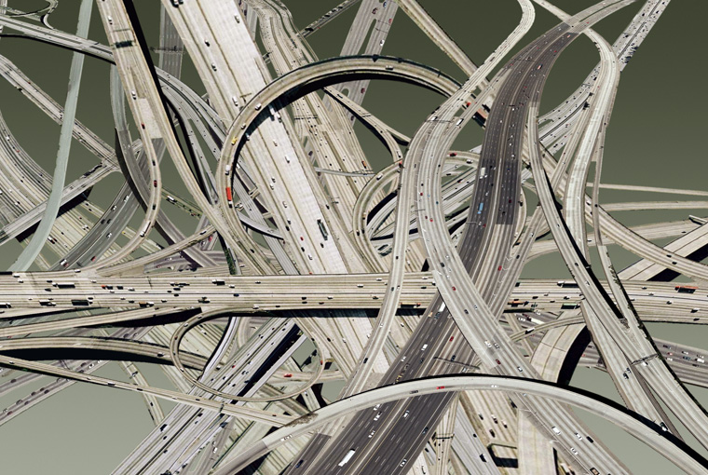
Transforming the health data landscape with FHIR®
Current: Multiple Different Methods/Approaches
MedMorph: Common Method/Approach
Notes:
MedMorph RA can expand to accommodate more use cases in the future. Using a common method/approach helps streamline data exchange/reporting to help reduce burden on data senders and data receivers.
Current: Having different methods/approaches creates additional burden for both data senders and data receivers.
MedMorph: Having a common approach eases burden for both data senders and data receivers, allowing for easier data exchange for multiple use cases.

Slide 24
Questions/Discussion

Slide 25
Contacts
CDC Team
Maria Michaels: ktx2@cdc.gov
Kasey Diebold: ykl4@cdc.gov
Caitlin Kennedy: mhy5@cdc.gov
Keydra Oladapo: cou5@cdc.gov
Nicole Cummings: ohj2@cdc.gov
Cynthia Bush: pdz1@cdc.gov
TEP Co-Chairs
John Loonsk: john.loonsk@jhu.edu
Bill Lober: lober@uw.edu
Technical Lead
Nagesh “Dragon” Bashyam: nagesh.bashyam@drajer.com
Support Team
Becky Angeles: becky.angeles@carradora.com
Jamie Parker: jamie.parker@carradora.com
Mike Flanigan: mike.flanigan@carradora.com
Technical SME
Brett Marquard: brett@waveoneassociates.com

Slide 26
MedMorph Resources
MedMorph Description: https://www.cdc.gov/csels/phio/making_rapid_data_exchange_reality.html
MedMorph Reference Architecture IG: http://build.fhir.org/ig/HL7/fhir-medmorph/index.html
Content IGs
Healthcare Surveys Reporting: https://build.fhir.org/ig/HL7/fhir-health-care-surveys-reporting-ig/
Central Cancer Registry Reporting: https://build.fhir.org/ig/HL7/fhir-health-care-surveys-reporting-ig/
Research Data Exchange: http://build.fhir.org/ig/HL7/fhir-medmorph-research-dex-ig/index.html
Hep C (eCR FHIR IG): http://hl7.org/fhir/us/ecr/
MedMorph RA IG GitHub: https://github.com/HL7/fhir-medmorph NOTE: You may need to be logged in to GitHub

Slide 27
Appendix A: MedMorph General Information

Slide 28
Making EHR Data More Available for Research and Public Health (MedMorph) - Background
Funded by the Patient-Centered Outcomes Research Trust Fund (PCORTF) via the U.S. Department of Health and Human Services (HHS) Assistant Secretary for Planning and Evaluation (ASPE)
Total project timeline: 3 years
PROBLEM: Patient-centered outcomes researchers and public health professionals need better ways to get data from different electronic health record (EHR) systems without posing additional burden on health care providers
GOAL: Create a reliable, scalable, generalizable, configurable, interoperable method to get EHR data for multiple public health and research use cases
OBJECTIVE: Develop a reference architecture and demonstrate a reference implementation (including implementation guides)
https://www.cdc.gov/csels/phio/making-ehr-data-more-available.html
Notes:
https://aspe.hhs.gov/making-electronic-health-record-ehr-data-more-available-research-and-public-health

Slide 29
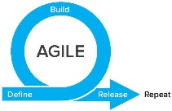
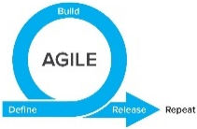
TIME
WE ARE HERE
SMEs: Hepatitis C
Research
Research
MedMorph Workgroups
Technical Experts
SMEs: Hepatitis C
Use Cases
(Public Health & Research)
Technical Experts
SMEs: Cancer
Use Case WG
SMEs: Cancer
Technical Experts
Technical Experts
SMEs: Health Care Surveys
SMEs: Health Care Surveys
Technical Experts
Technical Experts
Evaluation
WG
Evaluation Planning
Evaluation
Roadmap
Data Flows & Clinical Workflows
Reference Architecture/Authorities/Policies
SMEs: All use cases
SMEs: All use cases
Technical
Requirements
Reference Architecture WG
Data Flows & Clinical Workflows
Data Standards
SMEs: All use cases
SMEs: All use cases
Data Standards
Reference Architecture/Authorities/Policies
SMEs: All use cases
SMEs: All use cases
Notes:
Began with one workgroup per use case to be modeled for public health purposes (i.e., Hepatitis C Reporting, Cancer Reporting, Health Care Surveys), which included SMEs from other use cases as well, and across all use cases for a “Research Use Case”.
Switched to technical workgroups to identify Data Flows & Clinical Workflows, Data Standards, and Reference Architecture/Authorities/Policies based on the use case requirements drafted. Each of the technical workgroups had a mix of use case SMEs.
Eventually combined use case workgroups into one consolidated use case workgroup in order to better identify commonalities and differences. This workgroup will take the lead on defining requirements for content implementation guides (IGs), where applicable.
When each use case defined its requirements and then further identified commonalities and differences, a consolidated “Reference Architecture (RA)” WG focuses on technical requirements for the RA IG, and eventually the use case content IGs, where applicable. There may be iteration between the use case WG and RA WG, in agile fashion.
An evaluation workgroup works in parallel to the use case and RA WGs to develop short-term and long-term evaluation plans. The short-term evaluation plan will be part of the real-world pilots, and the long-term evaluation plan will be part of the roadmap (i.e., long-term evaluation is beyond the current scope of MedMorph, which is a time-limited PCORTF project).
Initial testing occurred in sandbox environments and then will be moving to real-world pilots.

Slide 30
The Data Lifecycle & Impacts to the Public’s Health
Guidelines
Recommendations
Guidance
Public Health Policies or
Mandates
Point of Care
Emergency Response
Public Health Departments
Community Services
Delivering actionable knowledge
ACTION
HEALTH
IMPACTS &
OUTCOMES
KNOWLEDGE
UPDATING
SCIENTIFIC
EVIDENCE
Fast Healthcare Interoperability Resources (FHIR®)
INFORMATION
DATA
Analyzing data to advance evidence
EHRs
Registries
Public Health Info Systems
Community Info Systems
…many potential sources
Data Science Analytics
Data Linkages
Data Visualization
Notes:
Structuring recommendations and using standards-based shareable CDS ultimately helps the data lifecycle. Computable guidelines (recommendations, guidance, etc.) help apply the evidence in practice more consistently since they are translated from the source of truth. Data resulting from the actions taken in practice would be more easily extracted to perform analyses that lead to information that can be incorporated into the knowledge that gets translated to practice… and the cycle begins anew. FHIR can help facilitate the data lifecycle by providing an interoperability standard for data exchange on its own or in partnership with existing widely used standards.
Data to Action patient-generated examples:
Patient takes a walk, pedometer records data that can be uploaded to patient’s chart
Patient uses CPAP, machine records sleep-related data, data is accessed remotely

Slide 31
Technical Expert Panel (TEP): Participating Partner Groups
Federal Partners
Health IT developers
Clinicians/ Healthcare Organizations
Medical Societies
Public Health Organizations
Evaluation experts
Laboratory Professional Groups
Standards experts
Clinical decision support developers
Clinical quality measure developers
Policy or technical support for implementation

Slide 32
Technical Expert Panel:
End Users, Data Recipients, Stakeholders – Including representatives of additional use cases
Foundation of standards supported by health IT certification (CCDS/USCDI, APIs, FHIR)
Fully Modeled Use Cases
Hepatitis C, Cancer, Healthcare Surveys
Fully Modeled Use Cases
Hepatitis C, Cancer, Healthcare Surveys
Implementation Guides
For general use and for each use case
Technological Strategies
To develop scalable and extensible architecture
Technological Strategies
To develop scalable and extensible application
Agile Development: Iterative Design-Build-Test Cycles (test case: Hepatitis C)
CCDS: Core Clinical Data Set
USCDI: US Core Data for Interoperability
APIs: Application Programming Interfaces
FHIR: Fast Healthcare Interoperability Resources
PRODUCTS: Reference Architecture, Reference Implementation
(Open Source Software) & Balloted Implementation Guides, Roadmap for Scalability and Sustainability
National Test Collaborative
Including a variety of clinical organizations and their EHR platforms
Software
Clinical organization
EHR platform
Other testing partners (e.g., public health departments, registries, health IT developers, etc.)
Evaluation Planning
Measure and Evaluate

Slide 33
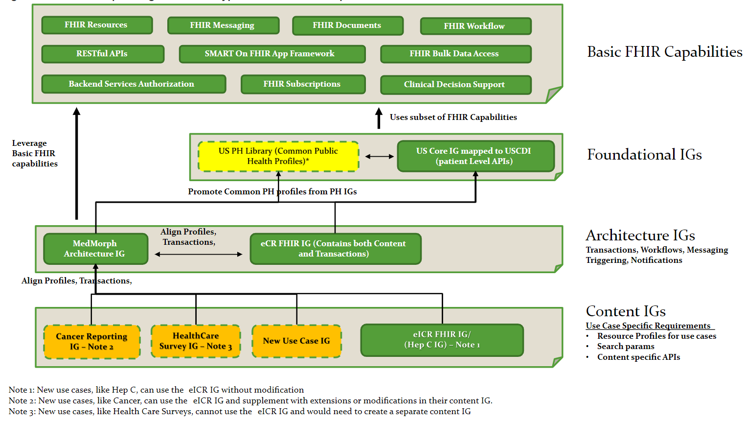
Relationship among Different IG Types and Basic FHIR Capabilities
http://hl7.org/fhir/us/medmorph/2022Jan/background.html

Slide 34
Appendix B: HL7 FHIR Resources

Slide 35
Helpful FHIR Links
FHIR Home Page & Summary:
https://hl7.org/fhir/
https://hl7.org/fhir/summary.html
FHIR Overview by user type:
General: https://www.hl7.org/fhir/overview.html
Developer: https://www.hl7.org/fhir/overview-dev.html
Clinical: https://www.hl7.org/fhir/overview-clinical.html
Architects: https://www.hl7.org/fhir/overview-arch.html
FHIR Implementation Guide Publishing: https://confluence.hl7.org/display/FHIR/IG+Publisher+Documentation
FHIR Implementation Guide Process Flow: https://confluence.hl7.org/display/FHIR/FHIR+Implementation+Guide+Process+Flow

Slide 36
Slides to be Deleted

Slide 37
Pilots & Alignments In Progress (1)
Central Cancer Registry Reporting – pilot (IG already developed)
Health Care Surveys – pilot (IG already developed)
Influenza Hospitalization Surveillance – IG development and pilot
Vital Statistics: Birth Reporting IG – alignment with MedMorph RA
HRSA Uniform Data System (UDS) Reporting from FQHCs – IG development and pilot
NOTE: There is interest from the international community in moving MedMorph to Universal Realm (it is currently US Realm)

Slide 38
Pilots & Alignments In Progress (2)
Discussions started:
CMS Quality Reporting
Vulcan: Real World Data, FHIR to OMOP, Adverse Events, Phenopackets
CIC WG: “Registry of Registries” – alignment to MedMorph RA
LHS WG” “Project of Projects” – bringing together existing IGs, accelerators, projects, and other efforts to help show how they can fit together to support the learning health system
NLM: ClinicalTrials.gov
FDA: SHIELD
CDC/FDA/ONC: Patient-Generated Health Data (from consumer medical devices)
NIDDK/AHRQ: Shared eCare Plans

Slide 39
The Future of the MedMorph Reference Architecture in Supporting Public Health & Beyond
Potential Additional Data Sources
Health Information Exchanges (HIEs)
Registries (e.g., immunization)
eCare Plans
Lab/Pharmacy/Radiology Systems
Electronic Birth Registration Systems (EBRS)
Patient-generated health data from consumer medical devices
ClinicalTrials.gov (NLM)
Non-EHR hospital systems
Potential Additional Data Repositories
CDC Data Lake/ Enterprise Data Analytics and Visualization (EDAV)
Health Information Exchanges (HIEs)
Registries
eCare Plans
EBRS
HRSA Uniform Data System (UDS)
CMS Quality Reporting Systems
ClinicalTrials.gov (NLM)
Additional Research Networks
Potential Ways to Leverage Distributed Knowledge via the Knowledge Artifact Repository
Any use case that needs broad sharing and updating of trigger codes, value sets, rules, etc. for reporting or knowledge sharing (e.g., multiple public health programs, quality measurement, research, etc.)

Slide 40
Pilot Update
Maria Michaels

Slide 41
Real-World Pilot #1: Chronic Hepatitis C Surveillance
Pilot Objectives:
Apply RA IG in real-world setting to continue learnings from HL7® FHIR® Connectathons
Demonstrate RA IG can facilitate data exchange using FHIR® across multiple EHR platforms and can be used by different types of health care organizations
Evaluate quantitative (e.g., completeness, timeliness, accuracy) and qualitative (e.g., perceptions of using an approach like MedMorph before and after implementation, organizational buy-in) aspects of the pilot
Pilot Design:
Data senders
Different clinical site types (e.g., academic medical center, FQHC, specialty clinic) on three different EHR platforms – Currently recruiting clinical sites / EHR vendors
Data receivers
Public Health Agency – New York City Department of Health and Mental Hygiene
Research Organization – Westat
Content:
Uses the electronic initial case report (eICR) data as described in the eCR FHIR® IG

