Slide 1
March 17, 2020
Making EHR Data More Available for Research and Public Health (MedMorph)
Technical Expert Panel (TEP)
Co-Chairs:
Bill Lober
University of Washington
John Loonsk
Johns Hopkins University

Slide 2
MedMorph TEP Meeting – 3/17/2020
TOPIC |  | LEAD(S) | TIME (ET)
1 | Roll Call & Welcome | Maria Michaels TEP Co-Chairs: Bill Lober/ John Loonsk | 3:00 – 3:05
2 | HL7 Balloting | Jamie Parker Nagesh “Dragon” Bashyam Brett Marquard | 3:05 – 3:15
3 | Transitioning to Technical WGs | Maria Michaels Bill Lober/ John Loonsk | 3:15 – 3:55
4 | Summary/ Q&A, Action Items, Announcements Next Meeting – April 21, 2020 | Bill Lober/ John Loonsk, MedMorph Project Team | 3:55 – 4:00

Slide 3
HL7 Ballot Update

Slide 4
HL7® FHIR® Balloting Process
Submit Project Scope Statement (PSS) to Sponsoring Work Groups (WGs) for Approvals
Reviews by US-Realm,
FHIR-Infrastructure, FHIR Mgt. Group,
Technical Steering Committee
Develop substantively complete content for Implementation Guide (IG)
Testing of IG at HL7 Sanctioned Events
Voting on Ballot (3 cycles/year - January, May, September)
Submit Implementation Guide Content for Ballot
Finalize Implementation Guide Content
Submit Notification of Intent to Ballot (NIB)
Complete Ballot Reconciliation and IG Updates
Submit Publication Checklist and Publication Request
Publish IG as Standard for Trial Use (STU)
Notes:
What is balloting (very top-level)? What is the ballot reconciliation process? (e.g., address all comments, make changes, review, etc.)
Not too much detail on any step, drill down based on questions.

Slide 5
From Project Scope Statement:
The goal of the MedMorph project is to develop and pilot a scalable and extensible standards-based reference architecture. This reference architecture will enable clinical data exchange with EHR systems and public health systems, specialized registries, national health care survey systems, and research information systems for multiple conditions. Initially, the reference architecture will be outlined using three priority use cases:
Hepatitis C
Cancer
Health Care Surveys
Notes:
Note that link to full PSS on next slide

Slide 6
HL7 FHIR Reference Architecture Ballot Timeline
Date | Artifact | Status
February 20, 2020 | Draft PSS Presented to the HL7 Supporting WG | Completed
February 21, 2020 | Submit PSS Scope Statement for September 2020 Ballot Cycle | Completed https://confluence.hl7.org/display/PHWG/Making+EHR+Data+More+Available+for+Research+and+Public+Health+%28MedMorph%29+Reference+Architecture+HL7+FHIR+Implementation+Guide
May 16th-17th | HL7 FHIR Connectathon- San Antonio, TX (https://www.hl7.org/events/working_group_meeting/2020/05/)
May 18th-22nd, 2020 | HL7 Workgroup Meeting - San Antonio, TX (https://www.hl7.org/events/working_group_meeting/2020/05/)
July 5th, 2020 | Notice for Intent to Ballot
July 26th-August 13th, 2020 | Ballot Pool/Consensus Group Sign Up
August 9th, 2020 | Ballot content due (FHIR Reference Architecture Implementation Guide)
August 14th- September 14th, 2020 | Ballot open for voting
September 19th-20th | HL7 FHIR Connectathon – Baltimore, MD (http://www.hl7.org/events/)
September 21st-25th, 2020 | HL7 Workgroup Meeting – Baltimore, MD (http://www.hl7.org/events/)

Slide 7
Timeline: MedMorph Activities & IG Balloting
March
April
May
June
July
August
September
October
HL7 PSS Submitted
MedMorph Use Case Development
End to End Use Case Review
HL7 Notice for Intent to Ballot Due
Finalize Use Cases
HL7 RA FHIR IG submitted
Prepare HL7 Reference Architecture (RA) FHIR IG
HL7 Working Group Meeting
Legend
HL7 Processes
Submission of HL7 RA FHIR IG ballot comments
MedMorph Project Activities
HL7 RA FHIR IG Ballot Reconciliation
Notes:
Add legend, peach vs blue

Slide 8
Helpful FHIR Links
FHIR Home Page & Summary:
https://hl7.org/fhir/
https://hl7.org/fhir/summary.html
FHIR Overview by user type:
General: https://www.hl7.org/fhir/overview.html
Developer: https://www.hl7.org/fhir/overview-dev.html
Clinical: https://www.hl7.org/fhir/overview-clinical.html
Architects: https://www.hl7.org/fhir/overview-arch.html
FHIR Implementation Guide Publishing: https://confluence.hl7.org/display/FHIR/IG+Publisher+Documentation
FHIR Implementation Guide Process Flow: https://confluence.hl7.org/display/FHIR/FHIR+Implementation+Guide+Process+Flow

Slide 9
Transitioning to Technical WGs

Slide 10
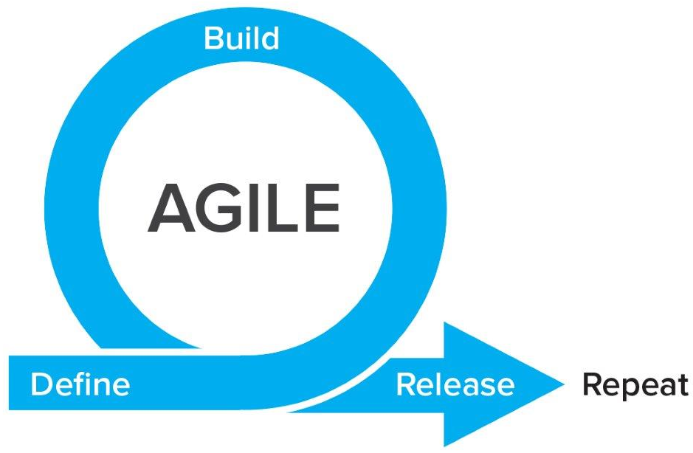
TIME
SMEs: Hepatitis C
SMEs: Hepatitis C
Technical Experts
Technical Experts
MedMorph Workgroups
Use Cases
(incl. Research)
SMEs: Cancer
SMEs: Cancer
Technical Experts
Technical Experts
SMEs: Healthcare Surveys
SMEs: Healthcare Surveys
Technical Experts
Technical Experts
Evaluation Planning
Evaluation
Clinical/Business Workflows & Data Flows
Clinical/Business Workflows & Data Flows
SMEs: All use cases
SMEs: All use cases
Data Standards
Data Standards
Technical Requirements
SMEs: All use cases
SMEs: All use cases
Reference Architecture/Authorities/Policies
Reference Architecture/Authorities/Policies
SMEs: All use cases
SMEs: All use cases
Notes:
Start with a workgroup per use case (for the proposed use cases) that each have technical experts and evaluators included to help fully model each use case. Begin with defining items listed in “What each use case should identify” slide.
When each use case has defined the items in “What each use case should identify” slide, we will switch to a focus on technical requirements, with a workgroup for each technical focus that will each have representatives from each use case.
There may be a need to break back out into the use case focused workgroups and come back to the technical workgroups as we work in agile fashion, initially testing in sandbox environments and then moving to real-world pilots.
Evaluators will be part of both use case and technical workgroups and will help identify what needs to be evaluated and will develop an evaluation plan as part of an “evaluation workgroup” (this is more of a process evaluation, not an outcomes evaluation, since outcomes will take longer to determine). Once we get to the real-world pilots, we can execute this evaluation plan. As part of the roadmap, the evaluation workgroup will identify important outcomes that would be important to evaluate in the long-term (i.e., beyond the timeline an scope of this project)

Slide 11
Common Considerations for Technical WGs
Input is welcome and needed on the 3 use cases modeled in this project AND any other use cases that use the EHR as a data source
Need input on BOTH public health and research perspectives
Focus on commonalities across use cases
There will be times when there are dependencies between WGs, which we will address as they come
Priority #1: Completing what was proposed in the PSS and preparing to ballot at the September HL7 meeting.

Slide 12
Clinical/Business Workflows & Data Flows
Goals:
Identify the capabilities that the system needs in order to support common clinical/business and data flows
Scope:
Identify commonalities in workflows and data flow across use case
Determining minimal complexity of logic that can support what is needed for clinical/business workflows and data flows within the reference architecture
Triggers
Data changes, workflow, temporal changes, other types?
Other
Identify authorities and policies that would require accommodation in the reference architecture
Notes:
Start with use case workflows developed to date – identify the commonalities
(how – subscription, etc. – would be addressed by reference architecture WG)
NOTE: Research where prospective triggers are helpful: study eligibility, adverse events, and other real time events that a study team would need to know about)
Start with authorities/policies – start with policy/authority-driven functional requirements, ref arch would need to have a way to allow/not allow data flow based on authority or policy, how it can accommodate PH & research use cases, core vs supplemental content

Slide 13
Data Standards
Goals:
Identify the data requirements that the system needs
Scope:
Use FHIR as a data model
Identify Common Data Elements (also a topic with Common Clinical Registries group – subgroup of Patient Care WG)
Vocabulary Requirements
Value Sets
Mappings (required common data elements to USCDI, to FHIR)
Data elements not collected in EHRs currently
Explore Transformations - Could these be uniformly done?
Focusing on commonalities for the reference architecture, but may require more detail for data exchange for specific use cases (e.g., supplemental IGs)
Notes:
Modular components of survey questions (e.g., manual entry on a form & FHIR Q&A? includes data not in EHR currently and/or not in USCDI?) – broader than Healthcare Surveys use case (which is more about data extraction)… need to clarify the verbiage around this item (e.g., if this does not include data in the EHR or data that would likely be added to EHR, then it is not in scope for this project… i.e., not all survey questions) – would this fit with follow-up forms for additional information (related to FHIR Questionnaire?)?

Slide 14
Reference Architecture/Authorities/Policies
Goals:
Produce a design document that outlines the system capabilities needed to accomplish the requirements of the workflows & data flows and data standards
Scope:
Document mechanisms, subscriptions, input/output, logic support, provisioning
Trust services (anonymization, pseudonymization, etc.)
Accommodate authorities and policies identified by Clinical/Business Workflows & Data Flows WG

Slide 15
Upcoming MedMorph Meetings
Next Full TEP Meeting
Tue 4/21/2020 @ 3-4pm ET / 2-3pm CT / 1-2pm MT / 12-1pm PT
Technical Workgroups (Weekly)
Clinical/Business Workflows & Data Flows (starting 3/25/2020):
Wednesdays @ 10-11am ET / 9-10am CT / 8-9am MT / 7-8am PT
Reference Architecture/Authorities/Policies (starting 3/25/2020):
Wednesdays @ 1-2pm ET / 12-1pm CT / 11am-12pm MT / 10-11am PT
Data Standards (starting 3/27/2020):
Fridays @ 3-4pm ET / 2-3pm CT / 1-2pm MT / 12-1pm PT

Slide 16
Making EHR Data More Available for Research and Public Health
Technical Expert Panel:
End Users, Data Recipients, Stakeholders – Including representatives of additional use cases
Foundation of standards supported by health IT certification (CCDS/USCDI, APIs, FHIR)
Fully Modeled Use Cases
Hepatitis C, Cancer, Healthcare Surveys
Fully Modeled Use Cases
Hepatitis C, Cancer, Healthcare Surveys
Implementation Guides
For general use and for each use case
Technological Strategies
To develop scalable and extensible architecture
Technological Strategies
To develop scalable and extensible application
Agile Development: Iterative Design-Build-Test Cycles (test case: Hepatitis C)
CCDS: Core Clinical Data Set
USCDI: US Core Data for Interoperability
APIs: Application Programming Interfaces
FHIR: Fast Healthcare Interoperability Resources
PRODUCTS: Reference Architecture, Reference Implementation
(Open Source Software) & Balloted Implementation Guides, Roadmap for Scalability and Sustainability
National Test Collaborative
Including a variety of clinical organizations and their EHR platforms
Software
Clinical organization
EHR platform
Other testing partners (e.g., public health departments, registries, health IT developers, etc.)
Evaluation Planning
Measure and Evaluate

Slide 17
Evaluation WG
Short-term evaluation: focused on Hep C pilot
Long-term evaluation: focused on broader impacts to research and public health

