Slide 1
MedMorph Consolidated Use Case Workgroup June 11, 2020

Slide 2
Meeting Agenda
Topic | Time
Use Case Workgroup logistics | 5 mins
Working Session Review User Stories and Flow Diagrams Health Care Survey Hep C Cancer | 50 mins
Next Steps | 5 mins

Slide 3
Use Case Workgroup Logistics
Use Cases can be found on our MedMorph Confluence site: https://carradora.atlassian.net/wiki/spaces/MedMorph/pages/381780019/Use+Case+Work+Groups
Please provide feedback and comments directly on the Confluence page(s)
We will provide an agenda prior to each call so you can plan accordingly
We may focus on a particular use case or a common section for all use cases

Slide 4
Working Session:
Review User Stories and Flow Diagrams

Slide 5
Health Care Surveys: Abstract Model

Slide 6
HCS: User Story 1 Ambulatory
Background: The National Ambulatory Medical Care Survey (NAMCS) is based on a sample of patient visits to non-federally employed office-based physicians (primary care or specialist) who are primarily engaged in direct patient care and, starting in 2006, a separate sample of visits to community health centers. NAMCS collects an encounter-based set of demographic and clinical data generally available in a medical record for any type of visit.
Workflow: Upon completion of an encounter, the physician or licensed clinician, using the EHR, completes and closes the clinical encounter (“sign off”). This “sign off” triggers the backend services app to evaluate the completed encounter. The completed encounter evaluation includes validating that the provider associated with encounter is a “sampled” NAMCS provider and the encounter occurred within a specified timeframe. If the encounter meets the criteria, and after a lag period to allow for lab results to post when applicable, the backend services app requests a set of FHIR resources representing patient-level and select provider-level data of the encounter from the EHR. Once obtained and validated, these resources are transmitted to NCHS where they are received, acknowledged, validated, and loaded into the National Health Care Surveys Data Store.

Slide 7
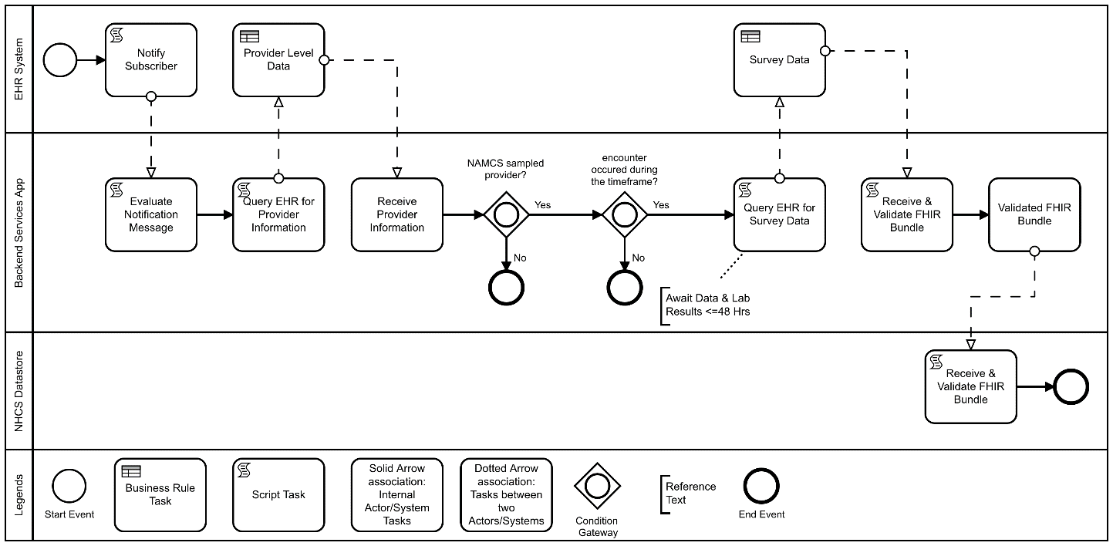
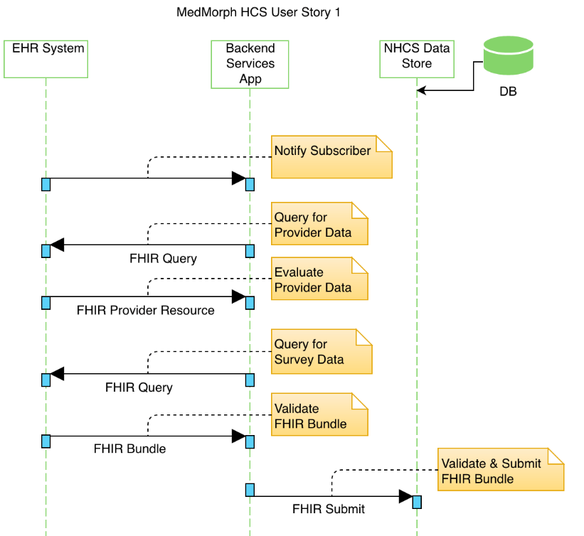
HCS: User Story 1 Flow
Activity Diagram
Step | Actor | Role | Activity | Input(s) | Output(s)
1 | EHR System | Trigger | Notify the Backend App that a trigger event has occurred | Data or workflow trigger | Notification message (e.g., “completed encounter” event) for a topic
2 | Backend Services App | Evaluator | Evaluate notification message against criteria | Notification message content | Continuation decision based on available information
3 | Backend Services App | Data Extractor | Query the EHR System for provider information | Notification message content | FHIR query
4 | EHR System | Query Responder | Return provider data | FHIR query | FHIR Provider Resource
5 | Backend Services App | Evaluator | Evaluate provider information, notification message | FHIR Provider Resource, Notification message | Submittal decision based on available information
6 | Backend Services App | Data Extractor | Query the EHR System for survey data | Notification message, timing, and other criteria | FHIR query
7 | EHR System | Query Responder | Return survey data | FHIR query | FHIR bundle
8 | Backend Services App | Data Receiver | Receive and validate FHIR bundle | FHIR bundle | FHIR validated Bundle
9 | Backend Services App | Data Sender | Send validated FHIR bundle to NHCS Data Store | FHIR validated Bundle | FHIR validated Bundle
10 | NHCS Data Store | Data Receiver | Receive and validate FHIR bundle | FHIR bundle | Validated FHIR bundle
Sequence Diagram

Slide 8
HCS: User Story 2 (Inpatient)
Background: The National Hospital Care Survey (NHCS) is an electronic data collection, gathering Uniform Bill (UB) 04 administrative claims data or electronic health record data from sampled hospitals. NHCS is designed to provide reliable and timely nationally representative healthcare utilization data for hospital-based settings. NHCS collects all inpatient discharges, and Emergency Department (ED) encounters from sampled hospitals for a survey period of one year. NHCS’ sample is drawn from all non-federal US hospitals with a bed size > 6.
Workflow: Upon completion of an inpatient or ED encounter, the physician or licensed clinician completes and closes the clinical encounter (“sign off”). This “sign off” triggers the backend services app to evaluate the completed encounter against the NHCS criteria. If the encounter meets the survey criteria the backend services app requests a set of FHIR resources representing patient-level and select provider-level data of the encounter from the EHR. Once obtained and validated, these resources are transmitted to NCHS where they are received, acknowledged, validated, and loaded into the National Health Care Surveys Data Store.

Slide 9
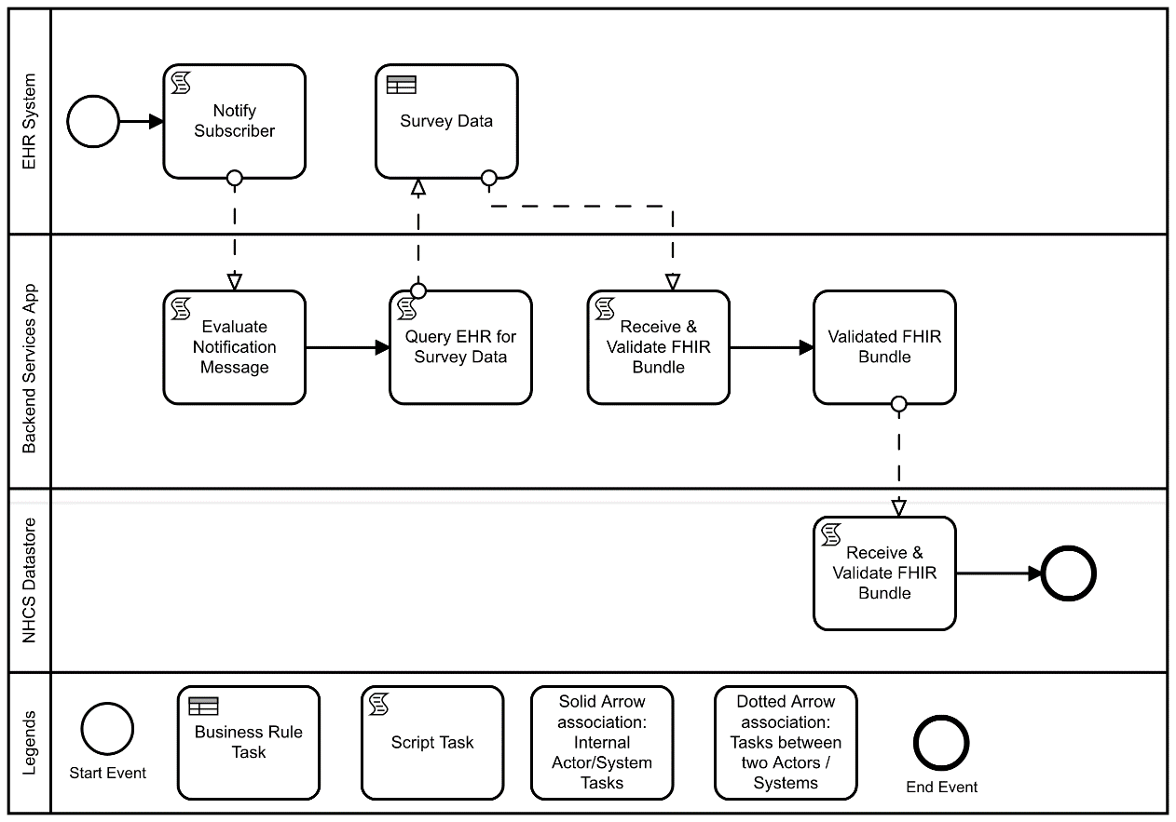
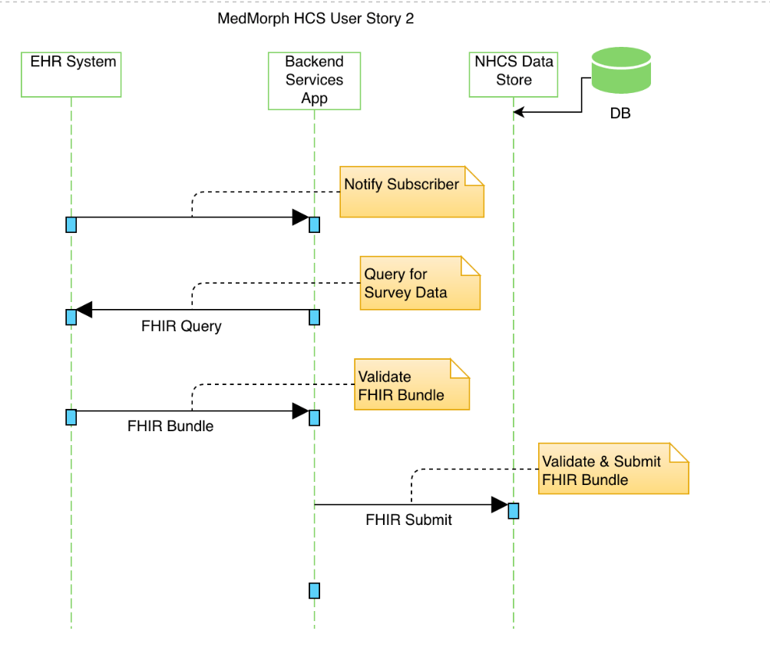
HCS: User Story 2 - Inpatient
Activity Diagram
Step | Actor | Role | Activity | Input(s) | Output(s)
1 | EHR System | Trigger | Notify the Backend App that a trigger event has occurred been met | Data or workflow trigger | Notification message (e.g., “completed encounter” event as a topic)
2 | Backend Services App | Evaluator | Evaluates notification message against criteria | Notification message content | Submittal decision based on available information
3 | Backend Services App | Data Extractor | Query the EHR System for survey data | Notification message, timing and other criteria | FHIR query
4 | EHR System | Query Responder | Return survey data | FHIR query | FHIR bundle
5 | Backend Services App | Data Receiver | Receive and validate FHIR bundle | FHIR bundle | FHIR validated bundle
6 | Backend Services App | Data Sender | Send validated FHIR bundle to NHCS Data Store | FHIR validated bundle | FHIR validated bundle
7 | NHCS Data Store | Data Receiver | Receive and validate FHIR bundle | FHIR bundle | Validated FHIR bundle
Sequence Diagram

Slide 10
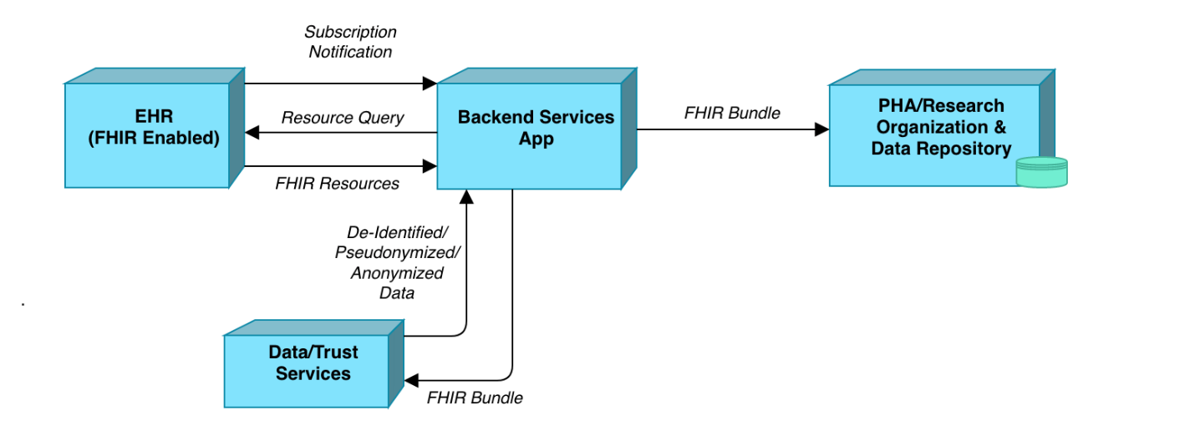
Hepatitis C – Abstract Models
Initial Diagnosis (eICR)
Reporting

Slide 11
Hep C: User Story 1- Uncomplicated Adult Male (eICR)
HCV Testing and Diagnosis
Patient X visits his primary care doctor, Dr. Y, for a non-emergent matter, and during the visit, Dr. Y notices that the EHR has flagged Patient X as being eligible/due for a hepatitis C test. Dr. Y places/approves an order for FDA approved hepatitis C antibody test, with automatic reflex to an FDA-approved Nucleic Acid Testing (NAT) assay intended for detection of hepatitis C virus (HCV) RNA to confirm the diagnosis. An onsite lab tech draws a blood specimen from Patient X via venipuncture and sends the specimen to an offsite lab.
The lab performs the recommended testing sequence. In this case, the anti-HCV test is reactive, so an FDA-approved NAT assay for HCV RNA is performed on the same specimen (reflex testing). This, too, is reactive, indicating that Patient X is currently infected with HCV. The lab sends results electronically to Dr. Y .
Receipt of any HCV antibody and/or HCV RNA test result in the EHR automatically triggers an initial electronic case report (eICR) to public health, as well as any clinical registry with which Dr. Y’s practice is affiliated.
Hepatitis C Pretreatment Assessment
A member of Dr. Y’s office calls Patient X to schedule a follow up appointment with the doctor to review/discuss test results. During that follow up appointment, Dr. Y orders a transient elastrography test (to evaluate the degree of hepatic fibrosis present); HCV genotype; and a series of lab tests, including complete HBV serology testing, complete blood count (CBC), HIV tests, and a complete metabolic profile including a hepatic function panel (i.e., albumin, total and direct bilirubin, alanine aminotransferase (ALT), aspartate aminotransferase (AST), calculated glomerular filtration rate (eGFR)). The results of these will be used by Dr. Y to inform his recommended HCV treatment strategy. Dr. Y’s office receives the results from these follow up tests.
Depending on registry protocols and state/local reporting requirements (e.g., around acute case reporting), receipt of these pretreatment test results triggers a report (following proper consent protocols) to public health and/or the clinical registry.
Patient X meets with Dr. Y to discuss treatment options. The results, which are shared with Patient X, indicate that there is no liver cirrhosis present and Patient X is infected with genotype 1b.

Slide 12
Hep C: User Story 2- Pregnant Woman and Exposed Infant (eICR) 1/2
Diagnostic Flow
Patient A, a pregnant woman (hereafter, “Mom”), visits her OBGYN, Dr. A, for her initial prenatal care visit. During this visit, Dr. A orders routine prenatal labs, including an FDA-approved hepatitis C antibody test. An onsite lab tech draws a blood specimen from Mom via venipuncture and sends the specimen to an offsite lab.
The lab performs the recommended testing. In this case, the anti-HCV test is reactive, so an FDA-approved NAT assay for HCV RNA is performed on the same specimen (reflex testing). This, too, is reactive, indicating that Mom is currently infected with HCV. The lab sends results electronically to Dr. A. Receipt of any HCV antibody and/or HCV RNA test result in the EHR automatically triggers an initial electronic case report to public health, as well as any clinical registry with which Dr. A’s practice is affiliated.
NOTE: the report triggered should include information indicative of current pregnancy. Ideally, this information would be communicated using emerging standards for representing pregnancy status. Alternatively, and/or additionally, other information in the EHR could be defined as being a reasonably reliable proxy indicator of potential pregnancy and so included in the report if present (e.g., calculated time since last menstrual period, recent prenatal panel test ordered).
Because current HCV treatment regimens are not approved for use during pregnancy, Dr. A does not immediately initiate a referral for treatment.
Delivery Flow
Several months later, Mom goes into labor and arrives at the hospital. Mom’s HCV infection status is communicated to the hospital staff and captured in its EHR (e.g., in the problem list or medical history) so healthcare staff can take necessary additional precautions.
Mom delivers a healthy baby girl (hereafter “Baby”). Data on the delivery and its outcome are captured in the hospital’s EHR. The combination of information indicating a live birth, as well as Mom’s documented HCV infection status, triggers the hospital EHR to send a report (following proper consent protocols) to public health. That report includes information on Mom; her HCV infection status (diagnosis and/or test results and date); and her delivery (delivery date and outcome).
The delivery records are also forwarded to Baby’s pediatrician, Dr. P, where it also triggers a report (following proper consent protocols) to public health that includes information on Baby and Baby’s exposure to HCV (recognized based on Mom’s HCV infection status).
NOTE: the hospital “delivery” and pediatrician “exposure” reports triggered under this flow allow for public health follow up to ensure the exposed infant receives appropriate care. In an ideal world, the “infant” flow outlined further below would itself ensure such follow up care. But reality is often far messier, especially when it comes to communication of data across different institutions and providers for different individuals (mom, baby). Adding these reporting steps better positions public health to help ensure those connections are made—and that providers like the pediatrician know what steps to take when caring for an exposed infant.

Slide 13
Hep C: User Story 1 and 2 (eICR) Flow
Step | Actor | Role | Activity | Input(s) | Output(s)
1 | EHR System | Notifier | Notify the Backend Services App that there has been activity in topics the app subscribes to | Trigger codes | Notification message
2 | Backend Services App | Evaluator | Evaluates criteria (and timing if needed to wait on lab results) | Notification message, criteria, rules | Yes/No query decision
3 | Backend Services App | Data Extractor | Query the EHR for case data | Query decision | FHIR queries
4 | EHR System | Query Responder | Return case data | FHIR queries | FHIR resources
5 | Backend Services App | Data Receiver | Receive and validate FHIR resources | FHIR resources | FHIR eICR validated bundle
6 | Backend Services App | Data Sender | Send validated FHIR bundle as eICR to a Trusted Third Party | FHIR eICR validated bundle | FHIR eICR bundle
7 | Trusted Third Party | Data Receiver | Receive and validate FHIR bundle | FHIR eICR bundle | validated FHIR eICR bundle
8 | Trusted Third Party | Evaluator | Confirms reportability of eICR and generates RR | FHIR eICR bundle | Reportability Response (RR)
9 | Trusted Third Party | RR Sender | Transmits RR to EHR System/Backend Services App/PHA | RR | RR
10 | Trusted Third Party | Data Sender | Send FHIR eICR bundle | Validated eICR FHIR bundle | FHIR eICR bundle
11 | EHR System/Backend Services App/PHA | Data Receiver | Receive and process RR | RR | processed RR
12 | PHA | Data Receiver | Receive and validate FHIR eICR bundle | FHIR eICR bundle | validated FHIR eICR bundle

Slide 14
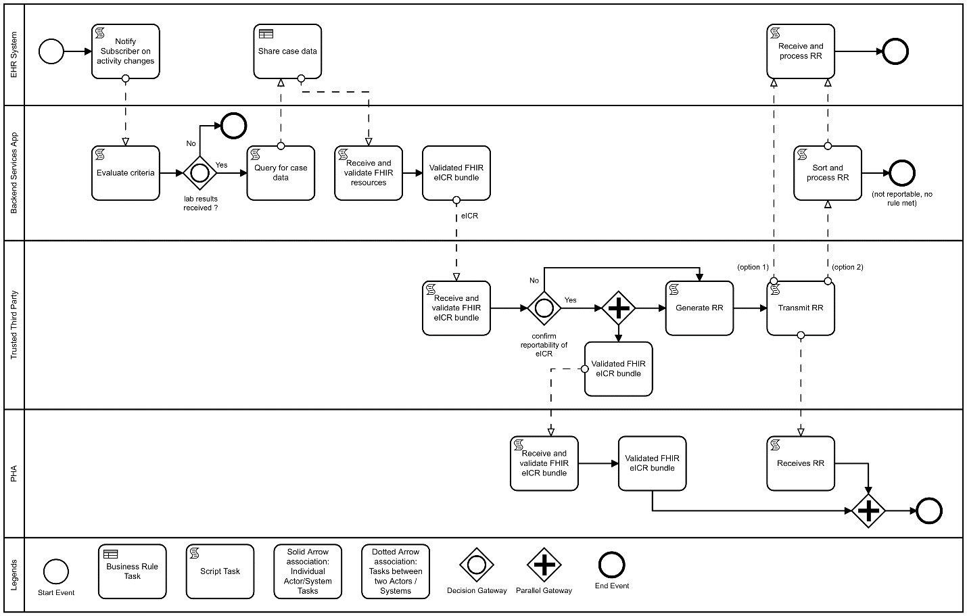
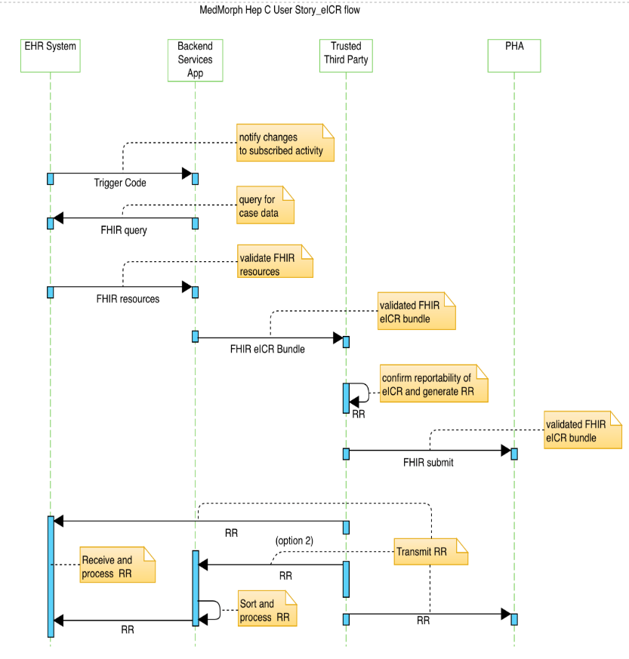
Hep C: User Story 1 and 2 eICR - Diagrams
eICR Activity Diagram
eICR Sequence Diagram

Slide 15
Hep C: User Story 1- Uncomplicated Adult Male- REPORTING
Treatment
Dr. Y performs a complete medication reconciliation to ascertain any potential drug-drug interactions and learns there is no risk. Dr. Y prescribes a daily fixed-dose combination of ledipasvir (90mg)/sofosbuvir (400mg) for 12 weeks as recommended by AASLD. Patient X’s insurer has a PA process in place for the medication Dr. Y is recommending, so the clinical pharmacist assembles and submits the necessary paperwork. Patient X is called by the case manager in 2 weeks that the medication has been approved and follows up with the next available appointment with the clinical pharmacist. Patient X follows up with the clinical pharmacist and receives counseling about adherence to the medication and picks up the medication and starts to take it.
When the electronic order for the prescription is entered by Dr. Y, it also triggers a report (following proper consent protocols) to public health and the clinical registry with which Dr. Y’s practice is affiliated.
Cured
Patient X follows up with the clinical pharmacist 4 weeks after starting treatment. During each visit, the clinical pharmacist reviews any adverse events and or newly started prescriptions that may pose risk of drug-drug interactions and discusses/reinforces the importance of adherence to the regimen. Patient X follows up every 4 weeks with the clinical pharmacist while being treated. During the 3rd visit, which is the end of treatment visit (12 weeks after starting treatment), the clinical pharmacist orders an HCV RNA test for 3 months later for the post treatment assessment of cure. Patient X goes to the lab 3 months later to be tested and returns to Dr. Y’s office to confirm HCV RNA is undetectable (virologic cure).
Receipt of the HCV RNA test result in the EHR automatically triggers a report (following proper consent protocols) to public health, as well as any clinical registry with which Dr. Y’s practice is affiliated.

Slide 16
Hep C: User Story 2- Pregnant Woman and Exposed Infant REPORTING (1/2)
Post-Partum Treatment Flow for Mother
Mom has a post-delivery visit with Dr. A at 2 weeks, at which time Dr. A makes a referral for Mom to see Dr. Z, an HCV treatment provider.
At her first appointment with Dr. Z, he orders a transient elastrography test (to evaluate the degree of hepatic fibrosis present); HCV genotype; and a series of lab tests, including complete HBV serology, complete blood count (CBC), HIV tests, and a complete metabolic profile including a hepatic function panel (i.e., albumin, total and direct bilirubin, alanine aminotransferase (ALT), aspartate aminotransferase (AST), calculated glomerular filtration rate (eGFR)). The results of these will be used by Dr. Z to inform his recommended HCV treatment strategy. Dr. Z’s office receives the results from these follow up tests.
Mom has a second appointment with Dr. Z to discuss options. The results, which are shared with Mom, indicate that there is no liver cirrhosis present and Patient X is infected with genotype 1b. Mom indicates that she is breast feeding and would like to continue to do so until Baby is at least 6 months old. Dr. Z and Mom thus decide to defer treatment for several months, until Baby has transitioned to bottle feeding.
Approximately 5 months later, Mom has a follow up visit with Dr. Z. Mom is no longer breast feeding, and she and Dr. Z agree to initiative treatment for her hepatitis C.

Slide 17
Hep C: User Story 2- Pregnant Woman and Exposed Infant REPORTING (2/2)
Treatment
Based on the records he received from the hospital, Dr. P knows that Baby was exposed to HCV. During Baby’s follow-up well child check, Dr. P orders an FDA-approved Nucleic Acid Test (NAT) intended for detection of hepatitis C virus (HCV) RNA. An onsite lab tech draws a blood specimen from Baby and sends the specimen to an offsite lab.
The lab performs the recommended test, and the results are reactive. The lab sends results electronically to Dr. P. Receipt of the HCV RNA test result in the EHR automatically triggers an electronic initial case report to public health.
Dr. P makes a referral for Baby to see Dr. X, a pediatric gastroenterologist. During Baby B’s first visit with Dr. X., Dr. X explains to Mom that it is too early to initiate treatment for Baby—and that there is a possibility that Baby’s viremia will prove transient. They will retest her at 18 months to determine if she remains infected, and, in the interim, monitor her.
At 18 months, an FDA-approved hepatitis C antibody test , with automatic reflex to FDA-approved NAT assay for HCV RNA, is performed and, again, Baby’s results are positive. The positive results are sent by the lab to Dr. X, who also shares them electronically with Dr. P. Receipt of the HCV RNA test result in Dr. X’s EHR automatically triggers an electronic initial case report to public health, as well as any clinical registry with which Dr. X’s practice is affiliated
Because HCV DAAs are not approved for use in children as young as Baby, Dr. X does not initiate treatment at this time. Instead, he will continue to monitor Baby’s health until she reaches age 3.
Once Baby is 3 years old, Dr. X will evaluate Baby and make a treatment recommendation.
At this point, the flow for Baby is similar to User Story #1 (treatment and cure).

Slide 18
Hep C: User Story 1 and 2 Reporting Flow
Step | Actor | Role | Activity | Input(s) | Output(s)
1 | EHR System | Notifier | Notify the Backend App that there has been activity in topics the app subscribes to | Trigger codes | Notification message
2 | Backend Services App | Evaluator | Evaluates criteria | Notification message, criteria, rules | Yes/no decision (and timing) for querying EHR
3 | Backend Services App | Data Extractor | Query the EHR for case data | Timing criteria | FHIR queries
4 | EHR System | Query Responder | Return case data | FHIR queries | FHIR resources
5 | Backend Services App | Data Receiver | Receive and validate FHIR resources | FHIR resources | FHIR validated bundle
6 | Backend Services App | Consent Verifier | Verify consent resources | FHIR validated bundle | FHIR validated bundle
7 | Backend Services App | Data Sender | Send validated FHIR bundle to trust service | FHIR validated bundle | FHIR bundle
8 | Data/Trust Services | Data Receiver | Receive and validate FHIR bundle | FHIR bundle | validated FHIR bundle
9 | Data/Trust Services | Data Anonymizer | Anonymize FHIR bundle | FHIR bundle | anonymized FHIR bundle
10 | Data/Trust Services | Data Sender | Send anonymized FHIR bundle | Anonymized FHIR bundle | Anonymized FHIR bundle
11 | Backend Services App | Data Receiver | Receive and validate anonymized FHIR bundle | validate FHIR bundle | FHIR bundle
12 | Backend Services App | Data Sender | Send FHIR bundle to PHA | Validated FHIR bundle | FHIR bundle
13 | PHA | Data Receiver | Receive and validate FHIR bundle | FHIR bundle | Validated FHIR bundle

Slide 19
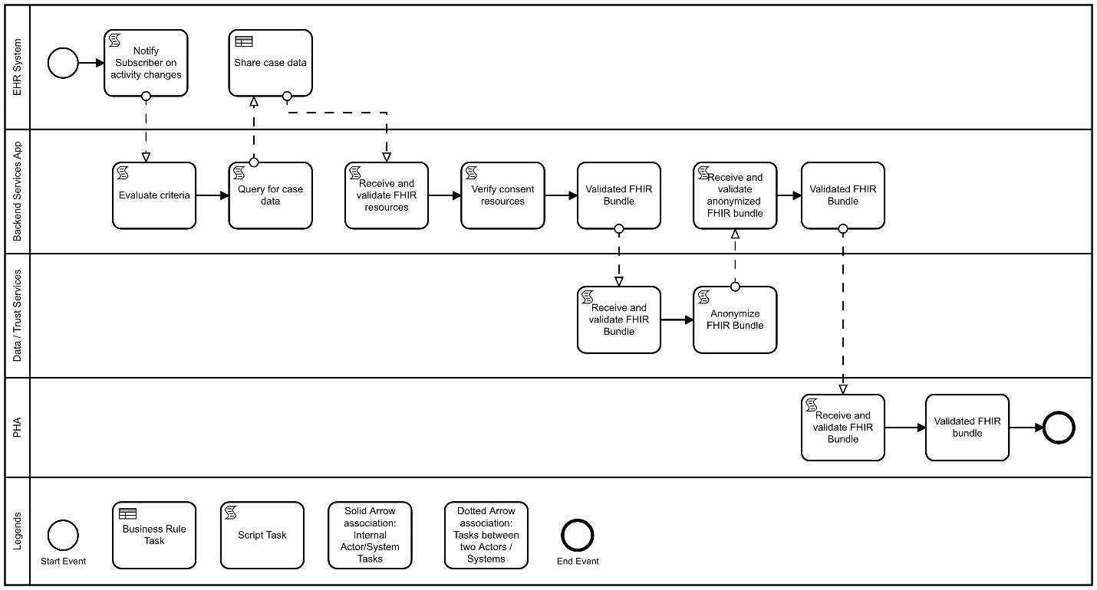
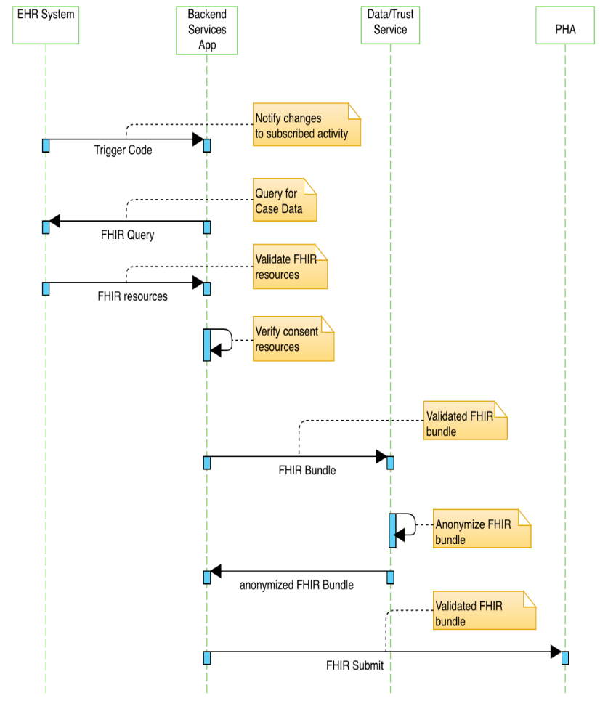
Hep C: User Story 1 and 2 Reporting Diagrams
Reporting Activity Diagram
Reporting Sequence Diagram

Slide 20
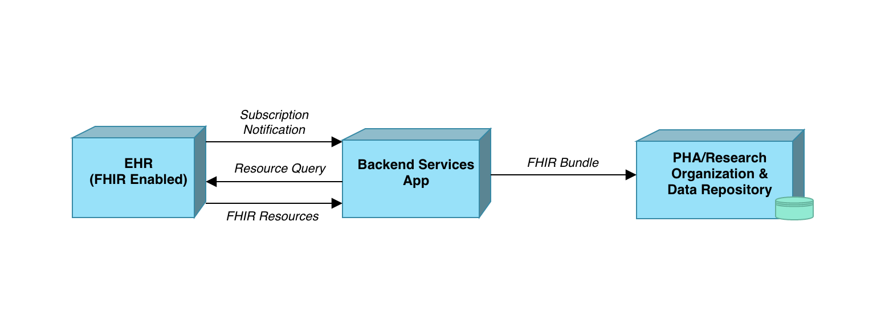
Cancer Abstract Model

Slide 21
Cancer: User Story 1- Diagnosis
User Story #1 –Cancer Diagnosis A patient with a dark skin ulcer on her arm visits a dermatologist. The dermatologist performs a biopsy that is sent to the pathology laboratory for testing. The laboratory analyzes the biopsy specimen which indicates the patient has melanoma in situ. The pathology report is sent to the dermatologist who performed the biopsy. The dermatologist confirms the diagnosis of melanoma in situ. This information is integrated into the patient's clinical record. The patient is informed of her test results. The dermatologist’s EHR system determines that the patient has been diagnosed with a cancer that meets the criteria for reporting to the central cancer registry, as defined by the national standard Cancer Reportability List. A standard report with the required data elements is sent to the central cancer registry where the patient resides, as required by state law.

Slide 22
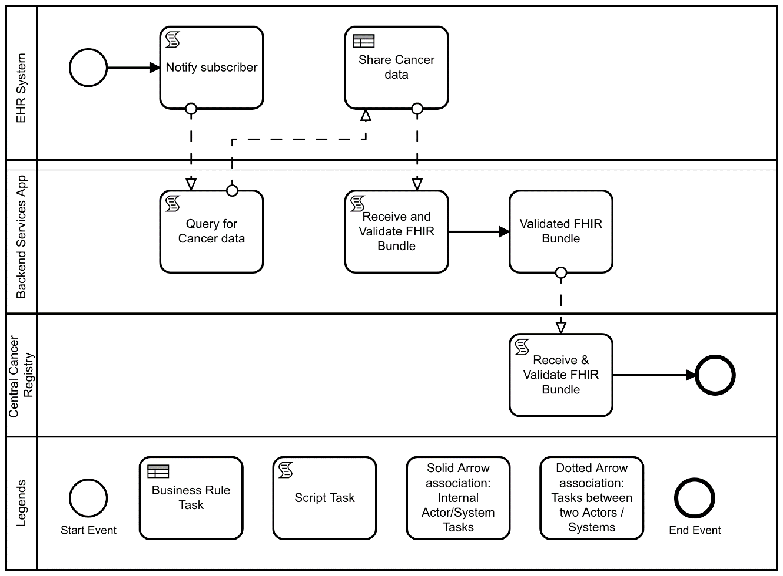
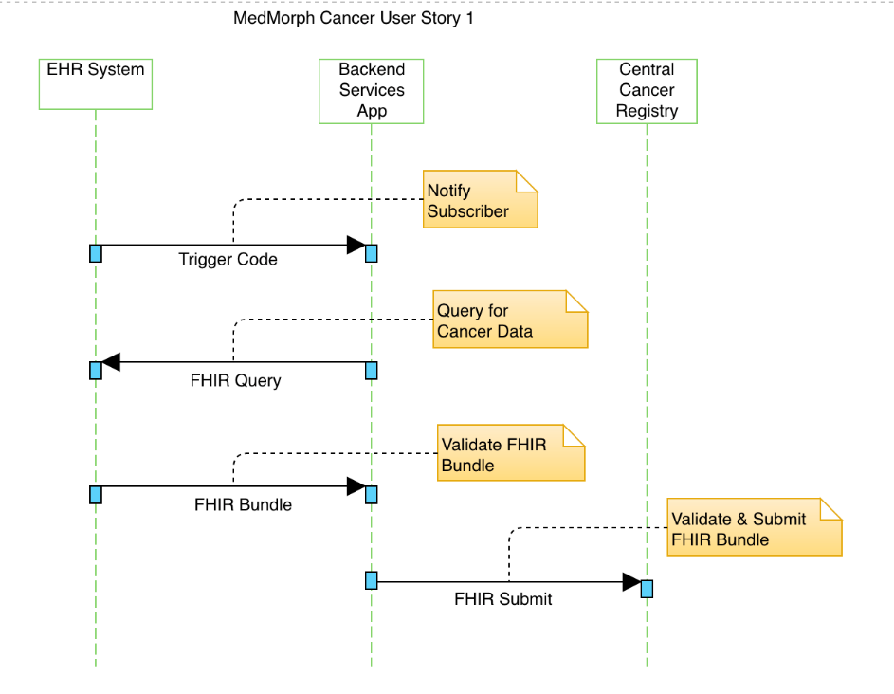
Cancer: User Story 1 Diagrams
Activity Diagram
Step | Actor | Role | Activity | Input(s) | Output(s)
1 | EHR System | Notifier | Notify the Backend Service App that criteria have been met | Trigger code | Notification message
2 | Backend Service App | Data Extractor | Query the EHR for cancer data | Notification message | FHIR query
3 | EHR System | Query Responder | Return cancer data | FHIR query | FHIR bundle
4 | Backend Service App | Data Receiver | Receive and validate FHIR bundle | FHIR bundle | FHIR validated bundle
5 | Backend Service App | Data Sender | Send validated FHIR bundle Central Cancer Registry | FHIR validated bundle | FHIR validated bundle
6 | Central Cancer Registry | Data Receiver | Receive and validate FHIR bundle | FHIR bundle | Validated FHIR bundle
Sequence Diagram

Slide 23
Cancer: User Story 2 - Reporting 1/2
User Story #2 Option 1 – Cancer Treatment—Reporting Every Encounter: The medical oncologist sends his patient to the cancer treatment center to initiate the chemotherapy course of treatment (every day for 5 days, once a month for five months) regimen as the first course of treatment for her colon cancer. The chemotherapy drugs are infused, and the chemotherapy treatment is documented in the EHR as the reason for the encounter/visit. The EHR system determines that the patient was seen for treatment of a cancer that meets the criteria for reporting to the central cancer registry, as defined by the national standard Cancer Reportability List. A standard report with the required data elements is sent to the central cancer registry where the patient resides, as required by state law. As directed by the treatment plan, the patient returns to the cancer treatment center to receive the next chemotherapy cycle. The intravenous chemotherapy drugs are infused, and the chemotherapy treatment is documented in the EHR as the reason for the encounter/visit. The EHR system determines that the patient was seen for treatment of a cancer meets the criteria for reporting to the central cancer registry, as defined by the national standard Cancer Reportability List. A standard report with the required data elements is sent to the central cancer registry where the patient resides, as required by state law.
User Story #2 Option 2 – Cancer Treatment—Reporting based on Specific Criteria:
The medical oncologist sends his patient to the cancer treatment center to initiate radiation therapy as part of the first course of treatment for her breast cancer. Radiation therapy is given and is documented in the EHR as the reason for the encounter/visit. The EHR system determines that the patient was seen for treatment of a cancer that meets the criteria for reporting to the central cancer registry, as defined by the national standard Cancer Reportability List. A standard report with the required data elements is sent to the central cancer registry where the patient resides, as required by state law. As directed by the treatment plan, the patient returns to the cancer treatment center to receive the next radiation treatment session. Radiation is given and is documented in the EHR as the reason for the encounter/visit. The EHR system determines that this patient has received this category of treatment and a report was already sent to the registry based on this category. Therefore, it does not generate a new report to send to the cancer registry.

Slide 24
Cancer: User Story 2- Cancer Reporting 2/2
After radiation, the medical oncologist sends the same patient to the cancer treatment center to initiate the chemotherapy regimen as part of the first course of treatment for her breast cancer. The chemotherapy drugs are infused, and the chemotherapy treatment is documented in the EHR as the reason for the encounter/visit. The EHR system determines that the patient was seen for treatment of a cancer that meets the criteria for reporting to the central cancer registry, as defined by the national standard Cancer Reportability List. A standard report with the required data elements is sent to the central cancer registry where the patient resides, as required by state law. As directed by the treatment plan, the patient returns to the cancer treatment center to receive the next chemotherapy cycle. The intravenous chemotherapy drugs are infused, and the chemotherapy treatment is documented in the EHR as the reason for the encounter/visit. The EHR system determines that this patient has received this category* of treatment and a report was already sent to the registry based on this category. Therefore, it does not generate a new report to send to the cancer registry.
The medical oncologist prescribes hormone therapy for the patient, which is documented in the EHR. The EHR system determines that the patient was prescribed a treatment that meets the criteria for reporting to the central cancer registry, as defined by the national standard Cancer Reportability List. A standard report with the required data elements is sent to the central cancer registry where the patient resides, as required by state law. The EHR system determines that this patient has not received this category of treatment and a report was already sent to the registry based on this category. Therefore, it does not generate a new report to send to the cancer registry.
*Category of treatment: Surgery, Radiation, Chemotherapy, Hormone Therapy, Immunotherapy (Biological Response Modifier (BRM)), Other cancer-directed therapy. (Note: These can all be provided in one or more value sets).

Slide 25
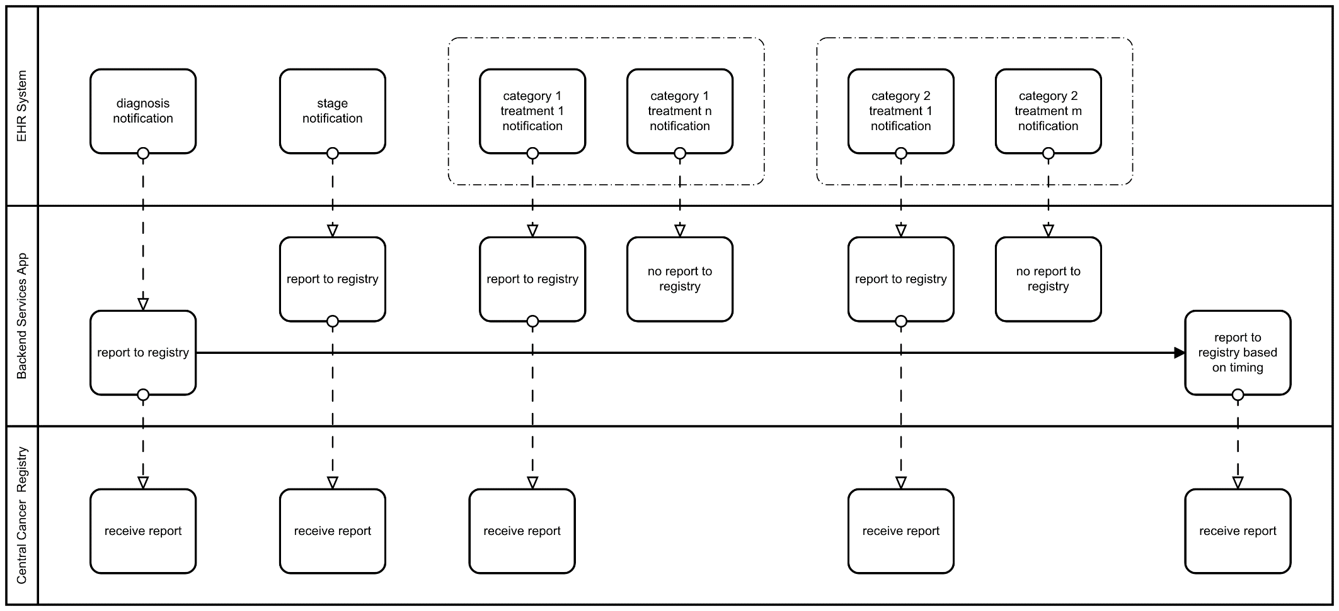
Cancer: Reporting by Care Site - Single

Slide 26
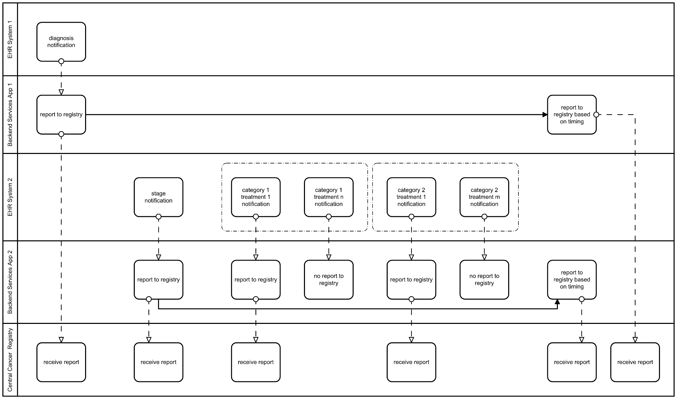
Cancer: Reporting by Care Site - Multiple

Slide 27
Cancer: User Story 2 Flow
Step | Actor | Role | Activity | Input(s) | Output(s)
1 | EHR System | Notifier | Notify the Backend Service App that criteria have been met | Trigger code | Notification message
2 | Backend Service App | Data Extractor | Query the EHR for cancer data | Notification message | FHIR query
3 | EHR System | Query Responder | Return cancer data | FHIR query | FHIR bundle
4 | Backend Service App | Data Receiver | Receive and validate FHIR bundle | FHIR bundle | FHIR validated bundle
5 | Backend Service App | Data Sender | Send validated FHIR bundle to Central Cancer Registry | FHIR validated bundle | FHIR validated bundle
6 | Central Cancer Registry | Data Receiver | Receive and validate FHIR bundle | FHIR bundle | Validated FHIR bundle
7 | Repeat Steps 1-6 for each treatment completed

Slide 28
Working Session :
Outstanding Questions

Slide 29
Hep C User Story
Questions for Workgroup:
When a prescription is made that triggers a report—this is a clinical workflow issue -Does doc enter prescription, but then it sits in limbo until PA received and script is filled? If so, report may be triggered weeks before treatment is initiated. Or is prescription not actually sent until after PA received (so gap is minimal). And, of course, clinical registries serving closed systems might actually have access to the pharmacy fill data, and so prefer to trigger based on patient pick up (vs. prescription sent). Then again, would those pharmacy data be captured in the EHR? Or would they be a separate feed to the registry (like direct lab reporting is to public health)?
Are we seeing any movement towards sharing data between pharmacies and providers, such that a “pick up” (vs. “prescribed) trigger is worth considering? Perhaps as part of a trigger hierarchy that says 1. Rx pick up within X days of order, else 2. Rx order?

Slide 30
Next Steps
Next Meeting: June 18th, 12-1 pm ET
Focus of Next Meeting:
Maternal and Child Record linkage discussion with Kate Woodworth and Sarah Schellie with respect to Hepatitis C User Story 2
Hepatitis C Use Case – User Stories, Flows, and Diagrams
Homework: Review Hepatitis C Use Case and submit any potential Research User Stories
Email edits to becky.angeles@carradora.com

Slide 31
Contacts
Use Case Development
Becky Angeles: becky.angeles@carradora.com
Jamie Parker: jamie.parker@carradora.com
Kishore Bashyam: kishore.bashyam@drajer.com
Mike Flanigan: mike.flanigan@carradora.com
Technical SME
Brett Marquard: brett@waveoneassociates.com
Technical Lead
Nagesh “Dragon” Bashyam: nagesh.bashyam@drajer.com
CDC Team
Maria Michaels: ktx2@cdc.gov
Wendy Blumenthal: wfb6@cdc.gov
Arun Srinivasan: fos2@cdc.gov
Syed Sameemuddin: puv5@cdc.gov
Abigail Vail: bzv3@cdc.gov
Aaron Harris: ieo9@cdc.gov
Brian Gugerty: vaz6@cdc.gov
Cynthia Bush: pdz1@cdc.gov
Laura Conn: lbk1@cdc.gov
TEP Co-Chairs
John Loonsk: john.loonsk@jhu.edu
Bill Lober: lober@uw.edu

Slide 32
Resources/Useful Links

