Slide 1
MedMorph Consolidated Use Case Workgroup June 25, 2020

Slide 2
Meeting Agenda
Topic | Time
Logistics and Recap from Last Week | 5 mins
Working Session: Hepatitis C Use Case – User Stories, Flows, and Diagrams | 50 mins
Next Steps | 5 mins
Notes:
Logistics and Recap from Last Week
Working Session: Hepatitis C Use Case – User Stories, Flows, and Diagrams
Next Steps

Slide 3
Use Case Workgroup Logistics
Use Cases can be found on our MedMorph Confluence site: https://carradora.atlassian.net/wiki/spaces/MedMorph/pages/381780019/Use+Case+Work+Groups
Please provide feedback and comments directly on the Confluence page(s)
We will provide an agenda prior to each call so you can plan accordingly
We may focus on a particular use case or a common section for all use cases

Slide 4
Recap from Last Week 6/18/20
Discussed maternal / child record linkage
Determined that the linkage is out of scope for the use cases but will include the linkage on the MedMorph roadmap.
Discussed user story 1 - no updates were made

Slide 5
Working Session:
Review Hep C User Stories and Diagrams

Slide 6
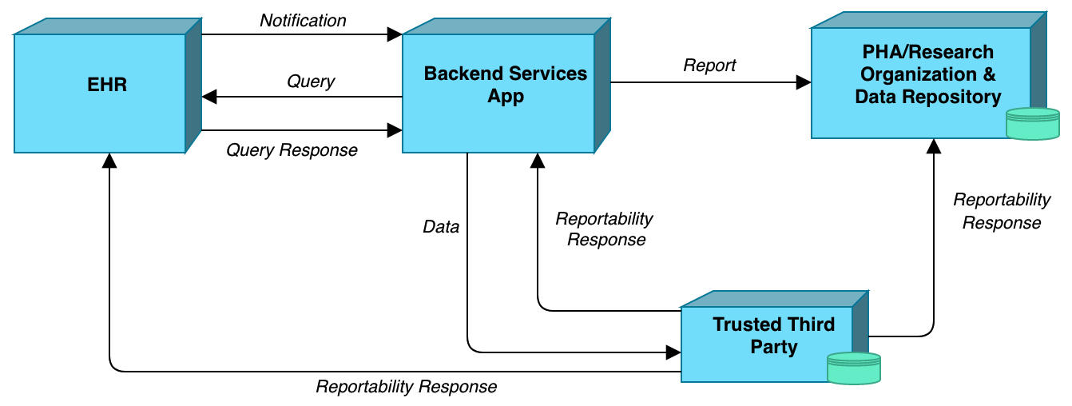
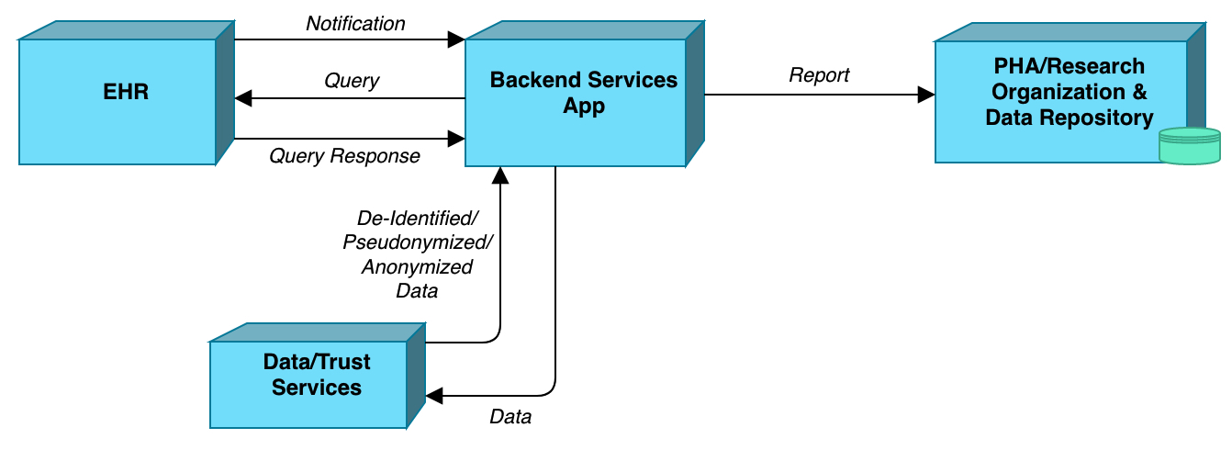
Hepatitis C – Abstract Models
Initial Diagnosis (eICR)
Reporting

Slide 7
Hep C: User Story 1- Uncomplicated Adult Male - eICR
HCV Testing and Diagnosis
The lab performs the recommended testing sequence. The anti-HCV test is reactive, so an FDA-approved NAT assay for HCV RNA is performed on the same specimen (reflex testing). The NAT assay is reactive, indicating that Patient X is currently infected with HCV.
The lab sends results electronically to Dr. Y. Receipt of the HCV antibody and/or HCV RNA test result in the EHR automatically triggers an initial electronic case report (eICR) to public health and any clinical registry affiliated with Dr. Y’s practice.

Slide 8
Hep C: User Story 2- Pregnant Woman and Exposed Infant - eICR
Diagnostic Flow for Mom
Patient A, a pregnant woman (hereafter, “Mom”), visits her OBGYN, Dr. A, for her initial prenatal care visit. Dr. A orders routine prenatal labs, including an FDA-approved hepatitis C antibody test. An onsite lab tech draws a blood specimen from Mom via venipuncture and sends it to an offsite lab.
The lab performs the recommended testing. The anti-HCV test is reactive, so an FDA-approved NAT assay for HCV RNA is performed on the same specimen (reflex testing). The NAT assay is reactive, indicating that Mom is currently infected with HCV. The lab sends results electronically to Dr. A. Receipt of the HCV antibody and/or HCV RNA test result in the EHR automatically triggers an initial electronic case report to public health, as well as any clinical registry affiliated with Dr. A’s practice.
NOTE: the report triggered should include information indicative of current pregnancy. Ideally, this information would be communicated using emerging standards for representing pregnancy status. Alternatively, and/or additionally, other information in the EHR could be defined as being a reasonably reliable proxy indicator of potential pregnancy and so included in the report if present (e.g., calculated time since last menstrual period, recent prenatal panel test ordered).
Testing, Diagnosis and Treatment Flow for Infant
During Baby’s follow-up well child check, Dr. P orders an FDA-approved Nucleic Acid Test (NAT) intended for detection of HCV RNA. An onsite lab tech draws a blood specimen from Baby and sends the specimen to an offsite lab.
The lab performs the recommended test, and the results are reactive. The lab sends results electronically to Dr. P. Receipt of the HCV RNA test result in the EHR automatically triggers an electronic initial case report to public health.

Slide 9
Hep C: User Story 1 and 2 eICR Flow
Step | Actor | Role | Activity | Input(s) | Output(s)
1 | EHR System | Notifier | Notify the Backend Services App that there has been activity in topics the app subscribes to | Trigger codes | Notification message
2 | Backend Services App | Evaluator | Evaluates criteria (and timing if needed to wait on lab results) | Notification message, criteria, rules | Yes/No query decision
3 | Backend Services App | Data Extractor | Query the EHR for case data | Query decision | FHIR queries
4 | EHR System | Query Responder | Return case data | FHIR queries | FHIR resources
5 | Backend Services App | Data Receiver | Receive and validate FHIR resources | FHIR resources | FHIR eICR validated bundle
6 | Backend Services App | Data Sender | Send validated FHIR bundle as eICR to a Trusted Third Party | FHIR eICR validated bundle | FHIR eICR bundle
7 | Trusted Third Party | Data Receiver | Receive and validate FHIR bundle | FHIR eICR bundle | validated FHIR eICR bundle
8 | Trusted Third Party | Evaluator | Confirms reportability of eICR and generates RR | FHIR eICR bundle | Reportability Response (RR)
9 | Trusted Third Party | RR Sender | Transmits RR to EHR System/Backend Services App/PHA | RR | RR
10 | Trusted Third Party | Data Sender | Send FHIR eICR bundle | Validated eICR FHIR bundle | FHIR eICR bundle
11 | EHR System/Backend Services App/PHA | RR Receiver | Receive and process RR | RR | processed RR
12 | PHA | Data Receiver | Receive and validate FHIR eICR bundle | FHIR eICR bundle | validated FHIR eICR bundle

Slide 10
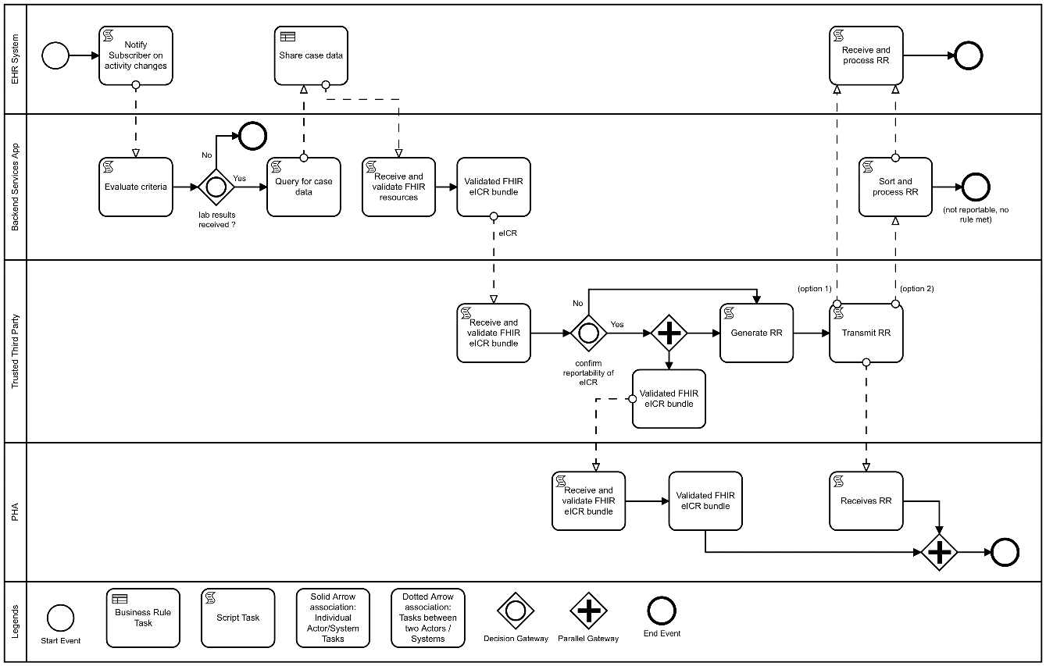
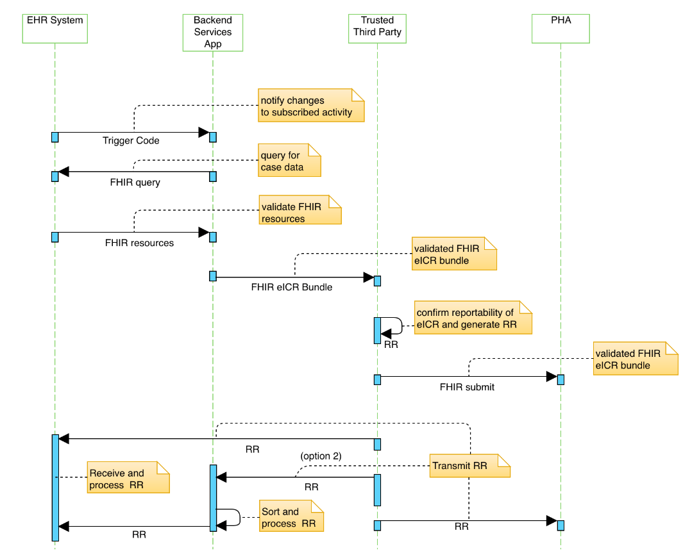
Hep C: User Story 1 and 2 eICR Diagrams
eICR Activity Diagram
eICR Sequence Diagram

Slide 11
Hep C: User Story 1- Uncomplicated Adult Male- Reporting
Hepatitis C Pretreatment Assessment
Dr. Y orders a transient elastography test (to evaluate the degree of hepatic fibrosis present), HCV genotype, HAV serology test, HBV serology test, complete blood count (CBC), HIV tests, and a complete metabolic profile including a hepatic function panel (i.e., albumin, total and direct bilirubin, alanine aminotransferase (ALT), aspartate aminotransferase (AST), calculated glomerular filtration rate (eGFR)). Dr. Y’s office receives the results from these follow up tests. Dr. Y will use these results to inform his recommended HCV treatment strategy.
Depending on registry protocols and state/local reporting requirements (e.g., around acute or chronic case reporting), receipt of these pretreatment test results triggers a report (following proper consent protocols) to public health and/or the clinical registry.
Treatment
Dr. Y prescribes a daily fixed-dose combination of ledipasvir (90mg)/sofosbuvir (400mg) for 12 weeks as recommended by AASLD.
When Dr. Y enters the electronic order for the prescription, it triggers a report (following proper consent protocols) to public health and the clinical registry affiliated with Dr. Y’s practice.
Cured
During the third visit, which is the end of treatment visit (twelve weeks after starting treatment), the clinical pharmacist orders an HCV RNA test for three months later for the post treatment assessment of cure. Patient X goes to the lab three months later to be tested and returns to Dr. Y’s office to confirm HCV RNA is undetectable (virologic cure).
Receipt of the HCV RNA test result in the EHR automatically triggers a report (following proper consent protocols) to public health, as well as any clinical registry affiliated with Dr. Y’s practice.

Slide 12
Hep C: User Story 2- Pregnant Woman and Exposed Infant - Reporting (1/2)
Delivery Flow for Mom and Infant
Mom delivers a healthy baby girl (hereafter “Baby”). Data on the delivery and its outcome are captured in the hospital’s EHR. The combination of information indicating a live birth, as well as Mom’s documented HCV infection status, triggers the hospital EHR to send a report (following proper consent protocols) to public health. That report includes information on Mom, her HCV infection status (diagnosis and/or test results and date), and her delivery (delivery date and outcome).
The delivery records are also forwarded to Baby’s pediatrician, Dr. P, where it also triggers a report (following proper consent protocols) to public health that includes information on Baby and Baby’s exposure to HCV (recognized based on Mom’s HCV infection status).
NOTE: the hospital “delivery” and pediatrician “exposure” reports triggered under this flow allow for public health follow up to ensure the exposed infant receives appropriate care. In an ideal world, the “infant” flow outlined further below would itself ensure such follow up care. But reality is often far messier, especially when it comes to communication of data across different institutions and providers for different individuals (mom, baby). Adding these reporting steps better positions public health to help ensure those connections are made—and that providers like the pediatrician know what steps to take when caring for an exposed infant.

Slide 13
Hep C: User Story 2- Pregnant Woman and Exposed Infant - Reporting (2/2)
Testing, Diagnosis and Treatment flow for Infant
Based on the records he received from the hospital, Dr. P knows that Baby was exposed to HCV. During Baby’s follow-up well child check, Dr. P orders an FDA-approved Nucleic Acid Test (NAT) intended for detection of hepatitis C virus (HCV) RNA. An onsite lab tech draws a blood specimen from Baby and sends it to an offsite lab.
The lab performs the recommended test, and the results are reactive. The lab sends results electronically to Dr. P. Receipt of the HCV RNA test result in the EHR automatically triggers an electronic initial case report to public health.

Slide 14
Hep C: User Story 1 and 2 Reporting Flow
Step | Actor | Role | Activity | Input(s) | Output(s)
1 | EHR System | Notifier | Notify the Backend App that there has been activity in topics the app subscribes to | Trigger codes | Notification message
2 | Backend Services App | Evaluator | Evaluates criteria | Notification message, criteria, rules | Yes/no decision (and timing) for querying EHR
3 | Backend Services App | Data Extractor | Query the EHR for case data | Timing criteria | FHIR queries
4 | EHR System | Query Responder | Return case data | FHIR queries | FHIR resources
5 | Backend Services App | Data Receiver | Receive and validate FHIR resources | FHIR resources | FHIR validated bundle
6 | Backend Services App | Consent Verifier | Verify consent resources | FHIR validated bundle | FHIR validated bundle
7 | Backend Services App | Data Sender | Send validated FHIR bundle to trust service | FHIR validated bundle | FHIR bundle
8 | Data/Trust Services | Data Receiver | Receive and validate FHIR bundle | FHIR bundle | validated FHIR bundle
9 | Data/Trust Services | Data Anonymizer | Anonymize FHIR bundle | FHIR bundle | anonymized FHIR bundle
10 | Data/Trust Services | Data Sender | Send anonymized FHIR bundle | Anonymized FHIR bundle | Anonymized FHIR bundle
11 | Backend Services App | Data Receiver | Receive and validate anonymized FHIR bundle | validate FHIR bundle | FHIR bundle
12 | Backend Services App | Data Sender | Send FHIR bundle to PHA | Validated FHIR bundle | FHIR bundle
13 | PHA | Data Receiver | Receive and validate FHIR bundle | FHIR bundle | Validated FHIR bundle

Slide 15
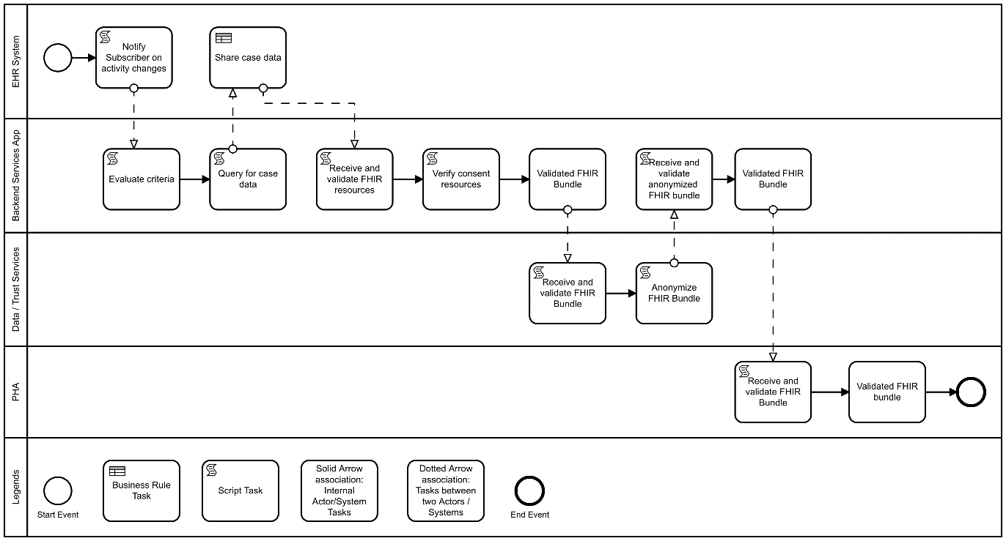
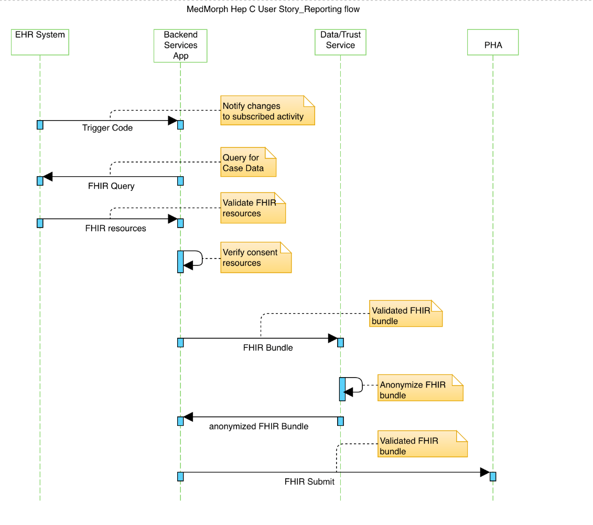
Hep C: User Story 1 and 2 Reporting Diagrams
Reporting Activity Diagram
Reporting Sequence Diagram

Slide 16
Working Session:
Outstanding Questions

Slide 17
Use Case Considerations
Policy Considerations (e.g., authorities, data use agreements, etc.)
Non-Technical Considerations (e.g., as performance, SLAs, etc.)

Slide 18
Hep C User Story
Questions for Workgroup:
When a prescription is made that triggers a report, does the Dr. enter prescription, but then does the trigger sit in limbo until PA received and script is filled? If so, the report may be triggered weeks before treatment is initiated. Or is the trigger not actually sent until after PA received (so gap is minimal)?
Clinical registries that serve closed systems might actually have access to the pharmacy fill data, and so prefer to trigger based on patient pick up (vs. prescription sent). Would those pharmacy data be captured in the EHR? Or would they be a separate feed to the registry (like direct lab reporting is to public health)?
Are we seeing any movement towards sharing data between pharmacies and providers, such that a “pick up” (vs. “prescribed) trigger is worth considering? Perhaps as part of a trigger hierarchy that says 1. Rx pick up within X days of order, else 2. Rx order?

Slide 19
Next Steps
Next Meeting: July 2nd, 12-1 pm ET
Focus of Next Meeting:
Cancer Use Case – User Stories, Flows, and Diagrams
Homework:
Review and provide comments on the Hepatitis C and Cancer Use Cases
Submit any potential Research User Stories
Or Email comments to becky.angeles@carradora.com

Slide 20
Contacts
Use Case Development
Becky Angeles: becky.angeles@carradora.com
Jamie Parker: jamie.parker@carradora.com
Kishore Bashyam: kishore.bashyam@drajer.com
Mike Flanigan: mike.flanigan@carradora.com
Technical SME
Brett Marquard: brett@waveoneassociates.com
Technical Lead
Nagesh “Dragon” Bashyam: nagesh.bashyam@drajer.com
CDC Team
Maria Michaels: ktx2@cdc.gov
Wendy Blumenthal: wfb6@cdc.gov
Arun Srinivasan: fos2@cdc.gov
Syed Sameemuddin: puv5@cdc.gov
Abigail Vail: bzv3@cdc.gov
Aaron Harris: ieo9@cdc.gov
Brian Gugerty: vaz6@cdc.gov
Cynthia Bush: pdz1@cdc.gov
Laura Conn: lbk1@cdc.gov
TEP Co-Chairs
John Loonsk: john.loonsk@jhu.edu
Bill Lober: lober@uw.edu

Slide 21
Resources/Useful Links

