Slide 1
MedMorph Consolidated Use Case Workgroup July 2, 2020

Slide 2
Meeting Agenda
Topic | Time
Logistics and Recap from Last Week | 5 mins
Working Session: Cancer – User Stories, Flows, and Diagrams | 50 mins
Next Steps | 5 mins
Notes:
Logistics and Recap from Last Week
Working Session: Hepatitis C Use Case – User Stories, Flows, and Diagrams
Next Steps

Slide 3
Use Case Workgroup Logistics
Use Cases can be found on our MedMorph Confluence site: https://carradora.atlassian.net/wiki/spaces/MedMorph/pages/381780019/Use+Case+Work+Groups
Please provide feedback and comments directly on the Confluence page(s)
We will provide an agenda prior to each call so you can plan accordingly
We may focus on a particular use case or a common section for all use cases

Slide 4
Tentative Meeting Schedule / Topics
Date | Topic(s)
7/2/20 | Cancer – User Story and Diagrams
7/9/20* | Policy and Non-Technical Considerations
7/16/20 | Research Use Case(s)
7/23/20 | Cancer – Data Elements
7/30/20 | Hep C – Data Elements
8/6/20 | HCS – Data Elements Data Element Crosswalk
8/13/20 | Cross UC Similarities (actors, flows, etc.) Gap Identification
Notes:
*The NACCHO 360 conference is happening next week. How many of you will be attending those sessions and will not be able to attend this call on 7/9 from 12-1pm ET?

Slide 5
Recap from Last Week 6/25/20
Hepatitis C Use Case Discussion
Updated User Story 2 Post-Partum Treatment Flow for Mother section with the paragraph mentioning that the receipt of pretreatment test results triggers an additional report to match User Story 1 flow.
Updated the non-eICR reports to be called an “additional report” in the user story text.
Updated the “Reporting Flow” to “Additional Reporting Flow”.
Generalized the “wait on lab results” to “wait on additional data (e.g., lab results)”

Slide 6
Working Session:
Review Cancer User Stories and Diagrams

Slide 7
Cancer – Abstract Model

Slide 8
Cancer Diagnosis and Treatment- Reporting Based on Specific Criteria 1/2
User Story Cancer Diagnosis and Treatment - Reporting based on Specific Criteria
A patient with visits her primary care provider (PCP) because of a lump in her breast. The provider orders a mammogram and then a biopsy that is sent to the pathology laboratory for testing. The laboratory analyzes the biopsy specimen which indicates the patient has breast cancer. The pathology report is sent to the provider who ordered the biopsy. The provider confirms the diagnosis of breast cancer. This information is integrated into the patient's clinical record. The patient is informed of her test results. The PCP’s clinic EHR system determines that the patient has been diagnosed with a cancer that meets the criteria for reporting to the central cancer registry, as defined by the national standard Cancer Reportability List. A standard report with the required data elements is sent to the central cancer registry where the patient resides, as required by state law. The PCP orders a further workup and clinically stages the patient’s cancer. The EHR system determines that staging information has not been previously submitted to the central cancer registry and meets the criteria for reporting. A standard report with the required data elements is sent to the central cancer registry where the patient resides, as required by state law.
Patient has surgery (not covered in this user story) and then PCP refers her to a medical oncologist in the same clinic for further treatment. The medical oncologist sends the patient to the radiation therapy department to initiate radiation therapy as part of the first course of treatment for her breast cancer. Radiation therapy is given and is documented in the EHR as the reason for the encounter/visit. The EHR system determines that the patient was seen for treatment of a cancer that meets the criteria for reporting to the central cancer registry and that this patient has not previously received this category* of treatment. A standard report with the required data elements is sent to the central cancer registry where the patient resides, as required by state law. As directed by the treatment plan, the patient returns to the cancer treatment center to receive the next radiation treatment session. Radiation is given and is documented in the EHR as the reason for the encounter/visit. The EHR system determines that this patient has received this category* of treatment and a report was already sent to the registry based on this category. Therefore, it does not generate a new report to send to the cancer registry.

Slide 9
Cancer Diagnosis and Treatment- Reporting Based on Specific Criteria 1/2
User Story Cancer Diagnosis and Treatment - Reporting based on Specific Criteria
A patient with visits her primary care provider (PCP) because of a lump in her breast. The provider orders a mammogram and then a biopsy that is sent to the pathology laboratory for testing. The laboratory analyzes the biopsy specimen which indicates the patient has breast cancer. The pathology report is sent to the provider who ordered the biopsy. The provider confirms the diagnosis of breast cancer. This information is integrated into the patient's clinical record. The patient is informed of her test results. The PCP’s clinic EHR system determines that the patient has been diagnosed with a cancer that meets the criteria for reporting to the central cancer registry, as defined by the national standard Cancer Reportability List. A standard report with the required data elements is sent to the central cancer registry where the patient resides, as required by state law. The PCP orders a further workup and clinically stages the patient’s cancer. The EHR system determines that staging information has not been previously submitted to the central cancer registry and meets the criteria for reporting. A standard report with the required data elements is sent to the central cancer registry where the patient resides, as required by state law.
Patient has surgery (not covered in this user story) and then PCP refers her to a medical oncologist in the same clinic for further treatment. The medical oncologist sends the patient to the radiation therapy department to initiate radiation therapy as part of the first course of treatment for her breast cancer. Radiation therapy is given and is documented in the EHR as the reason for the encounter/visit. The EHR system determines that the patient was seen for treatment of a cancer that meets the criteria for reporting to the central cancer registry and that this patient has not previously received this category* of treatment. A standard report with the required data elements is sent to the central cancer registry where the patient resides, as required by state law. As directed by the treatment plan, the patient returns to the cancer treatment center to receive the next radiation treatment session. Radiation is given and is documented in the EHR as the reason for the encounter/visit. The EHR system determines that this patient has received this category* of treatment and a report was already sent to the registry based on this category. Therefore, it does not generate a new report to send to the cancer registry.

Slide 10
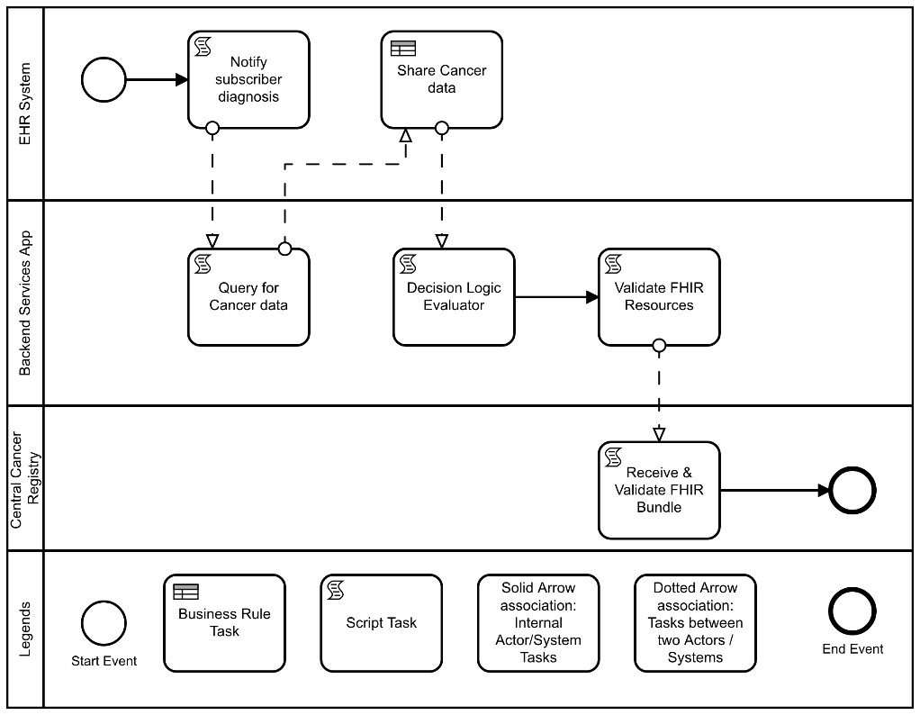
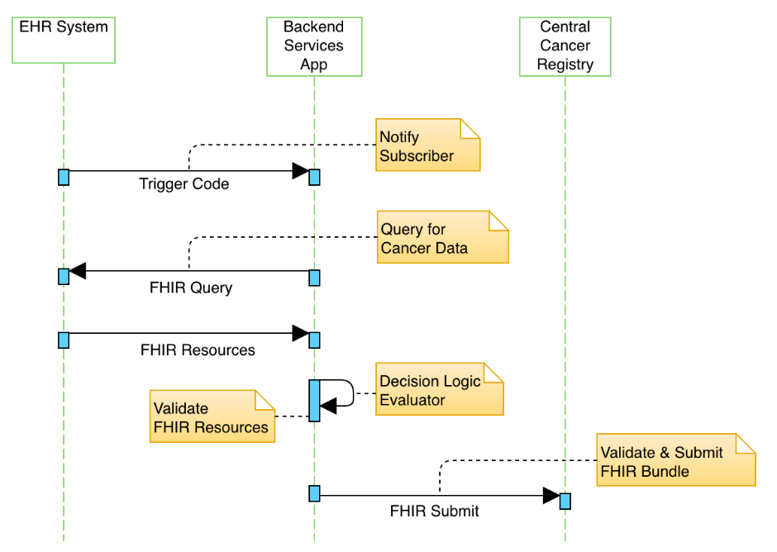
Cancer Diagnosis and Treatment
Activity Diagram
Step | Actor | Role | Activity | Input(s) | Output(s)
1 | EHR System | Notifier | Notify the Backend Service App that criteria have been met | Trigger code | Notification message
2 | Backend Services App | Data Extractor | Query the EHR for cancer data | Notification message | FHIR query
3 | EHR System | Query Responder | Return cancer data | FHIR query | FHIR resources
4 | Backend Services App | Decision Logic Evaluator | Evaluate if a report needs to be sent | FHIR resources | FHIR resources
5 | Backend Services App | Data Receiver | Receive and validate FHIR resources | FHIR resources | FHIR validated bundle
6 | Backend Services App | Data Sender | Send validated FHIR bundle to Central Cancer Registry | FHIR validated bundle | FHIR validated bundle
7 | Central Cancer Registry | Data Receiver | Receive and validate FHIR bundle | FHIR bundle | Validated FHIR bundle
8 | Repeat Steps 1-7 for any category notification that meets the reporting criteria as needed
Sequence Diagram

Slide 11
Cancer: Alternate Flow Reporting Every Encounter
The Cancer Diagnosis and Treatment – Reporting Every Encounter user story remains the same as the Cancer Diagnosis and Treatment user story except instead of identifying a category of criteria that triggers a report, the “all reports” criteria are set.

Slide 12
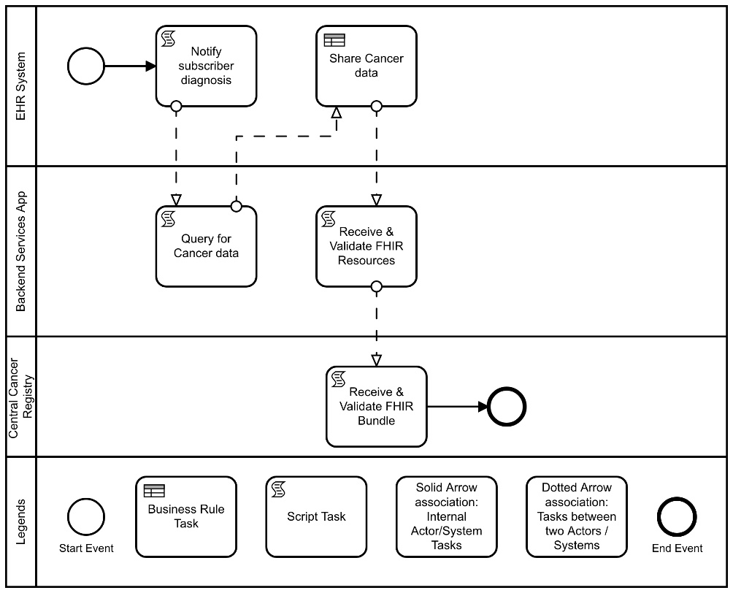
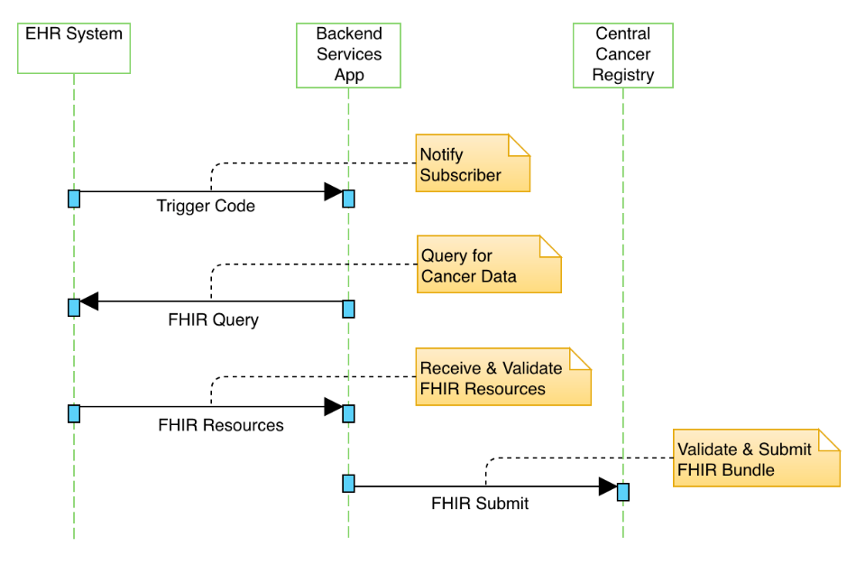
Cancer Alternate Flow Every Encounter
Activity Diagram
Step | Actor | Role | Activity | Input(s) | Output(s)
1 | EHR System | Notifier | Notify the Backend Service App that criteria have been met | Trigger code | Notification message
2 | Backend Services App | Data Extractor | Query the EHR for cancer data | Notification message | FHIR query
3 | EHR System | Query Responder | Return cancer data | FHIR query | FHIR resources
4 | Backend Services App | Data Receiver | Receive and validate FHIR resources | FHIR resources | FHIR validated bundle
5 | Backend Services App | Data Sender | Send validated FHIR bundle to Central Cancer Registry | FHIR validated bundle | FHIR validated bundle
6 | Central Cancer Registry | Data Receiver | Receive and validate FHIR bundle | FHIR bundle | Validated FHIR bundle
7 | Repeat Steps 1-6 for all reports
Sequence Diagram

Slide 13
Working Session:
Outstanding Questions

Slide 14
Use Case Considerations
Policy Considerations (e.g., authorities, data use agreements, etc.)
Non-Technical Considerations (e.g., as performance, SLAs, etc.)

Slide 15
Next Steps
Next Meeting: July 9th, 12-1 pm ET
Focus of Next Meeting:
Policy and Non-Technical Considerations
Homework:
Review and provide comments on the Use Cases
Submit any potential Research User Stories
Or Email comments to becky.angeles@carradora.com

Slide 16
Contacts
Use Case Development
Becky Angeles: becky.angeles@carradora.com
Jamie Parker: jamie.parker@carradora.com
Kishore Bashyam: kishore.bashyam@drajer.com
Mike Flanigan: mike.flanigan@carradora.com
Technical SME
Brett Marquard: brett@waveoneassociates.com
Technical Lead
Nagesh “Dragon” Bashyam: nagesh.bashyam@drajer.com
CDC Team
Maria Michaels: ktx2@cdc.gov
Wendy Blumenthal: wfb6@cdc.gov
Arun Srinivasan: fos2@cdc.gov
Syed Sameemuddin: puv5@cdc.gov
Abigail Vail: bzv3@cdc.gov
Aaron Harris: ieo9@cdc.gov
Brian Gugerty: vaz6@cdc.gov
Cynthia Bush: pdz1@cdc.gov
Laura Conn: lbk1@cdc.gov
TEP Co-Chairs
John Loonsk: john.loonsk@jhu.edu
Bill Lober: lober@uw.edu

Slide 17
Resources/Useful Links

