Slide 1
MedMorph Consolidated Use Case Workgroup January 21, 2021

Slide 2
Meeting Agenda
Topic | Time
Welcome and Logistics | 5 mins
Industry and Occupation Presentation (Genny Luensman) | 20 mins
RA IG Ballot Update and Reconciliation | 5 mins
USCDI Update | 10 mins
Content IG Planning | 15 mins
Next Steps | 5 mins

Slide 3
Use Case Workgroup Logistics
Use Cases can be found on our MedMorph Confluence site: https://carradora.atlassian.net/wiki/spaces/MedMorph/pages/381780019/Use+Case+Work+Groups
Please provide feedback and comments directly on the Confluence page(s)
We will provide an agenda prior to each call so you can plan accordingly
We may focus on a particular use case or a common section for all use cases

Slide 4
OCCUPATIONAL DATA FOR HEALTH (ODH)
Genevieve Luensman, PhD
National Institute for Occupational Safety and Health
Centers for Disease Control and Prevention
MedMorph Use Case Work Group Meeting
January 21, 2021

Slide 5
Purpose of ODH
Improve patient care
Manage populations
Support prevention, diagnosis, management, treatment
Support case reporting, submissions to cancer registries
Enhance surveillance data collection
Mitigate workplace outbreaks
Identify and monitor work-related conditions

Slide 6
ODH: Informatics Products to Facilitate Implementation
Information Model & Vocabulary
Data Sharing Standards
How to Collect & Use
www.cdc.gov/niosh/topics/ehr/default.html

Slide 7
ODH Information is Organized into Topics
Employment Status
Retirement Date(s)
Combat Zone Period(s)
Job(s) (Past or Present) and Voluntary Work
Longest-Held Work (Usual)
Work of Household Member(s) of a Minor
https://academic.oup.com/jamia/article/27/7/1072/5855728

Slide 8
ODH Job Topic is Used in Public Health Case Reporting
Job(s) (Past or Present) and Voluntary Work electronic case reporting (eICR)
Job: a work situation, training position, or (potentially-clinically relevant) volunteer position held for a specified time period.
Data for each job are kept linked (related to one-another).
Structure is for information about any job(s) as needed, i.e., current job(s), historical jobs.

Slide 9
ODH Usual Work Topic is Used in Multiple Public Health Use Cases
Longest-Held Work (Usual) cancer reporting, vital records death reporting, eICR
Usual Work: the work a person has performed for the longest amount of time during their life, regardless of the person’s current job and regardless of whether the person performed this work for a continuous time.
Only one set of information is kept: a person only has one “usual work” at the time its recorded.

Slide 10
Job(s)- Past or Present
with start & end dates per job
(Job) Occupation: type of work
(Job) Industry: kind of business
Employer Name & Address
Work Classification: (e.g., self-employed, armed forces, volunteer emergency responder)
Supervisory Level: (e.g., foreman, paygrade for military)
Work Schedule
Weekly Work Days
Daily Work Hours
Job Duty(s)
Occupational Hazard(s)
Underlined: has a defined value set. Italicized: collected as free text.

Slide 11
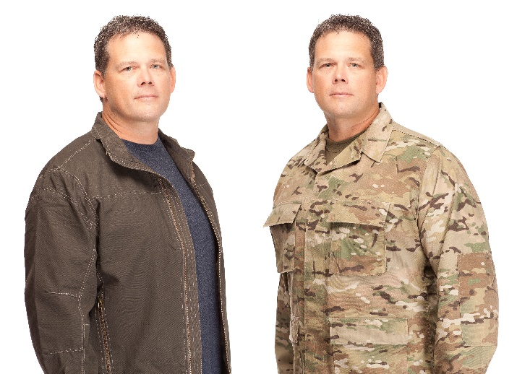
Longest-Held Work (Usual)
Can span multiple jobs
Usual Occupation
Usual Industry
Start Date
Duration

Slide 12
“Occupation” and “Industry” Require Context
Job(s) (Past or Present) and Voluntary Work electronic case reporting (eICR)
Job Occupation (aka Past or Present Occupation): LOINC 11341-5, History of Occupation
Job Industry (aka Past or Present Industry): LOINC 861880-0, Occupation Industry
Longest-Held Work (Usual) cancer reporting, vital records death reporting, eICR
Usual Occupation (aka Longest-Held Occupation): LOINC 21843-8, Usual Occupation
Usual Industry (aka Longest-Held Industry): LOINC 21844-6, Usual Industry

Slide 13
Selecting ODH Occupation and Industry Value Sets
Requirements:
Facilitates self-selection using computer search capabilities
Relevant for patient care
Hierarchical for population health, public health
Comprehensive
CDC_Census_Occupation_2010 and CDC_Census_Industry_2012
Categories used for public health surveys, death records, cancer reporting, etc.
Indexes are used to translate text to category codes after collection
Enhancement of coding system with index titles to support self-selection would have required extensive maintenance effort

Slide 14
“Occupation” and “Industry” Elements in Message Mapping Guides (MMGs) are Unique to MMGs
Current Occupation
For narrative text
LOINC code 85658-3, Occupation [Type]
Current Occupation Standardized
Specifically for the CDC_Census code determined from the narrative text
LOINC code 85659-1, Occupation CDC_Census code
Current Industry
For narrative text
LOINC code 85078-4, Occupation Industry [Type]
Current Industry Standardized
Specifically for the CDC_Census code determined from the narrative text
LOINC code 85657-5, Occupation Industry CDC_Census code
These LOINC codes do not specify a context; “current” is a meaning assigned by the MMG.

Slide 15
ODH Occupation Value Set: PHVS_Occupation_ONETSOC_Detail_ODH
Codes for the O*NET-SOC alternate (“lay”) titles
SOC: Standard Occupational Classification
O*NET: The Occupational Information Network
O*NET alternate titles: search-friendly titles for self-recognition
ODH concept code structure: XXXXX.YY.ZZZZZZ
SOC-Code.O*NET-Extension.NIOSH-Extension
Maintains hierarchy for grouping
Crosswalks to PHVS_Occupation_CDC_Census2010

Slide 16
ODH Occupation Vocabulary Meets Multiple Stakeholder Needs
Standard Occupational Classification (SOC)
Carpenters
(47-2031)
O*NET-SOC Occupation Categories
Rough Carpenters
(47-2031.02)
Construction Carpenters
(47-2031.01)
O*NET
“lay” titles
Scaffold Builder (472031.02.036650)
Trestle Builder (472031.02.043386)
Wharf Builder (472031.02.045396)
Refinisher (472032.01.034644)
Miniature Set Builder (472032.01.027176)
Garage Door Hanger (472032.01.018188)

Slide 17
ODH Industry Value Set: PHVS_Industry_NAICS_Detail _ODH
Codes for the NAICS index titles
NAICS: North American Industry Classification System
Index: search-friendly titles
ODH concept code structure: XXXXXX.YYYYYY
NAICS-Code.NIOSH-Extension
Maintains hierarchy for grouping
Crosswalks to PHVS_Industry_CDC_Census2010

Slide 18
ODH Industry Vocabulary Meets Multiple Stakeholder Needs
North American Industry Classification System (NAICS)
All Other Amusement and Recreation Industries
(71-3990)
Archery ranges (713990.000771)
Riding stables (713990.014504)
Billiard rooms (713990.001645)
Golf driving ranges (713990.007767)
Shooting galleries (713990.015475)
Skeet shooting facilities (713990.015654)
Trampoline facilities (713990.017746)
Industry Value Set:
Coded NAICS index terms
PHVS_Industry_CDC_NAICS2012_ODH

Slide 19
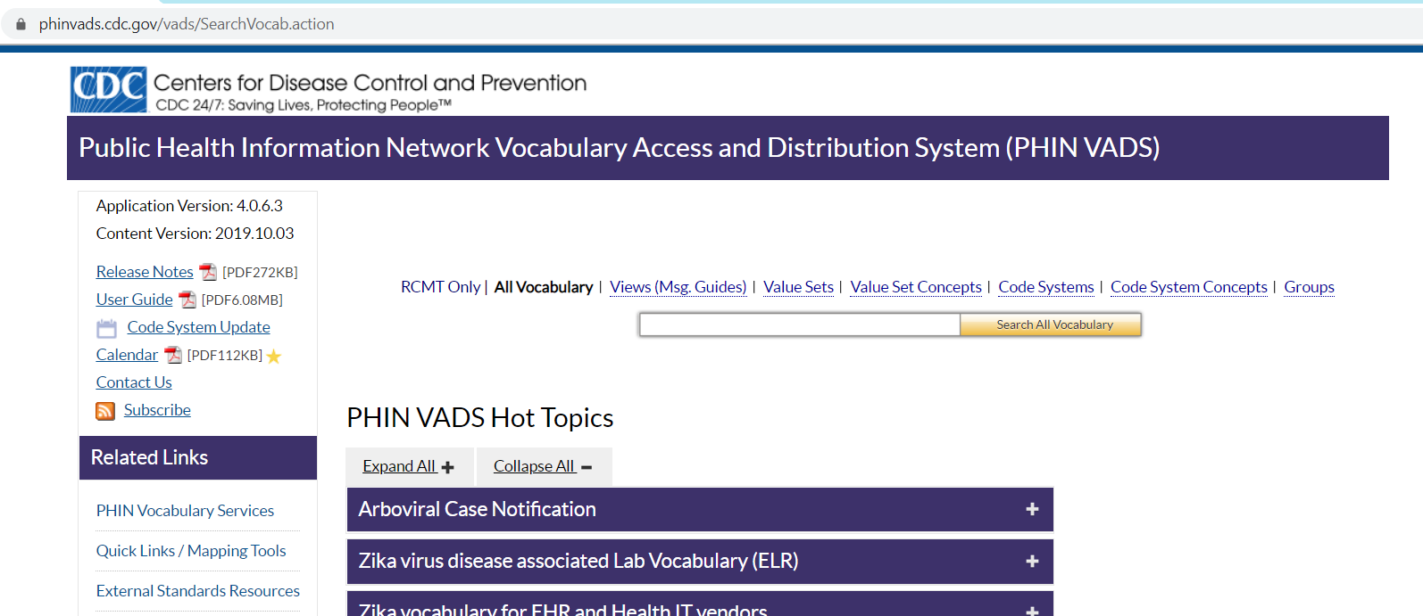
ODH Vocabulary is Publicly Available
ODH

Slide 20
ODH Interoperability Templates are Available
HL7 Fast Healthcare Interoperability Resources (FHIR)
ODH FHIR Implementation Guide (STU) http://hl7.org/fhir/us/odh/STU1/
Clinical Document Architecture (CDA)
HL7 ODH Consolidated-CDA (C-CDA) Supplemental Template(STU) http://www.hl7.org/implement/standards/product_brief.cfm?product_id=522
IHE Patient Care Coordination Technical Framework Content Module, ODH Supplement(Trial Use) https://www.ihe.net/resources/technical_frameworks/#pcc
HL7 Version 2 Messaging Standard (V2)
V2.9 ODH segments http://www.hl7.org/implement/standards/product_brief.cfm?product_id=516

Slide 21
ODH Is in Place for Some Interoperability Use Cases
HL7 Consolidated CDA Templates for Clinical Notes and IHE Medical Summary CDA:
patient summaries, transitions of care, etc.
HL7 Electronic Initial Case Report (eICR), CDA (Release 2) & Electronic Case Reporting (eCR), FHIR
HL7 Cancer Registry Reporting, CDA
HL7 Vital Records Death Reporting, CDA
HL7 Early Hearing Detection and Intervention (EHDI) Results, V2
HL7 Critical Congenital Heart Defects (CCHD) Pulse Oximetry Screening Results, V2
IHE Healthy Weight, CDA
IHE Emergency Department Referral, CDA
IHE Exchange of Personal Health Record Content, CDA
IHE Query for Existing Data for Mobile, FHIR
IHE International Patient Summary, FHIR
Notes:
ODH is included in eICR FHIR.
Current CDA eICR only has employment detail at this time.
First step is to have it included in case reporting and not a trigger code at this time.
Its valuable if it comes in the initial report – actions can be taken more quickly to establish preventive measures.
John: For triggering the initial report, it is not specific enough. It is better to trigger on a syndrome or condition and use the ODH to help with the rules.
Genny: For some conditions, ODH is very specific.
Steve: include ODH element for any condition reported.
Ryan: ODH is useful, but we need to minimize the burden on providers to collect it. (Chat).
Genny: it is very useful if it is collected in an organized fashion.
Ryan: What is the legal stance on this information for data mining?
Genny: It is out of my area of expertise, but there are situations when it is reported to PH and PH does an investigation and it comes around that way. I can’t see a provider engaging with an employer.
Bill: The level of detail for epidemiology is different (more granular) than what is needed by the clinician.
Ryan: we have been looking at structured data and NLP, which could be another source. We have collected a lot of data in H&P since we didn’t have a good place to put it. Need a balance to curate this data in other methods.
Genny: There has been a study looking at NLP – results were not promising at the time. I don’t remember the details though. We have looked at NLP though.

Slide 22
Instructions for Incorporating ODH in Health IT Systems is Available
HL7 EHRS-FM Release 2: Functional Profile; Work and Health, Release 1 – US Realm; Informative Document. April 2019. http://www.hl7.org/implement/standards/product_brief.cfm?product_id=498
Prototype for demonstration of ODH collection by NIOSH (not for release).
A Guide to the Collection of Occupational Data for Health (ODH) – Draft V1-012221.

Slide 23
Highlights
ODH informatics products are ready for pilot testing
Key ODH topics for public health are Job(s) and Usual Work
Key ODH data elements are flavors of occupation and industry
We are seeking pilot partners

Slide 24
www.cdc.gov/niosh/topics/ehr/default.html
Genevieve Luensman
gluensman@cdc.gov

Slide 25
MedMorph RA FHIR IG Ballot Update and Reconciliation Process

Slide 26
Timeline: MedMorph Activities and IG Balloting
March
April
May
June
July
August
September
October
November
December
January 2021
Submit HL7 PSS
Develop MedMorph Use Cases
Review Use Cases End to End
Submit HL7 NIB
Finalize Use Cases
Submit HL7 RA FHIR IG
Prepare HL7 Reference Architecture (RA) FHIR IG
Legend
Jan 2021 HL7 WGM
HL7 Processes
MedMorph Project Activities
Sep 2020 HL7 WGM

Slide 27
Ballot Results
No Quorum Requirement for STU 1
Quorum is determined by whether a sufficient percentage of the individuals who signed up to vote actually did so. I.e. It's the percentage of voters who cast an Affirmative, Negative or Abstention vote out of all voters who registered to participate in that ballot. Removed voters are not considered to be "signed up" for the purposes of quorum calculation.
Pass/Fail (of all voters) 60% for STU 1
Passing is determined after balloters have had a chance to withdraw or retract. A calculation is made of the percentage of Affirmative votes out of the combined total of Affirmative + Negative votes. This calculated value is compared to the minimum percentage required to pass based on the type of ballot. Abstentions and No-votes are relevant as part of determining quorum but have no impact on whether a ballot "passes".
Total in Ballot Pool: 158
Affirmative: 60
Negative: 6
Abstain: 61
No Vote: 31
80.38% Quorum
Pass

Slide 28
Ballot Next Steps
Comment Disposition
We will bring DRAFT disposition to the RA WG for discussion and validation
Once the RA WG agrees on the dispositions, we will present final dispositions to the HL7 Public Health WG for voting
We will keep the RA WG updated on when the MedMorph dispositions will be presented to the HL7 PH WG
Once the dispositions are accepted, we will make changes to the RA
Goal is to get all comments dispositioned by late Spring 2021

Slide 29
USCDI Update

Slide 30
MedMorph’s Submission to USCDI ONDEC
MedMorph analyzed data elements from the multiple MedMorph use cases. Identified elements that were used by 2 or more use cases that were not existing in USCDI
Submitted 76 data elements to be considered added to USCDI
43 MedMorph elements were assigned Level 2
6 MedMorph elements were assigned Level 1
17 MedMorph elements were assigned Comment Level
6 MedMorph elements were considered to be duplicates of existing USCDI v1 elements
4 MedMorph elements are unknown
A BIG thanks to all who contributed time, effort, brain power – especially:
Wendy Blumenthal, Cindy Bush, Steve Eichner, Brian Gugerty, Genny Luensman, Craig Newman, Jenna Norton, Sameemuddin Syed

Slide 31
Draft USCDI v2 New/Reclassified Classes and Elements
https://www.healthit.gov/isa/sites/isa/files/2021-01/Draft-USCDI-Version-2-January-2021-Final.pdf
Notes:
In the event that too many level 2 data elements were eligible for promotion into the USCDI’s next version, the HITAC recommended that ONC consider establishing a prioritization process in order to reduce the risk of overwhelming providers and health IT developers with new requirements. The HITAC noted that a prioritization process should consider data classes/elements’ relevance to high priority goals, applicability to broad stakeholder groups, clearly defined use cases and workflows, and clear value propositions for adoption. Consistent with these recommendations and the fact that more than 100 submitted data elements were classified at level 2, ONC further prioritized the level 2 data elements for consideration as part of what would be put forward for public comment in Draft USCDI version 2 (USCDI v2). A key factor as part of our prioritization this year recognized that the ongoing COVID-19 pandemic has placed a strain on the resources of health IT developers and the health care community. For the Draft USCDI v2, we determined that proposed data elements for inclusion would need to meet two general priorities: 1) impose minimal new development burden, and 2) complement existing data elements in USCDI in order to support the broadest possibilities of use. To prioritize data elements for Draft USCDI v2, we assessed whether a level 2 data element could fill a significant gap within USCDI v1 and was already supported by current versions of the C-CDA and FHIR US Core implementation guide. We recognize that these criteria may change each year based on trends within the submissions received, high priority target areas, and other factors. We aim to provide relevant details on a given year’s priorities in order to provide greater transparency into the process and ensure continued alignment of USCDI submissions to high priority target areas for health IT and health care. As a result, we identified a set of data classes and elements for the Draft USCDI v2, which is set forth on the following pages. Level 2 data elements that were not included in the Draft USCDI v2 can be reviewed on the USCDI Level 2 webpage.

Slide 32
MedMorph Elements and USCDI V2
Class | Element
Clinical Notes | Cause of Death Information Date Pronounced Dead
Current Pregnancy | Last Menstrual Period Estimated Date of Delivery Mother’s Prepregnancy Weight
Immunizations | Immunization Code Immunization Status Immunization Administered Date Reason Immunization Note Performed
Laboratory Test | Laboratory Test/Panel Code Laboratory Test Performed Date
Laboratory Values/Results | Laboratory Result Status Laboratory Result Value
Medications | Date Medication Prescribed Medication Prescribed Code Medication Prescribed Dose Medication Prescribed Dose Units Medication Prescribed Reason Reference Date Medication Administered Medication Administered Code Medication Administered Reason Reference Medication Administered Performer Medication Administration Dose Medication Administration Dose Units
Class | Element
Newborn's Delivery Information | Gestational Age Place of Birth APGAR Score Pregnancy Outcome Birth Weight
Mother's Delivery Information | Number of Prenatal Visits Date of First Prenatal Care Visit Mother’s Delivery Weight Number of Fetal Deaths this Delivery Number of Live Births this Delivery Plurality
Patient Demographics | Patient Medical Record Number Patient Medicare Number Patient Social Security Number Patient Gender Identity Patient Marital Status Patient Address Use Period Patient Vital Status Patient Pregnancy Status Observation Patient Birth Place
Patient Work | Job Usual Work
Class | Element
Problems | Condition Onset Date Condition Abatement Date Condition/Diagnosis Code Date of Diagnosis Condition/Diagnosis Recorded Date
Procedures | Procedure Code Procedure Date Procedure Status

Slide 33
MedMorph Elements and USCDI V2
Class | Element
Encounter | Encounter Status Classification of Encounter Encounter Type Encounter Subject Encounter Identifier Encounter Period Encounter Participant Type Participant Overseeing the Encounter Primary Participant Responsible for Encounter Encounter Participant Individual Encounter Primary Performer NPI Encounter Primary Performer Name Encounter Primary Performer Professional Role Time Period Participant Participated in the Encounter Reason for the Encounter Diagnoses Relevant to this Encounter Encounter Primary Diagnosis Encounter Principal Diagnosis Hospital Encounter Discharge Disposition Encounter Location Address Expected Source(s) of Payment for this Encounter Encounter Chief Complaint

Slide 34
USCDI Public Comment Process
Step | Activity | Date
1 | Evaluate Draft USCDI v2 and submit comments via the ONDEC system | By April 15, 2021
2 | ONC reviews comments and recommendations | April 15 – July 2021
3 | ONC publishes USCDI v2 | July 2021
4 | ONC will consider USCDIv2 be included in a future cycle of the Standards Version Advancement Process (SVAP), which permits health IT developers to voluntarily update their certified health IT with these new USCDI data elements and provide those updates to their customers | Aug 2021

Slide 35
MedMorph Use Case Content IG Planning

Slide 36
Use Case Content IGs
Chronic Hepatitis C Surveillance (Hep C)
FHIR eICR IG will be used for Hep C
Hepatitis C is a Public Health reportable disease
As of now, all Hep C elements are accounted for in eICR IG
Cancer Reporting
New content IG will be created
Model after the eICR
Health Care Surveys
New content IG will be created

Slide 37
What goes in a Content IG?
Payload
Structure
Vocabulary for conveyance of the data
Methods of transaction
Name the trigger codes, rules and value sets (but these items reside outside the IG since they change rapidly)
One Knowledge Artifact Repository per Use Case
Queries?

Slide 38
Next Steps
Next Meeting: Thursday, January 28th?
Focus of Next Meeting:
USCDI Comments
Content IG Planning
Notes:
Next week is the HL7 Working Group Meeting.
Craig Newman and Ben Hamlin will be tied up in the WGM. If we decide talk about Content IG on next week’s call, we may not have the folks needed for that discussion…

Slide 39
Contacts
Use Case Development
Becky Angeles: becky.angeles@carradora.com
Jamie Parker: jamie.parker@carradora.com
Kishore Bashyam: kishore.bashyam@drajer.com
Mike Flanigan: mike.flanigan@carradora.com
Technical SME
Brett Marquard: brett@waveoneassociates.com
Technical Lead
Nagesh “Dragon” Bashyam: nagesh.bashyam@drajer.com
CDC Team
Maria Michaels: ktx2@cdc.gov
Wendy Blumenthal: wfb6@cdc.gov
Arun Srinivasan: fos2@cdc.gov
Syed Sameemuddin: puv5@cdc.gov
Abigail Viall: bzv3@cdc.gov
Aaron Harris: ieo9@cdc.gov
Shaoman Yin: wso3@cdc.gov
Brian Gugerty: vaz6@cdc.gov
Cynthia Bush: pdz1@cdc.gov
Laura Conn: lbk1@cdc.gov
TEP Co-Chairs
John Loonsk: john.loonsk@jhu.edu
Bill Lober: lober@uw.edu

Slide 40
Resources/Useful Links
Use Cases:
Use Case Work Group: https://carradora.atlassian.net/wiki/spaces/MedMorph/pages/381780019/Use+Case+Work+Groups
Hep C: https://carradora.atlassian.net/wiki/spaces/MedMorph/pages/694452251/Hepatitis+C+Use+Case+-+DRAFT
Health Care Surveys: https://carradora.atlassian.net/wiki/spaces/MedMorph/pages/692060180/Health+Care+Survey+Use+Case+-+DRAFT
Cancer: https://carradora.atlassian.net/wiki/spaces/MedMorph/pages/699990019/Cancer+Use+Case+-+DRAFT
Reference Architecture: https://carradora.atlassian.net/wiki/spaces/MedMorph/pages/545914881/Reference+Architecture+Document

