Slide 1
Making EHR Data More Available for Research and Public Health (MedMorph)
PCORnet and the Research Data Exchange Implementation Guide (IG)
May 26, 2021

Slide 2
Meeting Agenda
Topic | Presenter | Time
Welcome | Maria Michaels | 2 mins
PCORnet Data Processing/Quality Needs | Kristin Lyman (REACHnet) | 45 mins
Questions/ Statements from PCORnet Sites | Maria Michaels | 10 mins
Next Steps | Maria Michaels (CDC) | 3 mins

Slide 3
PCORnet Data Processing/Quality Needs
Kristin Lyman

Slide 4
PCORnet Data Processing/Quality Needs
Discuss how the MedMorph architecture would support:
  Transformation of raw values in an EHR (or associated EDW) to PCORnet CDM value set values given large variation in raw values and without requiring extensive mapping input from the data contributor
    e.g., for the result unit for a lab result, raw values like ‘ x10E3/uL’ and ‘Thousand/uL’ would need to be translated to the PCORnet CDM value of ‘10*3/uL’
  Population of standard nomenclatures like LOINC and RxNorm CUI where this data is not populated at the source but could potentially be derived from other data
    e.g., raw lab name, raw medication name
Notes:
Transformation of raw values in an EHR (or associated EDW) to PCORnet CDM value set values given large variation in raw values and without requiring extensive mapping input from the data contributor
Manual mapping requires significant input from data contributor. Kristin does a lot of this and it takes a lot of time.
Data quality is a huge problem
Mike B: Non uniformity of discreet data collected in EHR – lack of standardization across EHRs. Hundreds of studies that have come out of PCORnet that show the strength of structured data. Any one data source compared to another is hard due to quality problems. Variation between vendor problems and within vendors. Use analytics to see through the wholes of data
Maria: How can a framework help with this? What can we grab onto to help with this issue?
Mike B: Most HL7 standards aim to healthcare. There are no public health standards that deal with biosurveillance, infectious, disease, genetic variation, etc. The issue is that PH needs to step up and standardize the data from public health.
Maria: We are developing PH Libraries
Mike: Standards are different than profiles.
Maria: working with federal partners to regulate these items.
Dragon: In order to standardize data and representation for PH use case, we are working to create a library of profiles that represent content that include specific data elements from PH. Derived from us core and add other PH (pregnancy, problems, medications, etc.). These profiles have values sets, binding, code sets. When EHR conforms to these profiles, it could be used for other reasons downstream. Library will grow and standard dataset will evolve from it.
Brian: US core 3.1.1 made it into regulations to operationalize data elements in EHRs starting in the next year or so.
Kristin: IF the profile can help with the transformation, it may be helpful to lay out the steps on how this would work. Not familiar with FHIR enough to know how that would work.
Hongfang: Any plans for PGHD centers
Maria: not in scope for now, but it is on our roadmap.
Susan: Can a patient opt out for research purposes?
Maria: Not in scope for MedMorph, but sync for science may be addressing this.
Future ideas: IRB approval, patient consent (unless you opt out)
Ram: How would the transformation not require extensive mapping input form data contributor.
Kristin: this is an issue we face, how would it be different with the MedMorph architecture?
Maria: if the mappings are done for the required US core FHIR APIs, MedMorph would leverage them.
Ram: Semantic mapping would be different for each system. Still need to map to PCORnet or FHIR.
Dragon: MedMorph would reduce the lift of mapping.
Ram: If the source has existing mappings to FHIR
Population of standard nomenclatures like LOINC and RxNorm CUI where this data is not populated at the source but could potentially be derived from other data
Kristin: another manual process currently – how can MedMorph help
Maria: this is out of scope for MedMorph. ONC regulation ? requires 80% of data to be LOINC.
Susan: PCORnet is working with data in 2011. LOINC wasn’t used until 2015.
Maria: Need to make ONC aware of this issue. Document as something for the roadmap
Mike: Most laboratory data is structured and just needs to be mapped.
Susan: Can use the same component id for a lab but can use different LOINC codes

Slide 5
PCORnet Data Processing/Quality Needs
Discuss how the MedMorph architecture would support:
  Transformation of clinical observations relevant to specific studies
    e.g., transformation of inpatient vitals data from flowsheet to populate PCORnet CDM clinical observations table
  Transformation of general observations relevant to specific studies
    e.g., leveraging ADT data to identify ICU admissions and create an associated flag in the PCORnet CDM general observations table
Notes:
Transformation of clinical observations relevant to specific studies
Kristin: catch all clinical observations table in PCORnet CDM. Use vitals data from Flowsheet to populate the table.
Brian: USCDI includes vital signs. Vendors are coding to it now.
Dragon: mapping it to FHIR at the source will reduce variations. The way the clinical workflows document the data is a separate issue.
INSERT Ram’s Chats here. (ETL, FHIR)
Susan: You are mentioning the requirements for reporting but may not be applicable for research.
Brian: It applies to certified EHRs (no matter the purpose)
Policy piece of roadmap: Policy and legal considerations – how to automate these in a standard approach: checks IRB application to send data element, with identifying data, needs consent.
Kristin: take into account individual DSUA have limitations
Ram: For research, it is what my hospital research feels is safe to send through EHR.
Maria: we would put technical standards in place to support policy regulations (not make requirements). Document technology that help with policies.
Brian: the MedMorph BSA has services to de-identify, etc.
Maria: MedMorph could document the standards and implement technology (and identify and advance standards) to help with executing the policy.
Transformation of general observations relevant to specific studies
Kristin: PCORnet CDM does not have a way to note that transfer patient across different unit. Leverage ADT data that will cerate a flag in the observations table.

Slide 6
PCORnet Data Processing/Quality Needs
Discuss how the MedMorph architecture would support:
  Data quality checks that are often built into site or network-level data pipelines – these include:
    Value conformance
    Relational conformance
    Data persistence
    Completeness
    Plausibility
  Research queries involving the need for curation of value sets/code lists to be applied to historical data sets

Slide 7
Questions/Statements from the PCORnet Community
Maria Michaels

Slide 8
Questions from the Community
PCORnet has enough trouble supporting the sites already involved; are they able to support these new data partners?
  Response: From what we understand so far, a lot of the effort in supporting data partners is related to having multiple different ways that the data is collected and sent. This approach would help streamline the approaches so that the effort should lessen, allowing for the ability to support more data partners (if desired) or to be able to focus more on research.
How does this effort compare with HL7 Vulcan, which is also about using FHIR to make EHR data more available for research?
  Response: We’ve connected with Vulcan, and they seem to be focused on streamlining content rather than architecture and focused on some work with FDA. We will continue to reach out and work together where possible. They have indicated they could use the MedMorph reference architecture.
How will FHIR capacity be expanded in public health agencies, to take advantage of this IG?
  Response: There is a public health component of the MedMorph reference architecture already, so we’ve been working on it in parallel with the research FHIR capacity. We’re approaching it in a similar way, with a common architecture to start with, working towards common content profiles wherever possible (we’re aiming to ultimately develop a “U.S. Public Health Library” of common content profiles), and then defining any remaining specific use case needs, if not already covered by the MedMorph reference architecture or shared content profiles, in content IGs.

Slide 9
Statements from the Community
TriNeTX seems to have cornered the market on use case 1 (new data partner), albeit in a non-PCORnet/non-FHIR context.
  Response: This is helpful to know. We’re providing more of a method to do this using FHIR and focusing on PCORnet needs. It could be that this company may eventually want to use this Research Content IG to venture into FHIR. We can look into it further to see if there are overlaps we should be considering for this IG.
I have heard (but I can’t my finger right now on exactly where) that someone has already implemented PCORnet CDM→FHIR.
  Response: Would be happy to learn more about this if you figure out who’s doing it. If they have a FHIR IG, that can simplify our work (e.g., we’re using an existing FHIR IG for one of the public health use cases). If they don’t, we can work together to ensure we have a shared IG that everyone can benefit from.
Medical University of South Carolina has a FHIR-to-PCORnet system.
  Response: I think this may be written up in a pre-print that Les Lenert mentioned on the last call. We can definitely learn from MUSC’s approach to inform the IG.

Slide 10
Next Steps

Slide 11
Next Steps
Next Meeting?
  Focus of Next Meeting:
    Continue with requirements
Test at an upcoming Connectathon

Slide 12
Contacts
Use Case Development
Becky Angeles: becky.angeles@carradora.com
Jamie Parker: jamie.parker@carradora.com
Kishore Bashyam: kishore.bashyam@drajer.com
Mike Flanigan: mike.flanigan@carradora.com
Technical SME
Brett Marquard: brett@waveoneassociates.com
Technical Lead
Nagesh “Dragon” Bashyam: nagesh.bashyam@drajer.com
CDC Team
  Maria Michaels: ktx2@cdc.gov
  Wendy Blumenthal: wfb6@cdc.gov
  Arun Srinivasan: fos2@cdc.gov
  Syed Sameemuddin: puv5@cdc.gov
  Abigail Viall: bzv3@cdc.gov
  Aaron Harris: ieo9@cdc.gov
  Shaoman Yin: wso3@cdc.gov
  Brian Gugerty: vaz6@cdc.gov
  Cynthia Bush: pdz1@cdc.gov
  Laura Conn: lbk1@cdc.gov
TEP Co-Chairs
  John Loonsk: john.loonsk@jhu.edu
  Bill Lober: lober@uw.edu

Slide 13
Resources/Useful Links
Research Use Case (login with Carradora id/password): https://carradora.atlassian.net/wiki/spaces/MedMorph/pages/858980359/Research+Use+Case+-+DRAFT
MedMorph Research Content IG Proposal (login with HL7 id/password): https://confluence.hl7.org/display/FHIR/Research+Data+Exchange
MedMorph Reference Architecture FHIR IG: http://hl7.org/fhir/us/medmorph/2021Jan/

Slide 14


REACHnet Infrastructure
PTR Queries
Use case-specific ad hoc transfers
PopMedNet
Daily transfer
LA CaTS Genomics
Quarterly transfer
GPID
PGD
Secure Environment
Longitudinal Data Sources (claims, vital records, hospital discharge data, etc.)
Quality Checks
Study Specific Data Marts (aggregated clinical and other data types)
Partner ETL
TriNetX
Health System
Partner A
i2b2
SMART
Frozen SAS CDM Data Mart
Live
CDM
Data cleaning, Derivations, Transformations
Quality Checks
Combined
CDM (Longitudinal patient records linked by GPID)
Condition Specific Cohort A
Data
Lake
TriNetX
GPID Hashing
i2b2
GPID Matching
Secure Connections
Frozen SAS CDM Data Mart
Data cleaning, Derivations, Transformations
Health System Partner B
Live
CDM
Condition Specific Cohort B
Quality Checks
I2b2 & analysis tools
Views Access
TriNetX
i2b2
Frozen SAS CDM Data Mart
Data cleaning, Derivations, Transformations
Condition Specific Cohort C
Health System
Partner C
Live
CDM
Quality Checks
i2b2
Sync App
Pragmatic Trial App Suite
Secure Environment

Slide 15
REACHnet Infrastructure and Research Use Case
September 16, 2020

Slide 16



What is REACHnet?
1 of 9 Clinical Research Networks in PCORnet
REACHnet enables the conduct of multi-site research with enhanced efficiency in real-world healthcare delivery systems
Original members:
Administered by LPHI
Reflects EHR data for > 8 million patients across LA and TX
New
members:

Slide 17
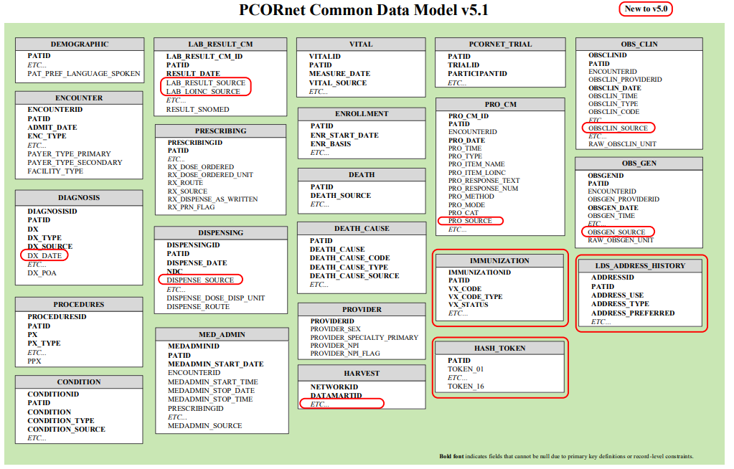
PCORnet® Common Data Model

Slide 18
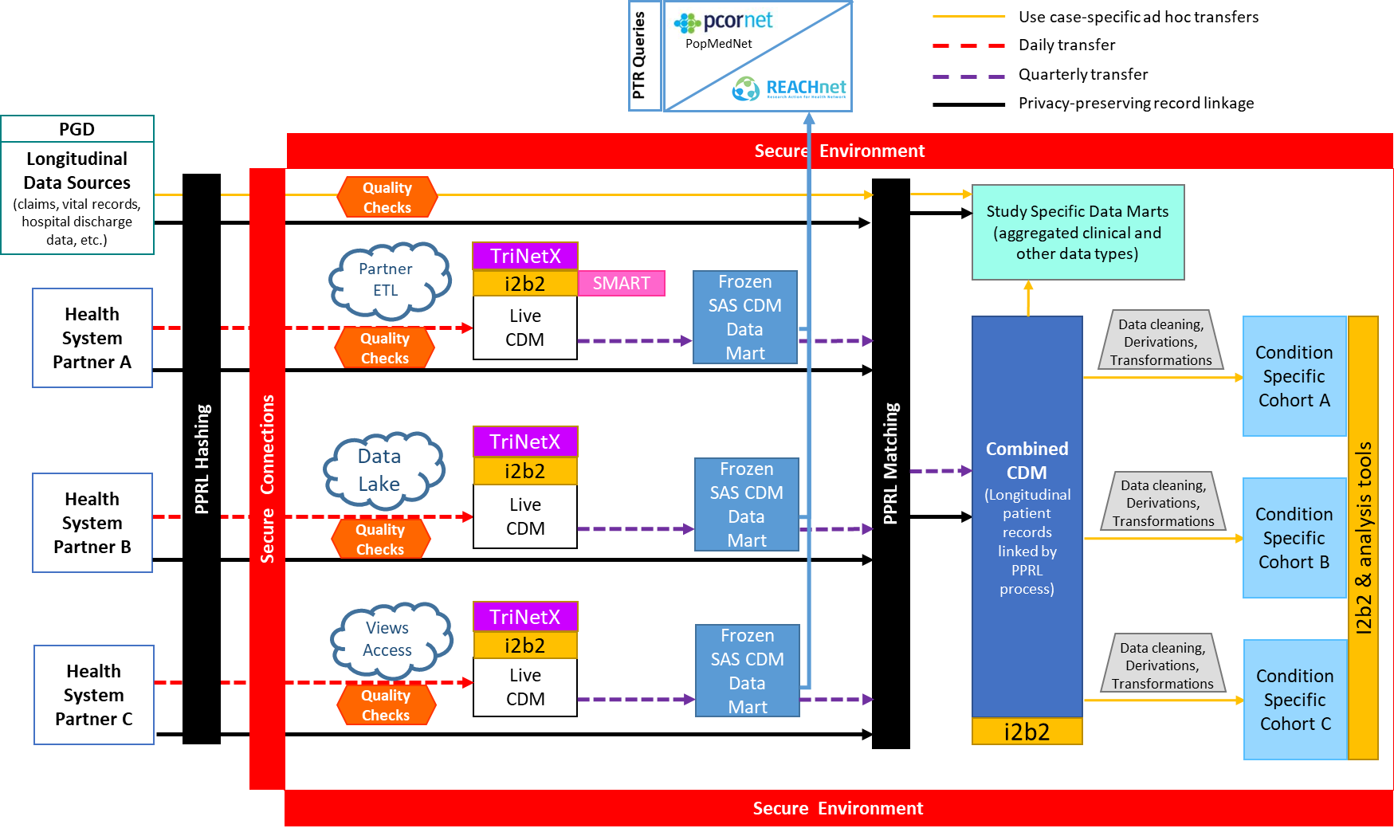
REACHnet Infrastructure

Slide 19
REACHnet Data Contribution Models
Partner ETL – REACHnet member completes transformation to the PCORnet CDM within their environment and transmits the curated data to the REACHnet data center.
Data Lake – REACHnet accesses raw EHR data within REACHnet member data warehouse and transforms raw data to the PCORnet CDM.
Views Access – REACHnet accesses EHR views within REACHnet member environment from which data is transformed to the PCORnet CDM.

Slide 20
REACHnet Research Use Case
Context: Request for data that is not currently housed in the REACHnet data center (i.e., data that falls outside of the elements contained in the PCORnet CDM)
Research participation: a) research partner submits request through REACHnet “Front Door”; b) REACHnet confirms feasibility; c) REACHnet members confirm interest in participating.
Regulatory: Study-specific data sharing and use agreement required between research partner, LPHI, participating REACHnet member(s).
Data extraction: REACHnet coordinates with the participating REACHnet member(s) to locate, transform, and extract the relevant data (process differs based on applicable data contribution model).
Other considerations: a) whether data needs to be linked to PCORnet CDM data; b) how often data needs to be updated; c) whether data updates are incremental or full refreshes.

Slide 21
Old Slides

Slide 22
MedMorph Background

Slide 23

The Data Lifecycle & Impacts to the Public’s Health
Guidelines
Recommendations
Guidance
Public Health Policies or
Mandates
Point of Care
Emergency Response
Public Health Departments
Community Services
Delivering actionable knowledge
ACTION
HEALTH
IMPACTS &
OUTCOMES
KNOWLEDGE
UPDATING
SCIENTIFIC
EVIDENCE
Fast Healthcare Interoperability Resources (FHIR®)
INFORMATION
DATA
Analyzing data to advance evidence
EHRs
Registries
Public Health Info Systems
Community Info Systems
…many potential sources
Data Science Analytics
Data Linkages
Data Visualization
Notes:
Structuring recommendations and using standards-based shareable CDS ultimately helps the data lifecycle. Computable guidelines (recommendations, guidance, etc.) help apply the evidence in practice more consistently since they are translated from the source of truth. Data resulting from the actions taken in practice would be more easily extracted to perform analyses that lead to information that can be incorporated into the knowledge that gets translated to practice… and the cycle begins anew. FHIR can help facilitate the data lifecycle by providing an interoperability standard for data exchange on its own or in partnership with existing widely used standards.
Data to Action patient-generated examples:
Patient takes a walk, pedometer records data that can be uploaded to patient’s chart
Patient uses CPAP, machine records sleep-related data, data is accessed remotely

Slide 24
Making EHR Data More Available for Research and Public Health (MedMorph)
Funded by the Patient-Centered Outcomes Research Trust Fund (PCORTF) via the U.S. Department of Health and Human Services (HHS) Assistant Secretary for Planning and Evaluation (ASPE)
  Total project timeline: 3 years
PROBLEM: Patient-centered outcomes researchers and public health professionals need better ways to get data from different electronic health record (EHR) systems without posing additional burden on health care providers
GOAL: Create a reliable, scalable, generalizable, configurable, interoperable method to get EHR data for multiple public health and research use cases
OBJECTIVE: Develop a reference architecture and demonstrate a reference implementation (including implementation guides (IGs)
https://www.cdc.gov/csels/phio/making-ehr-data-more-available.html
Notes:
https://aspe.hhs.gov/making-electronic-health-record-ehr-data-more-available-research-and-public-health

Slide 25
Technical Expert Panel (TEP):
Participating Stakeholder Groups
Federal Partners
Health IT developers
Clinicians/ Healthcare Organizations
Medical Societies
Public Health Organizations
Evaluation experts
Laboratory Professional Groups
Standards experts
Clinical decision support developers
Clinical quality measure developers
Researchers
Policy or technical support for implementation
*NOTE: Over 100 individuals from these partner groups have participated in the MedMorph TEP and at least one of its workgroups.

Slide 26
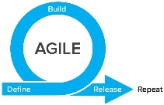
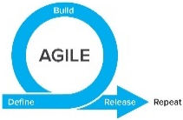
TIME
WE ARE HERE
SMEs: Hepatitis C
Research
Research
MedMorph Workgroups
Technical Experts
SMEs: Hepatitis C
Use Cases
(Public Health & Research)
Technical Experts
SMEs: Cancer
Use Case WG
SMEs: Cancer
Technical Experts
Technical Experts
SMEs: Health Care Surveys
SMEs: Health Care Surveys
Technical Experts
Technical Experts
Evaluation
WG
Evaluation Planning
Evaluation
Roadmap
Data Flows & Clinical Workflows
Reference Architecture/Authorities/Policies
SMEs: All use cases
SMEs: All use cases
Technical
Requirements
Reference Architecture WG
Data Flows & Clinical Workflows
Data Standards
SMEs: All use cases
SMEs: All use cases
Data Standards
Reference Architecture/Authorities/Policies
SMEs: All use cases
SMEs: All use cases
Notes:
Began with one workgroup per use case to be modeled for public health purposes (i.e., Hepatitis C Reporting, Cancer Reporting, Health Care Surveys), which included SMEs from other use cases as well, and across all use cases for a “Research Use Case”.
Switched to technical workgroups to identify Data Flows & Clinical Workflows, Data Standards, and Reference Architecture/Authorities/Policies based on the use case requirements drafted. Each of the technical workgroups had a mix of use case SMEs.
Eventually combined use case workgroups into one consolidated use case workgroup in order to better identify commonalities and differences. This workgroup will take the lead on defining requirements for content implementation guides (IGs), where applicable.
When each use case defined its requirements and then further identified commonalities and differences, a consolidated “Reference Architecture (RA)” WG focuses on technical requirements for the RA IG, and eventually the use case content IGs, where applicable. There may be iteration between the use case WG and RA WG, in agile fashion.
An evaluation workgroup works in parallel to the use case and RA WGs to develop short-term and long-term evaluation plans. The short-term evaluation plan will be part of the real-world pilots, and the long-term evaluation plan will be part of the roadmap (i.e., long-term evaluation is beyond the current scope of MedMorph, which is a time-limited PCORTF project).
Initial testing occurred in sandbox environments and then will be moving to real-world pilots.

Slide 27

Technical Expert Panel:
End Users, Data Recipients, Stakeholders – Including representatives of additional use cases
Foundation of standards supported by health IT certification (CCDS/USCDI, APIs, FHIR)
Fully Modeled Use Cases
Hepatitis C, Cancer, Healthcare Surveys
Fully Modeled Use Cases
Hepatitis C, Cancer, Healthcare Surveys
Implementation Guides
For general use and for each use case
Technological Strategies
To develop scalable and extensible architecture
Technological Strategies
To develop scalable and extensible application
Agile Development: Iterative Design-Build-Test Cycles (test case: Hepatitis C)
CCDS: Core Clinical Data Set
USCDI: US Core Data for Interoperability
APIs: Application Programming Interfaces
FHIR: Fast Healthcare Interoperability Resources
PRODUCTS: Reference Architecture, Reference Implementation
(Open Source Software) & Balloted Implementation Guides, Roadmap for Scalability and Sustainability
National Test Collaborative
Including a variety of clinical organizations and their EHR platforms
Software
Clinical organization
EHR platform
Other testing partners (e.g., public health departments, registries, health IT developers, etc.)
Evaluation Planning
Measure and Evaluate

Slide 28

MedMorph Abstract Model of Actors and Systems
EHR
Trusted Third Party
Updates/Sign off
Reportability
Response
Reportability
Response
Provider
Notification
Reportability
Response
Query
Query
Response
Data
Research Organization
Reportability
Response
Backend Services
App
Report
PHA
Response
Data Repository
De-Identified/
Pseudonymized/
Anonymized
Data
Query
Response
Query
Data/Trust Services
Knowledge Artifact Repository
Data

Slide 29
Value for PCORnet

Slide 30



What’s in it for PCORnet?
The Research Content IG will help provide…
Standardization across EHRs, institutions, etc. so that implementation is more consistent & can be more portable between sites or platforms (e.g., if there are transitions between systems or onboarding of more sites)
Consistent description of how to leverage EHR FHIR implementations for data exchange between EHRs and an endpoint (e.g., data marts)
DATA
EHR
+
+
FHIR
APIs
IG

Slide 31
Research Requirements Collected

Slide 32
Research Requirements Collected
We have met with Louisiana Public Health Institute (LPHI) a few times and have collected some requirements for Use Stories and a Research Content IG
Collected Requirements can be found on the Research Use Case Confluence Page
  https://carradora.atlassian.net/wiki/spaces/MedMorph/pages/858980359/Research+Use+Case+-+DRAFT

Slide 33
User Stories
User Story 1 – Onboard a New Research Data Partner
  User story text and diagrams
User Story 2 – Accessing Additional Data for a Specific Research Question
  Needs additional work on the user story text and diagrams

Slide 34
Actors
User Story 1 - Onboard a New Research Data Partner
  EHR System
  Backend Service App
  Data Mart
  Trust Service Provider
User Story 2 - Accessing Additional Data for a Specific Research Question
  Researcher Portal
  Query Translator and Submitter
  Backend Service App
  Data Mart
  Result Translator and Aggregator

Slide 35
User Story 1 - Onboard a New Research Data Partner
When a new data partner wants to onboard with a research network, the new data partner executes a regulatory agreement (Master Data Sharing and Use Agreement (DSUA)). The data partner would install the MedMorph Backend Services App (BSA). They would then provision the BSA via the appropriate Knowledge Artifact Repository(ies) (KAR). Once provisioned and trust has been established, the BSA would be operational. The new data partner can now provide research data to the research organization. Due to the trust relationships, any responses can flow back to the new data partner.
  5/6 NOTE: It was mentioned to include a Data Quality Assessment step after the query
Notes:
Need to add a step to include a Data Quality Assessment after the query.

Slide 36
FHIR IG Proposal for the Research Content IG
https://confluence.hl7.org/display/FHIR/Research+Data+Exchange

Slide 37
User Story 1 – Onboard a New Research Data Partner (1/3)
Creation of Group Resource
  The EHR system SHALL support the creation of the Group Resource using the POST API.
  The Group will contain a list of patients who have consented to contribute their data for research.
  Note: The Group resource creation process will depend on the healthcare organizations and the workflows used and the approvals required. This varies widely and hence this will be left to the healthcare organizations.
Feedback Requested:
  Since there may be many research activities supported by a healthcare organization, there could be multiple instances of Groups each with overlapping or no-overlapping set of patients. We need to determine what is the best way to search for different groups. Currently, we are prescribing searching for Group by identifier where the identifier and name. However, we need some feedback on if this is a good mechanism to search or should a Group resource instance be provisioned for each research activity approved by the IRB?

Slide 38
User Story 1 – Onboard a New Research Data Partner (2/3)
Consent Management
  Healthcare organizations are responsible for collecting patient Consent before sharing the patient data for research.
  Each healthcare organization follows their own policies and processes to obtain consent.
  Consent obtained may be represented using electronic and structured data or could just be a signed PDF document.
  Consent also may be stored as part of an EHR or an external system.
Because of these variations we are requesting the following feedback:
  Should MedMorph prescribe representation of Consent using HL7 FHIR Consent resource?
  Where should this consent be stored? In the EHR or External Systems?
  Alternatively:
  Should MedMorph prescribe the use of ResearchStudy resource for each Study and enroll each participant as a ResearchParticipant and assume that Consent collection and validation is performed as the patient is enrolled in the study?

Slide 39
User Story 1 – Onboard a New Research Data Partner (3/3)
Requirements for a Trust Service Provider
  The Trust Service Provider supports many of the Data/Trust Services required for the various research use cases.
    The Trust Service Provider SHALL support the Trust Service Operations as specified in the Trust Service Provider Capability Statement.
Feedback Requested:
  Should MedMorph prescribe specific behavior/operation to translate from one data model to another? Since this is an internal implementation detail of the organization, MedMorph's intention is to leverage the CDMH mappings from FHIR to research data models but not prescribe any behavioral/operational constructs for the actual conversion.

Slide 40
Data Elements
PCORnet Common Data Model (CDM) v6 (needs mapped to FHIR)
PCORnet Common Data Model (CDM) v5.1
  Used the CDMH FHIR IG mappings of CDM v4 to FHIR
5/6 Notes:
  A post-processing step is needed after PCOR is transformed to FHIR
  Les Lenert has done FHIR (STU 3) to PCORnet v6 mapping
  Mapping to FHIR is a challenge
    When to map? Data is always changing
    In FHIR, when a record is “closed” the data still changes (corrections, revisions)
    Need a place to store revisions
Notes:
Post processing step is needed after transformation from PCOR to FHIR

Slide 41
Content IG Requirements – User Story 1
Research Data Extraction
  Requirements for EHR
    Creation of Group Resource
    Consent Management
    Validating Consent Before Disclosing Data
    EHR APIs and Profiles to be Supported
  Requirements for Backend Service App (BSA)
  Requirements for Data Mart
    APIs and Profiles to be Supported by Data Mart
  Requirements for a Trust Service Provider
  Sufficiency of US Core Data Elements

Slide 42
Content IG Requirements – User Story 2
Research Data Query
  Requirements for Researcher Portal
  Requirements for Query Translator and Submitter
  Requirements for Backend Service App
  Requirements for Data Mart
  Requirements for Result Translator and Aggregator

Slide 43
FHIR IG Proposal for the Research Content IG
https://confluence.hl7.org/display/FHIR/Research+Data+Exchange

Slide 44
Use Case 2 – Querying a Data Mart
Once a data partner joins a research network and contributes data, a researcher should be able to perform queries to filter specific data sets and analyze the data to improve treatments and outcomes. Currently researchers are able to query data marts on a limited basis because of the variations in the data models (e.g., PCORnet CDM, i2b2, OMOP, FHIR Resources) and the technologies (e.g., Microsoft SQL, Postgres SQL, SAS, etc.) used to host the data mart. Standardizing these data access mechanisms will help overcome the hurdles faced by researchers in accessing data from EHRs.
Notes:
An investigator approaches a research organization with a specific research question that wants to acquire data from the organization, but the organization does not currently have access to the data. The research organization negotiates an agreement and the DUA, IRBs are put in place (preconditions).
Open questions:
How does a query get into the BSA?
The criteria would need to be established and approved.
How do authorities respond to the query?
The server would have to handle authorizations.
Would the authority be placed on the data receiver?
The organization that is sending the data needs to ensure they are only sending what they are supposed to send. This should be a precondition - authorities on both ends (sender and receiver).
Extracted from LPHI: If a request comes in for data that is not regularly collected by the data mart, data partners are approached through a governance process to determine willingness to participate in the study. The research network informatics team works with the data partner to determine the feasibility of extracting data that is not customarily collected as part of the PCORnet CDM. If data is available, the research network works with the study sponsor to clarify requirements (e.g., value sets) and formatting of additional data elements. A study-specific data sharing and use agreement (DSUA) is executed with the research partner, as dictated by the research network’s Master DSUA. The data partner provides (or the research network extracts the data under the data lake/views models) and the research network ingests the additional data.

Slide 45

Abstract Model for Querying a Data Mart
Data Mart 1
Q4
Backend
Q1: Researcher composes a FHIR query, creates a Knowledge Artifact, and submits it to the Researcher Portal.
Q2: FHIR query is submitted for translation and converted into multiple formats.
Q3: Query is distributed to Backend Service App .
Q4: Backend Service App receives the query via the Knowledge Artifact and submits the query for execution to the Data Mart.
Q5: Data Mart executes the query and returns the results to the Backend Service App.
Q6: Results are forwarded to Results Translator and Aggregator to translate back to FHIR and aggregate as needed.
Q7: Results are submitted back to the Researcher Portal.
Q8: Results are made available to the researcher in a FHIR format.
using FHIR
Service
Data Model
App
-
Q5
1
Q3
Query
Q2
Translator and
Submitter
Researcher
Data Mart 2
Q4
Backend
Portal
using PCORnet
Service
CDM
App
-
Q5
2
Q7
Q1
Q8
Q6
Result
Translator and
Aggregator
Data Mart 3
Q4
Backend
using OMOP or
Service
i2b2
App
-
Q5
3
Researcher
Note: Each Data Mart is populated from one or more EHRs and may exist in different healthcare organizations or could be hosted by a Trusted Third Party.
Notes:
The researcher submits a query to a researcher portal which then sends the query to be submitted to the various data marts after translating the query as needed. The query is then received by the Backend Service App and then executed on the data marts, the results are collected and then sent back to the researcher after translation. This workflow is currently being standardized by the Common Data Model Harmonization (CDMH) project led jointly by FDA and NIH. We will be leveraging many of capabilities being built by the CDMH project to execute this workflow and add additional APIs and standards as needed.
Step Q1 : The researcher composes a FHIR query, creates a Knowledge Artifact (that includes thePlanDefinition, ValueSets, Data Marts to be queried etc.), and submits it to the Researcher Portal.
Step Q2: FHIR query is submitted for translation so that it is converted into multiple formats ( OMOP query, FHIR query, i2b2 query, PCORNet CDM query) based on the data models that need to be queried.
Step Q3: The query is distributed to the Backend Service App.
Step Q4: The Backend Service App receives the query via the Knowledge Artifact and submits the query for execution to the Data Mart. The query language, syntax and expressions will be specific to the data model supported by each data mart.
Step Q5: The Data Mart executes the query and returns the results back to the Backend Service App.
Step Q6: The results are forwarded to Results Translator and Aggregator to translate them back to FHIR and aggregate as needed.
Step Q7: The results are submitted back to the Researcher Portal.
Step Q8: The results are made available to the researcher in a FHIR format.

Slide 46
Researcher Portal
A system that is used by the researcher to explore which data marts exist, compose queries, submit the queries, receive results for analysis.
Requirements:
  SHALL provide an interface to create a Knowledge Artifact containing the researcher query and required value sets for filtering data.
  SHALL support both FHIR Path and CQL based queries. Other formats?
  SHALL maintain Endpoint information for each Data Mart to submit the query. This Endpoint refers to the Backend Service App responsible to interact with the Data Mart.
  SHALL create a Task instance for each submission of the query. This is designated as the parent Task for the query.
  SHALL submit query to Query Translator and Submitter?
Notes:
Any obstacles currently when creating queries?
The group on the call represented PCOR sites and are not involved with creating the queries. They suggested to reach out to the folks at Duke and Harvard for help with query generation.

Slide 47
Query Translator and Submitter
A system that interacts with the Researcher Portal to receive queries, translate queries and then submit the queries to the Backend Service App.
Requirements:
  Will translate the FHIR Path or CQL Query to a format desired by the Data Mart based on the Data Mart Endpoint information. Other formats?
  Will create a Task for each Data Mart to which the query is submitted. The parent Task for each of the created Tasks is set to the one created by the Researcher Portal. This will ensure tracking of a single query across all Data Marts and allows for monitoring and management of the Tasks.
  Will allow the retrieval of Tasks specific to each Data Mart using search mechanisms.
  Will allow the update of the Task Status by the Backend Service App as the Task gets executed in the data mart.
  Will distributed translated query to Backend Service App?
Notes:
Change “will” to SHALL?

Slide 48
Query Translator and Submitter
Feedback Requested:
  In the current CDMH architecture, the Query Translator and Submitter is a common service that can be used to translate queries.
    Should the query translation services be subsumed into the Backend Service App which can leverage common Data/Trust Services for conversion as needed?
    Or should the Query Translator and Submitter be a distinct actor as currently shown in the abstract model?

Slide 49
Backend Services App
A system that resides within the clinical care setting and interacts with the EHRs, Data Marts and the systems used by the researchers. The system will use specific Knowledge Artifact resources to identify when data has to be extracted, when data has to be queried and how results have to be returned.
Requirements:
  SHALL retrieve the specific Tasks designated to be executed on it’s connected Data Marts.
  SHALL execute the query specified by the Task on the Data Mart and collect the results.
  SHALL update the Task status based on the execution.
  If required and specified in the Knowledge Artifact, the Backend Service App SHALL allow display and approval of query results before submitting them to the researcher.
  SHALL submit the results to the Result Translator and Aggregator after query execution, results review and approval.
Notes:
The term “Backend Service” is used to refer to the fact that the system does not require user intervention to perform reporting. The term “App” is used to indicate that it is similar to SMART on FHIR App which can be distributed to clinical care via EHR vendor-specified processes. The EHR vendor-specified processes enable the Backend Service App to use the EHR’s FHIR APIs to access data. The healthcare organization is responsible for choosing/developing and maintaining the Backend Service App within the organization.

Slide 50
Data Mart
A system that will hold data that is to be accessed by researchers. Typically, researchers do not access the EHR or operational data stores directly as they are used for clinical operations. In order to facilitate access to researchers’ healthcare organizations populate Data Marts that can be accessed by researchers. The data models that are used to store the data may depend on the types of research studies. The following are the commonly used data models for research:
  PCORnet CDM
  i2b2
  OMOP
  Sentinel
  FHIR could also be used for research in the future as it gets adopted in research settings.
Requirements for Data Mart
  SHOULD support execution of queries in one of the following formats
    ANSI SQL
    SAS
    FHIR Path
    CQL
  MAY support other formats for querying, however a Backend Service App interacting with such a data mart has to be customized to translate from FHIR to the new format
Notes:
Typically, these data stores are present within the healthcare organization, but could also be hosted externally to the healthcare organization.

Slide 51
Data Mart
Feedback Requested
  Should MedMorph prescribe the query formats or leave it to implementation?
  The current approach used by CDMH to translate FHIRPath or CQL queries to different formats in the Query Translator in a common service to all data marts.
    This works only when the target format is known, if the target format is not known the translations will not help.

Slide 52
Result Translator and Aggregator
A system that interacts with the Backend Service App to receive results back from healthcare organizations and then translates the results as needed and aggregates the data if needed before forwarding the results to the Researcher Portal.
Requirements:
  SHALL be capable of receiving results from the Backend Service App using a FHIR Bundle.
  SHALL be capable of translating results from local research model formats to FHIR formats leveraging the CDMH developed mappings.
  SHALL be capable of aggregating results from different data marts for the same query before displaying it to the researcher.
  SHALL submit aggregated results to Researcher Portal

Slide 53
Result Translator and Aggregator
Feedback Requested:
  In the current CDMH architecture, the Result Translator and Aggregator is a common service that can be used to translate and aggregate results.
    Should the result translation services be subsumed into the Backend Service App which can leverage common Data/Trust Services for conversion as needed?
    Or should the Result Translator and Aggregator be a distinct actor as currently shown in the abstract model?

Slide 54
Other IG Requirements? (Dragon)
http://hl7.org/fhir/us/medmorph/2021Jan/artifacts.html
  Actor Capability Statements?
  Additional Profiles? (besides ResearchParticipantGroup)

Slide 55
Need PCORnet CDM v6 to FHIR Mappings
We have a PCORnet CDM v4 to FHIR mappings from the Common Data Models Harmonization (CDMH) FHIR IG:
  http://build.fhir.org/ig/HL7/cdmh/profiles.html
Someone mentioned they have mapped FHIR STU3 to PCORnet CDM v6 – can that be shared?

Slide 56
Need PCORnet CDM v6 Value Sets
Is this the best source for the PCORnet CDM v6 Value sets?
  https://pcornet.org/wp-content/uploads/2021/05/2021_04_12_PCORnet_CDM_ValueSet_ReferenceFile_v1.11.xlsx
Are the value sets loaded into a single system somewhere (e.g., VSAC)?

Slide 57
Use Case Items
Goals of the Use Case
Scope of the Use Case
  In Scope
  Out of Scope
Preconditions
  The research organization negotiates an agreement and the DUA, IRBs are in place
Postconditions
  The desired query results reside in the Researcher Portal

