Slide 1
Making EHR Data More Available for Research and Public Health – Hepatitis C Use Case
Division name here
Aaron M. Harris, MD MPH FACP
Abigail Viall, MA
January 17, 2020

Slide 2
Agenda for Call
Introductions (new members only)
Review proposed HCV use case goal and scope
Primary use case--key data elements
Mapping to USCDI
alignment, level of detail, gaps and potential alternative sources (e.g., eICR)
(Time Permitting) Relevant authorities for reporting
Alignment with USCDI
Next meeting

Slide 3
Hepatitis C Use Case: Vision, Goals, Scope

Slide 4
HCV Use Case: Proposed Primary Use Case
Primary Use Case Focus: Reporting priority* elements of HCV surveillance and care cascade to public health
Build on and extend eICR efforts and infrastructure where possible
Priority elements include:
Key steps along the care cascade
Patient level “risk” data needed to identify key populations

Slide 5
HCV Use Case: Proposed Use Case Supplements
Use Case Supplement 1:
Convey core elements of HCV care cascade to clinical registries and HIEs to support population health management activities by healthcare providers and payers
Use Case Supplement 2:
Leverage reporting paths created under primary use case and supplemental case 1 to transfer additional data elements for research, augmented surveillance, and population health management

Slide 6
Hepatitis C Use Case Primary Goal: Core Elements of Care Cascade
HCV testing
Anti-HCV
HCV RNA
HCV genotype
Hepatitis C diagnosis
Acute vs. chronic
Treated
Prescribed direct acting antiviral
Cured (SVR)?
negative HCV RNA > 3 months after completing treatment

Slide 7
Prioritized Patient Level Risk Data
Pregnancy status and (select) outcomes
Pregnancy status
Last menstrual period
Pregnancy outcome
Gestational age at outcome
Infant born with neonatal abstinence syndrome (NAS)*
Substance use and abuse, particularly injection drugs
Injected drugs (ever)
Current drug use (esp. opioids)
SUD/OUD diagnosis
MAT prescribed or administered
Notes:
Infant NAS outcome may be harder because unclear whose (moms, infants, both) record data would be found in—could make trigger and linkage conversations a bit more tricky

Slide 8
Primary Use Case and USCDI Cross-walk: Care Cascade Elements
Laboratory Tests
Laboratory Values/Results
Medications
Problems
Health Concerns ?
Clinical Notes
HCV Testing
Ab, RNA, genotype
HCV Diagnosis
Acute case--clinical criteria*
HCV Treatment
HCV Cure (SVR)
*Jaundice, OR Peak elevated total bilirubin levels ≥ 3.0 mg/dL, OR Peak elevated serum alanine aminotransferase (ALT) levels >200 IU/L

Slide 9
Primary Use Case and USCDI Cross-walk: Patient Identification and Risk
Patient Demographics
Name, sex, DOB, address, phone, lang. pref, etc.
Medications
Problems
Health Concerns ?
Clinical Notes
Patient Identifying Info
Name, address, etc.
Patient Demographics
Age, sex, race/ethnicity, etc.
Pregnancy
Status, outcomes
SUD (esp. injecting drugs)
Behavior, diagnosis, treatment

Slide 10
Discussion Questions
Are the previous mappings complete?
Are there other USCDI data classes or elements that we should be considering as potential sources for the HCV Primary Use Case data elements?
Are the current specifications associated with these USCDI data classes/elements sufficiently granular for the envisioned use case?
If not, where are we particularly likely to encounter limitations?

Slide 11
Discussion Questions (2)
What’s not clearly captured by existing USCDI data elements—but needs to be for the HCV primary use case?
Diagnosis, pregnancy status/outcomes, social/behavioral data (e.g., IDU)
What are the potential implications of these gaps?
Are any of these gaps covered by eICR standards?
If so, which ones?

Slide 12
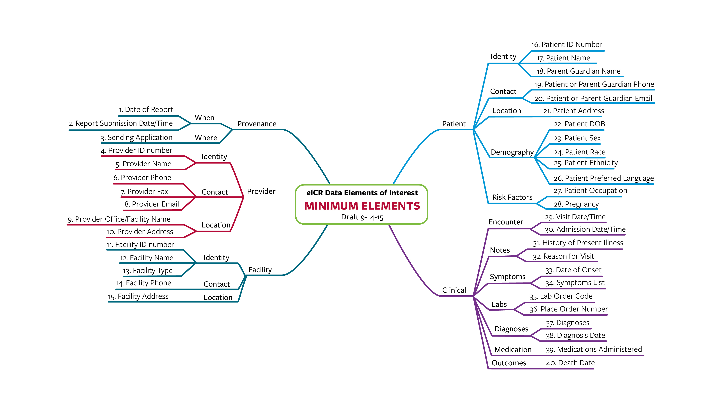
Electronic Initial Case Report (eICR) Contents*
Data must exist in the EHR
Used for all conditions in all jurisdictions
*CSTE Initial Case Report Task Force

Slide 13
Discussion Questions (3)
Are there data classes/elements in the USCDI that definitely won’t be needed for the HCV primary use case?
Assessment and plan of treatment, goals, unique device identifiers, etc.?
Would some of these likely be important under the supplemental use cases?
Immunizations, procedures, vital signs?

Slide 14
Discussion Questions (4)
What are the relevant authorities and reporting incentives (e.g., state, federal regs) to consider?
Do they vary by desired classes and elements from the USCDI?
Or certain kinds of data captured within USCDI classes and elements (e.g., SUD)?
Do they vary by level of “level” and degree of aggregation?

